Slide 1
Enterprise Cloud -
The Evolution to Next Generation Computing
Alberto Farronato
VMware, Product Marketing Manager

Slide 2
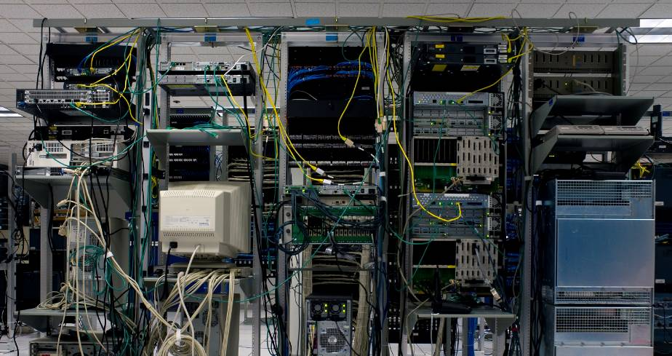
The Problem
Where the IT Budget Goes
Overwhelming complexity
>70% of IT budgets just to keep the lights on
<30% of IT budgets goes to innovation and competitive advantage
5%
Infrastructure Investment
23%
Application Investment
42%
Infrastructure Maintenance
30%
Application
Maintenance
Your Business Can Change
Only as Fast as Your IT Can
Notes:
The Traditional Model Of IT…..has become inoperable
The overwhelming complexity of today’s infrastructure is what keeps IT occupied most of the time; fighting fires, running routine maintenance is a task fraught with complexity
No room to manoeuver
In today’s highly automated, technology-enabled economy, business capability has become inextricably linked to IT capability. As IT infrastructure has become increasingly complex, it can best be described as inflexible, brittle, and costly. In fact, the typical company spends upwards of 70% - 80% of their IT budgets to simply maintain the status-quo, leaving the business starved for new and updated capabilities. We have reached a point where business opportunity is literally trapped in IT infrastructure.

Slide 3

The Goal
IT
as a Service
(Internally or
Externally
Provisioned)
Efficiency
Control
Choice
Notes:
3
3
The VMware goal is to eliminate this complexity, turn IT into a ubiquitously available service – within 3 main operating principles.
We turn IT into a service while still maintaining the lowest possible costs (providing IT as a service with maximum efficiency and lowest operational overhead)
We make it easy for IT to provide and maintain operational control over service levels they provide to the business
We enable IT to become a service provider without locking IT into any specific application, OS or hardware architecture. We turn IT into a service – in a future proof manner

Slide 4
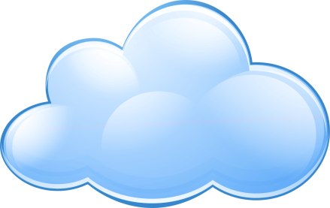
The Path to IT as a Service
Trusted
Reliable
Secure
Efficient
Flexible
Dynamic
Private Cloud
App
Loads
App
Loads
App
Loads
App
Loads
App
Loads
Federation & Choice
DATACENTER
TODAY
Internal Cloud
Standards
Cloud
Computing
External Cloud
Efficient • Reliable • Flexible • Secure • Dynamic
Notes:
To break the trend of ever-decreasing flexibility, combined with ever-increasing costs – caused by the excessive hardware and plumbing in today’s datacenters, a new model for IT services is beginning to emerge – cloud computing.
Cloud computing is a new style of computing where IT infrastructure is available as a ubiquitous, easily accessible, and reliable utility service conceptually similar to the telephone or electricity.
Early industry conversations have focused on external, public cloud infrastructure, often focused on a new breed of applications. Most of the commonly available cloud computing options today provide a fast and easy means of getting access to infrastructure at a service – but in most cases, applications have to be rewritten or customized to take advantage of this flexibility. Also, production enterprise datacenters are usually worried about loss of security and control with these new architectures. The reality is that businesses don’t have the luxury of throwing away today’s applications in favor of new architectures.
Only VMware is enabling a pragmatic approach, the first step of which is to turn today’s datacenter into an internal cloud. In parallel, VMware is working with hosting and service providers to enable compatible external cloud infrastructures. Through federation and common management services between clouds, VMware presents a seamless, dynamic operating environment. This enables the bridging of internal resources with available external resources, helping businesses achieve the full flexibility and benefits of cloud computing. The result is in essence a private cloud.

Slide 5
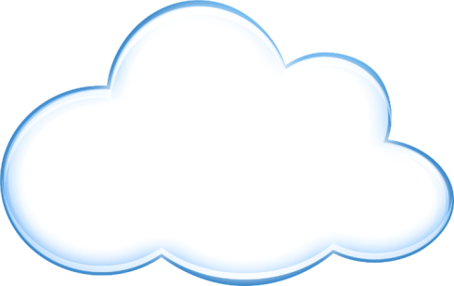
The Cloud… as Architecture
Datacenter/ Cloud
Virtualization is the key to making all of this happen in an evolutionary way
Cloud OS
Existing Apps
New Apps
Existing and multiple future app models
Management
SLA management model
Policies
Security, Compliance…
Software
Scale and availability through software
Hardware
Industry Standard building blocks
Notes:
VMware is using an evolutionary approach to deliver cloud computing internally so IT can transform itself with the least amount of disruption.
This is because of the unique position of virtualization in the stack –it is a software substrate that is in the unique position to abstract away hw complexity across the entire datacenter and run existing apps safely encapsulated inside virtual machines
Addition of policies and mgmt allows delivery of security, compliance, availability services to existing apps as well as any new apps in a uniform manner and allows true cloud computing to be possible without the need for customization or change.
This software substrate – that provides datacenter level virtualization across server, storage and networks –and that provides built in controls for delivering policies – is categorized as a Cloud Operating System because it transforms internal datacenters into cloud infrastructure.

Slide 6
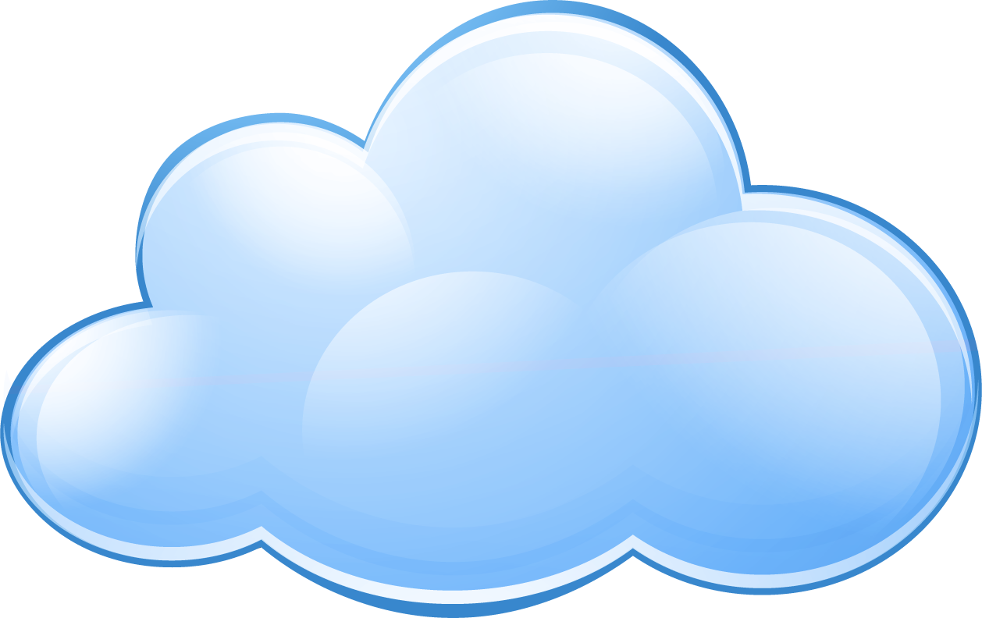
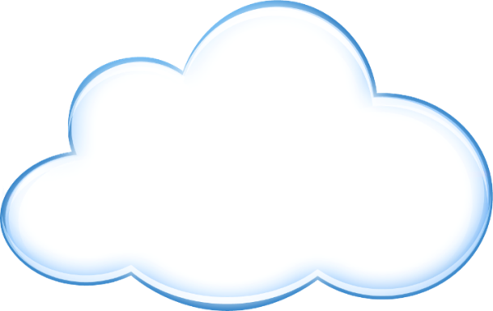

Cloud OS - The Underpinning For Cloud Infrastructures
Private Cloud
App
Loads
App
Loads
App
Loads
App
Loads
App
Loads
Management
Management
2
2
Federation & Choice
Cloud OS
Cloud OS
1
3
1
Standards
Internal
Clouds
External
Clouds
Efficient • Reliable • Flexible • Secure • Dynamic
Notes:
The Cloud OS becomes the common platform for datacenters and service providers, linked through federation and standards based interaction allowing the creation of private clouds leveraging common management services
This allows datacenters to retain the choice of how they provide computing…without getting locked out of external clouds at a later date
The key things that make the VMware cloud vision different from most other competitors in the industry are the following:
Use your existing infrastructure and existing skillsets; across existing apps and new apps
No need to rewrite applications - Companies like Google, MS etc require you to rewrite your applications and once in their cloud, you’re locked in. “hotel california – checkin- but no checkout”
With the VMware model – the move to using external infrastructure to host apps can be a short term decision without long term consequences. VMware essentially makes cloud computing accessible to enterprises in a future-proof manner

Slide 7
VMware Leads the Way to the Private Cloud
  The
  Client Hypervisor
  The
  Server Hypervisor
  Virtual Infrastructure
  The Cloud OS
  VMware vSphere™
  Foundation for Internal and External Clouds
1999
2000
2003
2009+
Notes:
With the introduction of VMware vSphere , the industry’s first cloud operating system, VMware paves the path to private clouds.
The Cloud OS brings
Aggregation and coordination of all underlying resources
Dramatic Performance and Scale
Integrated Availability & Reliability
Integrated Policy & Compliance
Extensible Management
Self-service Datacenter
Manage at Service Level

Slide 8

VMware vSphere™ – Architecture
Application
Services
Infrastructure
Services
  Clustering
  Data Protection
  Firewall
  Anti-virus
  Intrusion Prevention
  Intrusion Detection
  Dynamic Resource
  Sizing
Availability
Security
Scalability
vSphere 4.0
vCompute
vStorage
vNetwork
  Hardware Assist
  Enhanced Live
  Migration Compatibility
  Storage
  Management
  & Replication
  Storage Virtual
  Appliances
  Network
  Management
Notes:
VMware vSphere™ is a cloud operating system - A cloud operating system is a new category of software that is specifically designed to holistically manage large collections of infrastructure – CPUs, storage, networking – as a seamless, flexible and dynamic operating environment. Analogous to the operating system that manages the complexity of an individual machine, the cloud operating system manages the complexity of a datacenter. Although alternative approaches may be pursued, VMware believes that virtualization is the key underpinning technology to enable the cloud.
The cloud OS comprises infrastructure services that transform server, storage and network hardware into a shared resource and application services that are built in and available to all applications that run on it.
Also equally important for an OS is the vibrant ecosystem that builds and complements it providing plug and play services to users
Note:
vCompute, vStorage and vNetwork represent categories of functionality provided by vSphere that abstract and aggregate server, storage and network hardware and allocate it precisely and efficiently to applications.
Availability, Security and Scalability represent the categories of services that are provided by vSphere to all virtual machines that run on it.

Slide 9
Infrastructure Services – Abstraction and Aggregation
  Hardware assist
  Extended Live
  Migration Compatibility
  Storage Management
  & Replication
  Storage Virtual
  Appliances
  Network Management
vCompute
vStorage
vNetwork
Storage/network optimizations
Power Management
vStorage Thin Provisioning
Volume Grow
vNetwork Distributed Switch
Third party distributed virtual switches
NEW
CPU/Memory optimization
DRS
vStorage VMFS
vNetwork Standard Switch
CURRENT
Highest consolidation ratios in the industry
Most efficient use of hardware resources
Low operational overhead
Notes:
This is a quick summary of current and new infrastructure Services that deliver greater capital and operational savings than any other virtualization solution. Infrastructure services are components of the cloud OS that abstract away from the underlying server, storage and networking hardware; aggregate them and deliver them precisely as needed to applications
At the highest level – vCompute services deliver the most efficient way to virtualize single servers and maximize utilization across and group of servers increasing capital and operational savings.
vStorage services deliver abstraction from the type of storage and the most efficient use of storage in virtual environments
vNetwok services deliver the most optimal way to integrate networking in virtual environments

Slide 10

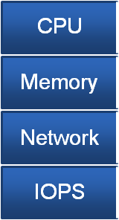
vSphere 4 Delivers Performance for Demanding Applications
95% of applications
ESX 3.5
ESX 4.0
1 to 2 CPUs
4 VCPUs
8 VCPUs
< 4 GB at peak
64 GB per VM
255 GB per VM
< 2.4Mbits/s
9 Gb/s
20 Gb/s +
% of Applications
< 100 at peak
100,000
200,000+
Application Performance Requirements
1. Source: VMware Capacity Planner assessments
Notes:
10
In terms of absolute numbers, with ESX 3.5, we address the performance requirements of a large section of workloads today.
In 2009, we will now have the ability to accommodate some of the largest workloads out there.
We’ll support VMs with up to 8 Virtual CPUs (8-way SMP)
These VMs can be assigned up to 255GB of RAM
We can sustain 40Gb/s of network I/O, and
We can push up to 200,000 I/O operations per second!
There aren’t a lot of workloads out there today that come close to limits we will handle.
Our goal? There should not be a single workload out there which isn’t a great candidate for virtualization.
We think we’re pretty close today. In 2009 we hope we’ll have achieved this goal.
Peak means peak hours: 7 am – 7 PM

Slide 11
Single VM Performance: Well-Known Database OLTP Workload†
Next Generation Intel® Xeon® based 8-pCPU server
RHEL 5.1
Oracle 11gR1
In-house ESX Server
  < 15% overhead for 8 vCPU VM
  8,900 total DB transactions per second
  Near-perfect scalability from 1 to 8 vCPUs
  60,000 I/O operations/second
Transaction Rate (Ratio to 1-way VM)
  † A fair-use implementation of the TPC-C workload; results are not TPC-C compliant
Notes:
Running a resource-intensive OLTP benchmark, based on a fair-use implementation of the TPC-C* workload specification, VMware achieved 85 percent of native performance when running Oracle DB on VMware ESX. This workload, which demonstrated 8,900 database transactions per second and 60,000 disk input/outputs per second (IOPS), is the most resource-intensive load ever shown in a virtual environment to date.

Slide 12
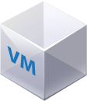

Comparison to VISA
5x
Global payment processing traffic
Notes:
Some graphic here to illustrate that with the transaction performance from the previous 2 slides, vSphere can run 5x the entire VISA payment processing traffic in a single VM.

Slide 13
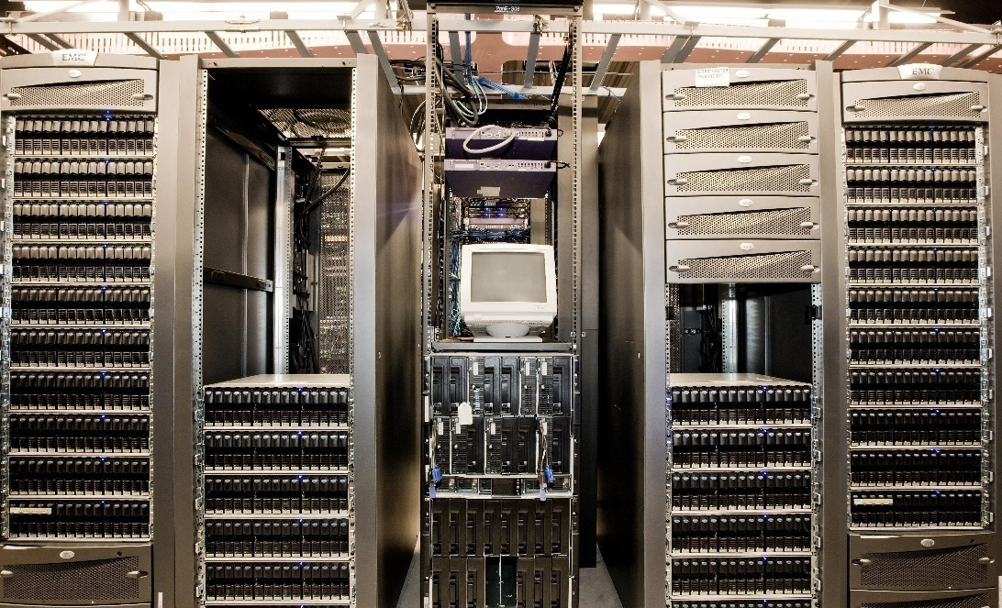

Notes:
This level of i/o and transactions are generated by a single virtual machine that we’ve tried to represent in this picture

Slide 14
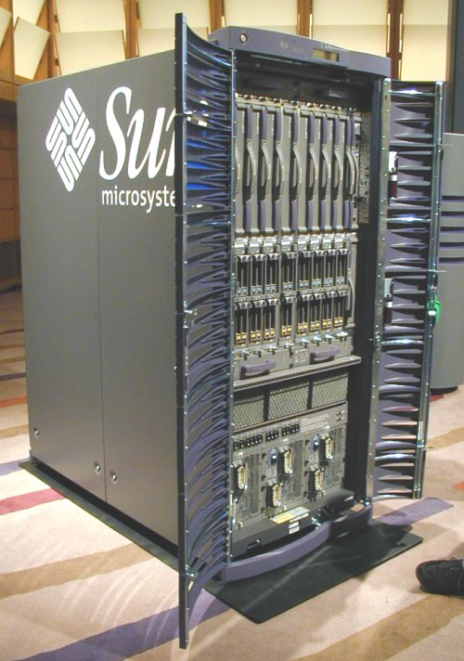
Sun Fire 15k (ca. 2002)
=
;)
Notes:
To generate this level of i/o and transactions per second required a really big piece of hardware just a few years ago.

Slide 15
ESX 4.0 Performance with SQL Server 2008
Relative Scaling Ratio
ESX achieves 90%
of native performance on 4.0 vCPU VM
Workload transaction latency unchanged between ESX 4.0
and Native
VM
147.24
Native
133.12
94.04
79.88
51.08
45.22
1 vCPU
2 vCPU
4 vCPU
Notes:
For a real life example of what the effect on application performance is – take a look at the above results for a 4-vCPU SQL workload.
Performance approaches native with ESX 4.0
industry standard workload modeling a brokerage house, a 4vCPU VM with 26GB SQL buffer cache ran at 90% of native performance with a 500 GB database performing 10,500 iops and 50Mb/s of network throughput.
15

Slide 16
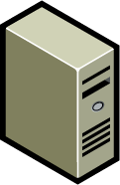
Scale Out with vSphere to Exceed Physical Performance
How many cores can your app scale to on a quad-socket x86?
2005
2010
64
56
Quad-Socket
16-Core
48
40
Max scalability (# cores)
32
Quad-Socket
Dual-Core
24
16
8
Average
App
Exchange
Web
Servers
SQL
Server
ESX
Scale-out
Average
App
Exchange
Web
Servers
SQL
Server
ESX
Scale-out
Notes:
For a single VM, vSphere can provide amazing levels of performance and throughput. That’s only half the story however, we also have to look at the performance achieved per physical host.
There is a major problem today – the application – CPU gap. If we look back in 2005, the largest quad-socket server had a total of 8 processor cores. Many apps were able to scale to that number of cores and hence use the full server capacity. In 2010, quad-socket servers will have up to 64 processor cores. The vast majority of apps can NOT scale to that many cores, and hence in the traditional deployment model of 1 app to 1 server, will only be able to use a fraction of the server’s capacity. Exchange for example will only scale to 8 cores, and even SQL will be limited to 32 cores – leaving the majority of the compute capacity unused.
With ESX, these apps can be scaled out to tap the full capacity of these servers. For example, you can use VMware to deploy multiple Exchange mailboxes on one physical host, and increase the total throughput achieved from that host as compared to that traditional single-mailbox deployment model.
16

Slide 17


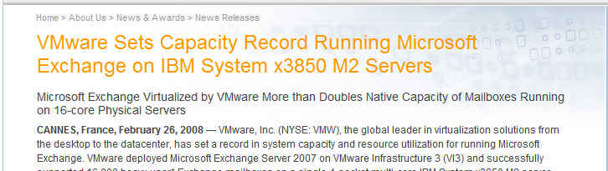
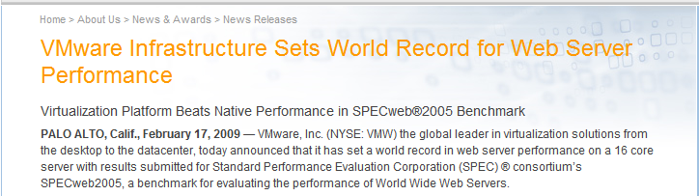

Multi-core + VMware = Record Performance
Application
APP
APP
APP
OS
OS
OS
Operating System
VMware
Notes:
We already set a world record with 3.5 recently – we hope to beat it with 4.0. Details on world record for web server performance
The SPECweb2005 workload benchmark gives web users the most objective and representative benchmark for measuring a system's ability to act as a web server and is used by all major vendors as a basis for comparing platform capabilities and ability to support web traffic. When using the highly network-intensive SPECweb2005 workload to compare performance of VMware Infrastructure 3 to that of a similarly configured native – i.e., unvirtualized – server, the results on VMware’s virtualization platform in some cases exceeded any number recorded on any physical machine. VMware’s aggregate SPECweb2005 performance of 44,000 is higher than any 16-core system has ever recorded.
This benchmark was on 3.5 – 4.0 is even better.

Slide 18

Multi-Core + VMware = Record Performance
3x
eBay’s daily web traffic on a single server
22
Notes:
18

Slide 19
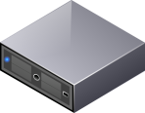
vStorage: Thin Provisioning
App
App
App
OS
OS
OS
VMware ESX
20GB
10GB
40GB
Virtual
Disks
20GB
40GB
100GB
Physical
Storage
5GB
20 GB
40GB
Notes:
In the area of storage we added the Thin Provisioning which allows to make a more efficient of disk by consuming only the actual space in use. Storage requests more often than not are usually overestimated by users mostly to avoid having to go through the request/approval process. With vStorage Thin Provisioning, IT depts can now use storage as a pool and assure business users of storage space availability while deferring the actual costs of purchasing storage to when it is really needed. Full reporting and alerting on allocation and consumption ensure that virtual machines don’t really run out of storage, Storage VMotion and Volume Grow (next slide) ensure that virtual machines can either migrate to datastores with additional storage or volumes can be increased in size when consumption approaches allocation.

Slide 20

vNetwork: Distributed Switch
App
App
App
OS
OS
OS
Net State
Net State
Net State
V
vSwitch
vNetwork Distributed Switch
vSwitch
vSwitch
Notes:
vNetwork Distributed Switch enables the network to be treated as an aggregated resource… much like what we do with compute and storage already today
vDS moves away from single host virtual switch management, and moves management up to the cluster level. With vDS, no longer will you be configuring virtual switches on every host. Instead, with vDS, you’ll be managing a single global entity, with a single namespace and globally assured configuration, and you’ll be attaching VM’s only to that cluster or datacenter-wide entity. VDS is a new type of virtual switch which spans the entire Virtual Infrastructure…analogous in many ways to a “stacked switch”.
Today, when virtual machines migrate from one host to another,
Network statistics don’t follow the VM after it migrates
Value-added services like inline filtering, failover teaming, etc. may not follow the VM
By creating vDS, a single cluster-wide global virtual switch, we lay the foundation for a new generation of properly mobile, networking services.

Slide 21
vNetwork: Switch Plug-Ins
App
App
App
OS
OS
OS
Net State
Net State
Net State
Nexus 1000V
vSwitch
vNetwork Distributed Switch
vSwitch
vSwitch

Slide 22
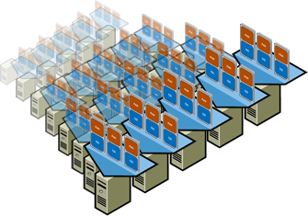
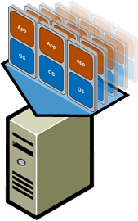



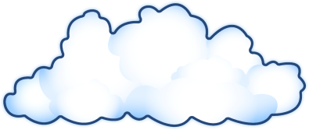
Building the Giant Computer
32-Nodes per cluster
64TB of RAM
  VMware DRS automatically balances VMs
4,096 processor cores
6 Million IOPs

Slide 23
Distributed Power Management:
Make the Giant Computer Power Thrifty
2000
1800
No DPM
1600
1400
1200
Watts
1000
800
600
400
With DPM
200
0
50% Savings During VMmark™

Slide 24
Application Services Provide Built in Service Level Controls
  Clustering
  Data Protection
  Firewall
  Anti-virus
  Intrusion Detection
  Intrusion Prevention
  Dynamic Resource
  Sizing
Availability
Security
Scalability
VMware Fault Tolerance
VMware Data Recovery
VMware VMsafe
VMware vShield Zones
Hot add of virtual CPU, memory
Hot plug devices
Hot extend or virtual disks
8-way SMP and 255 GB of virtual machine RAM
NEW
HA, VMotion, Storage VMotion, NIC/HBA teaming provide resiliency to downtime
ESXi locked down interfaces, no general purpose OS dependence
DRS shares and reservations allow apps to shrink and grow based on priority
CURRENT
Notes:
Application Services are components of the cloud OS that provide built in controls for service levels –these are usable with any application running on any OS inside a virtual machine – and can be turned on or off easily.
This is a summary of all the new and existing application services that VMware vSphere™.

Slide 25

Attach Policy to Your VMs
Availability = 99.99% uptime
Security = High
Max Latency = 500ms
App
App
App
OS
OS
OS
vApp
SLA
Definitions
Application
vServices
Availability
Security
Scalability
VMware Infrastructure
Notes:
vApp is the construct that allows for existing or new applications to be packaged up into self describing entities – that can move from location to location ; and yet have the same service levels delivered. The OVF descriptor acts as a bar code allowing the requirements of the application to be specified by the administrator and interpreted and automatically delivered by the infrastructure. <vApps can consist of one or more virtual machines>
For example, a typical application now consists of a web, application and database tier and all these tiers must be managed as one for logical consistency and to protect the application flow. vApps allow you to create a container for these components such that you can clone, snapshot and manage them as an entity vs. their individual components.
vApp becomes the unit of control for applications in vSphere environments
vApps simplify the deployment and ongoing management of an n-tier application in multiple virtual machines by encapsulating it into a single virtual service entity. vApps encapsulate not only virtual machines but also their interdependencies and resource allocations allowing for single-step power operations, cloning, deployment, and monitoring of the entire application. VMware vSphere™ now includes support for creating and running vApps as well as importing and exporting them in compliance with Open Virtualization Format (OVF) 1.0 standard.
Initially with vSphere – a vApp can describe network configurations of virtual machines and DRS CPU and memory requirements for virtual machines
irtual netwVorks can be configured with a range of IP addresses
When a VM starts up inside a vApp, it is assigned an IP address
All other VMs in the vApp also get notified of the new VMs IP address

Slide 26
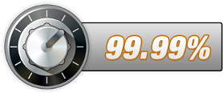



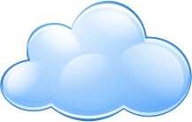



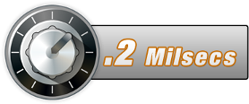
Rolling Out a New Business Service
Availability
Availability
Security
APP
Internal
Cloud
Security
Performance
Performance
Lowest TCO
Becomes a Matter of Specifying Required SLAs
Notes:
Rolling out new business services becomes easy and transparent for IT: The Cloud OS allows application administrators to focus on defining the desired outcomes – what levels of availability, security and performance the application needs. The transparent infrastructure automatically interprets and ensures these policies, at the lowest possible cost with low maintenance effort required

Slide 27


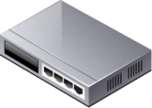
VMware Solutions Maximize Uptime
Site Recovery Manager
Planned Downtime
Unplanned Downtime
Virtual Machines
VM Failure
Monitoring
APP
APP
APP
APP
APP
OS
OS
OS
OS
OS
Server
VMotion
HA
ESX
Storage
Storage vMotion
VCB
Interconnect
Network
Redundancy
NIC & HBA
Teaming

Slide 28
VMware Fault Tolerance
  Single identical VMs running in lockstep on separate hosts
  Zero downtime, zero data loss failover for all virtual machines in case of hardware failures
  Zero downtime, zero data loss
  No complex clustering or specialized hardware required
  Single common mechanism for all applications and OS-es
APP
APP
APP
OS
OS
OS
VMware vSphere™
X
Notes:
28
VMware Fault Tolerance is a component of VMware vSphere™ that ensures continuous availability for virtual machines against hardware failures. VMware FT creates virtual machine “pairs” that run in lock step - essentially mirroring the execution state of a VM. To the external world they appear as one instance (one IP address, one application) – but they are fully redundant instances.
In the event of an unexpected hardware failure that causes the active, primary VM to fail – a secondary, formerly passive VM immediately picks up where the primary left off, and continues to run, uninterrupted, and without any loss of network connections or transactions.
This technology will also work across any application & any OS without modifications, without scripting, and provides a much more cost-effective way of running mission critical workloads than fault-tolerant hardware dedicated entirely to individual applications.
At VMware, we say that “virtual is better than physical” very frequently, and our advanced development work on providing continuous availability for VMs – to enable VMs to keep executing, completely uninterrupted by unexpected hardware failures - is one of the great examples of why this is true. We have taken technology implemented with very complex custom hardware and delivered it for commodity x86 hardware.
We believe this technology, and all of the other business continuity benefits of virtualization will drive more and more mission critical workloads into virtual machines because they can enable HIGHER levels of availability, at a fraction of the cost & complexity of physical solutions.
DETAILS ( use only as needed)
Limitations of FT initially: dependent on shared storage, Uniprocessor VMs only. Additional overhead also associated with this type of solution. Overall performance impact still TBD, but you can expect more CPU & memory resources will be required to run the 2nd VM, and applications may experience small amounts of added latency.
In spite of initial limitations, longer term trends are in our favor: FT will take advantage of hardware assisted virtualization in CPUs, more and more CPU cores becoming available to offload overhead, and high-speed network improvements like 10gigE to reduce latencies…

Slide 29
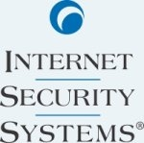
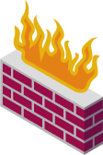

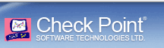

Security: VMsafe APIs and Partners
Security = High
Network Ports = 80, 443, 1521
Protocols = HTTP, SQL, TNS
AV = Required, On-Demand
App
App
App
App
OS
OS
OS
OS
Security
vService
vApp
Policies
ALTOR
NETWORKS
VMware ESX with VMsafe™
Notes:
VMware VMSafe announced earlier in 2008, is a set of APIs that enable protection of VMs by a protection engine that :
Works with the hypervisor to inspect a VM’s mem, cpu and storage from a higher privilege point
Is isolated from the malware
Covers all aspects of security – not limited to network or host.
VMware VMSafe based products from our security partner ecosystem will work with VMware vSphere™ editions to provide higher levels of security than even physical systems
Partners who are working on VMSafe products: Symantec, trend micro, checkpoint, Internet security systems prototyped products at Vmworld 2008, McAfee also working on a product.
MORE DETAIL
Security solutions have an inherent problem. Protection engines are running in the same context as the malware they are protecting against and as a result, malware is able to subvert these engines by simply using the same hooks into the system as the protection engine. Worse, with Longhorn and Vista, Microsoft has enabled Patchguard, effectively eliminating the kernel hooks available to both the security solutions and the malware. While this helps, it doesn’t change the fact that malware and rootkits still exist and can run in those environments. The context that these security solutions need to protect against is also not limited to one set of interactions (e.g. attacks from the network and from spyware and from rootkits). Even those solutions that are in a safe context (outside the OS), they can’t see information from other contexts (e.g. network protection has no host visibility).
Security API’s built into the hypervisor allow for 2 key advantages:
Better Context – Provide protection from outside the OS, from a trusted context
New Capabilities – now they can view all interactions and contexts
Now, new security solutions can be developed and integrated within the VMware virtual infrastructure and we can protect the VM by inspection of virtual components (CPU, Memory, Network and Storage). Provides complete integration with VMotion, Storage VMotion, HA, etc. for any new security solution using the API’s. The end-result is an unprecedented level of security for VMs that’s better than the physical infrastructure. These API’s are already being made available to the security ISVs ecosystem.
We utilize VC for role-based privileges to assign protection to any single VM and VMware certifies the solutions developed by our partners to ensure the security VM is created by a real security ISV and not a malicious hacker.
Some potential use cases:
An AV virtual appliance that intercepts all storage IO and is able to scan files as they are read/written from disk. This can be done without loading an AV agent on each machine.
Inline Network Security for each ESX host. Now you can ensure that ALL network IO traffic is inspected by an inline appliance, regardless of your virtual networking setup. This includes even inter-VM traffic and allows state to be transferred from host to host during VMotion so that the security protection is never lost.

Slide 30


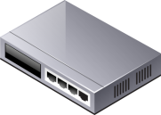
VMware vShield Zones
  Self-learning, self-configuring firewall Service
  VMotion and network-configuration aware trust zones
  Dynamic firewall policy using application protocol awareness
  Dynamic security capacity using infrastructure vServices
  Security policies auto-adapt
  to network reconfiguration
  or upgrades
APP
APP
APP
APP
APP
APP
OS
OS
OS
OS
OS
OS
APP
APP
APP
APP
APP
APP
OS
OS
OS
OS
OS
OS
VMware vSphere™
Notes:
VMware vShield Zones, a new security service for VMware’s Cloud OS, vSphere, ensures strict compliance with security policies and industry regulations for user data as customers adopt cloud computing with virtual environments for increased efficiency and flexibility. Previously, compliance required diverting network traffic to external physical appliances resulting in disconnected ‘islands’ of infrastructure. With VMware vShield Zones, customers can now create logical zones in the virtual datacenter that span all of the shared physical resources, and each zone represents a distinct level of trust and confidentiality. This allows businesses to comply with corporate security policies and regulations on data privacy while still running applications efficiently on shared computing resource pools.
( this comes to VMware from our blue lane acquisition)
Traditional security products, such as firewall appliances, require that all network activity pass through a handful of fixed physical locations in order to be monitored. Virtualized applications, in contrast can be migrated between physical hosts for higher resource efficiency and improved uptime. Therefore, companies virtualizing security sensitive applications faced the choice of either leveraging virtualization capabilities such as live migration for optimal load balancing and availability, or enforcing strict security compliance. To solve that dilemma, most customers ended up dividing their virtual environments into smaller, less efficient clusters for areas such as their Internet-facing demilitarized zones (DMZ’s) or consumer credit data processing systems subject to Payment Card Industry regulations. VMware vShield Zones enables customers to create security zones within enterprises or in multi-tenant cloud infrastructures, where security policies are enforced even as virtual machines dynamically migrate between hardware devices. Deployed as a virtual appliance and integrated into vCenter Server, vShield Zones makes it easy to centrally manage and enforce compliance with security policies across large pools of servers and virtual machines. Built-in auditing capabilities make compliance straightforward and verifiable.
Example : today you send network traffic to an external Network IDS/IPS box which becomes a chokepoint. With this feature all that traffic can be handled internal to the virtual infrastructure. Similarly, there is also the capability for packet/protocol monitoring to be on the alert for SQL insertion or other data oriented attacks. By combining multiple layers of the security “onion” within the virtual infrastructure you can more easily pass security and compliance audits will eliminating much of the costs associated with these activities
30

Slide 31
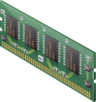


Hot-Add Capacity to Guarantee QoS
TPS
TPS
Latency
Latency
SQL
SQL
OS
OS
2 GB
1 vCPU
8 GB
4 vCPU
  Hot-add capacity with zero application downtime
  Minutes to stabilize VM and recover from SLA violation
  Other options include VMotion to more powerful host & add instance for fast scale-out
Notes:
31
31
Many applications are difficult to size – databases being a good example. Admins have to forecast capacity requirements for coming 3 years, then translate that estimate into system specs (CPU, memory). If they guess wrong, then the app has to be reprovisioned. This is a cause of downtime and major disruption to the application.
With hot add, now applications can be provisioned in a “future proof” manner. As apps grow, as they get more and more intense over time and need more compute, memory or network/storage resources, admins can now scale them up dynamically and on the fly – without disrupting the app, and without requiring complex re-provisioning.
In this example, the transaction rate (TPS) goes up, and as a result latency increases beyond the SLA limits. The VI Admin can hot-add capacity to the VM, and SQL 2008 automatically detects this new capacity. In a matter of minutes – without downtime – SQL stabilizes with new capacity, and the latency goes back down to within SLA requirements.

Slide 32
Next Generation Management Enhances Control
Application
Services
Infrastructure
Services
vCenter
Suite
Management
Availability
Security
Scalability
vSphere 4.0
vCompute
vStorage
vNetwork
Notes:
I mentioned at the beginning that a new management model is required to create the private cloud. VMware delivers such model with its vCenter Suite

Slide 33
Extensible Management Suite
Self Service Management
Self Service Portal
Service Catalogue
Billing/Chargeback
Availability
Security
Performance
VMware
vCenter
Suite
SLA Driven Management Model
99.99%
High
.2 Milliseconds
Provisioning
Configuration
Capacity
Operations
Performance
Availability
Infrastructure Management
vSphere
Hardware
Notes:
This new model must focus on the properties of that service, rather than on the underlying infrastructure components. In other words, the private cloud requires a service level-driven management model that allows IT to manage what business users and application owners understand – the degree of availability and security the service needs – to enable business users and application owners to easily request services, specify desired service levels, and then consume those services without understanding the intricacies of the underlying infrastructure. At the same time, this new SLA-driven management model must also translate the humanly comprehensible language into machine instructions, so that IT can perfome critical management operations such as provisionig, configuration mgmt, capacity mgmt., ect with a high degree of automation,
With vCenter Suite we plan to release a set of tools that will enable self-service management model where application owners can request a service with a certain SLAs and will be accordingly charged back on. We believe this will greatly simplify application deployment and substantially reduce cost.

Slide 34


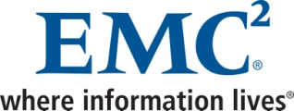
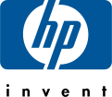


Choice of End-to-End Integrated Management
Enterprise System Management
Non-Virtual Management Tools
vCenter
Physical-Only Environments/
Non-x86/Non-VMware
Non-Virtualized
Notes:
Controls provided at the virtual machine ,application as well as host level are integrated with today’s enterprise systems management frameworks to enable end to end seamless physical and virtual management.
This slide defines the VMware position on physical infrastructure management – we believe that instead of having to rip and replace existing ESM frameworks, customers would be better served by our close integration with partners that provide physical infrastructure management

Slide 35
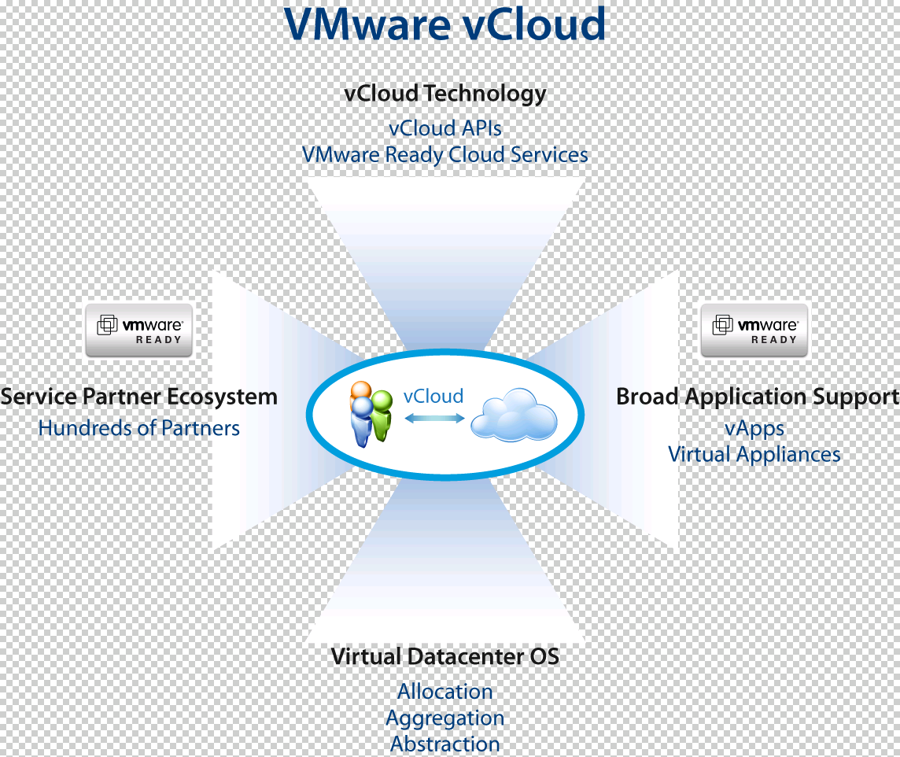
VMware vCloud
Notes:
The third key component is federation of internal and external cloud common management and standards. For this reason VMware has launched an industry wide VMware vCloud initiative to create compatible, standard based cloud offering
The VMware vCloud initiative enhances choice by providing customers with a range of service providers that can augment and supplement their datacenter capabilities and provide capacity on demand for existing or new vApps
Depending on the range of application services, customers can choose among service providers while renting burst capacity or disaster recovery capacity.

Slide 36
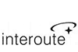
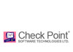

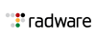






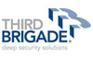
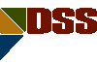

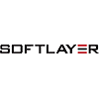


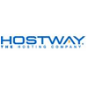


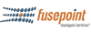




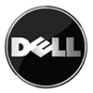


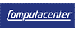
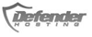



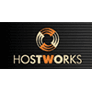



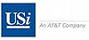



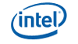
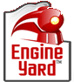
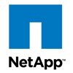

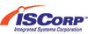
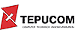
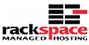
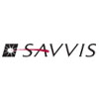

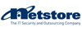
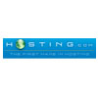




















Broad Ecosystem – Technology and Service Providers
Notes:
VMware enables service providers to provide value added and differentiated external clouds that enterprise IT can choose to use.

Slide 37
Private Cloud - Future Proofing IT
Internal Cloud
External Cloud
APP
APP
Management
Management
Cloud OS
Cloud OS
Internal
Cloud
External
Clouds
Unlock new market based economies of scale, service
and innovation beyond what currently exists today
Notes:
Cloud computing is not a decade away, not some distant vision. It’s here today.
Now, with the availability of VMware vSphere, the industry’s first cloud operating system, the path to the next major evolutionary stage of IT – the private cloud – is clear.
With vSphere, a comprehensive set of management tools and VMware vCloud initiave, VMware enables IT organizations to abstract applications and information from the complexity of the underlying infrastructure
It’s not all-or-nothing. It’s not a radical, unaffordably expensive, messy and disruptive gut-rehab of the datacenter. And it’s not something that’s only for the large global enterprise either.

Slide 38
Q & A

Slide 39
Glossary
Cloud Operating System
A cloud operating system is a new category of software that is specifically designed to holistically manage large collections of infrastructure – CPUs, storage, networking – as a seamless, flexible and dynamic operating environment. Analogous to the operating system that manages the complexity of an individual machine, the cloud operating system manages the complexity of a datacenter. Although alternative approaches may be pursued, VMware believes that virtualization is the key underpinning technology to enable the cloud.
Internal Cloud
An internal cloud is a cloud infrastructure provided within the internal IT environment, which brings the benefits of cloud computing to internal IT service providers. Gartner refers to an internal cloud as a private cloud.
External Cloud
An external cloud is a cloud infrastructure that is owned and managed by an external IT service provider, such as a hosting or software-as-a-service (SAAS) provider. This is often referred to as a public cloud infrastructure as well.
Virtual Private Cloud
A virtual private cloud is a cloud computing environment that spans internal and external cloud infrastructure, presenting a seamless, managed cloud to the business.
Notes:
[begin]
Let’s start with software support.
Independent analysts like Burton Group have concluded that VMware ESX has the broadest support for both guest operating systems and applications.
On the applications side, more and more ISVs now test their upcoming software on VMware before releasing them to market. For existing applications, more and more ISVs go back and re-certify on VMware. As an example, VMware ESX was the first x86 virtualization platform for SAP to announce full support for its solutions in 64-bit Windows- and Linux-based production environments. That’s a testament to the stability SAP saw in VMware ESX.
Visit vmware.com to see a comprehensive list of the software vendors with support statements for VMware products. It includes marquee software developerslike: Adobe, BMC Software, HP, IBM, McAfee, Microsoft, SAP, Sybase, and Symantec to name a few.
[next slide]

Slide 40
The Private Cloud Brings…
The Efficiency of
Cloud Computing…
…Without the Risk Or Disruption
  Business
  Fast response times
  Contractual and auditable SLAs
  Usage based, pay-as-you-go financial model
  IT
  Economies of scale
  High performance,
  highly available
  Policy-driven automation
  Compatible with any existing or future application
  Security enforced on- and off-premise
  Leverage and evolve existing skills, management
  Future proof – no lock in to specific architectures
Notes:
40
40
VMware’s approach brings the benefits of cloud computing – fast deployment, low to $0 upfront cost, easy turn on and off or change, pay as you go, pay for what you use – to internal infrastructure.
It creates a win win situation for both business owners and IT – business owners can meet rapidly changing market conditions with a fast deployment mechanism and IT can retain control, manage on a tight budget, yet provide flexible, scalable computing to the business
This approach also has significant advantages over other cloud computing models that have proprietary interfaces and require custom application development (thereby creating lock in). It not only retains the flexibility of hosting existing or future apps without customization, but also can leverage and evolve existing skillsets to this new model.
The private cloud is a logical entity that spans on site and offsite infrastructure, securely and under IT control – providing the same security of on-premise infrastructure – with the choice of any type of industry standard hardware.
Key Benefits:
Easy to get started
No technology lock in
No commitment
Lower ongoing costs

