Slide 1
Impact of Wireless
“Doing More With Less”
John Ferrell
Public Sector Account Manager
913-485-8692

Slide 2
Objectives
Effective
Efficient
Responsive
Real-time
Interaction
Communications
Voice & Data
Resource Management
Real-time Interaction
Day-to-Day
Situational Awareness
Location & Visibility
Notes:
The components of day-to-day operational effectiveness and efficiency are the same as those needed when an organization is faced with a disaster or emergency situation. That is, the more effective you are in your day-to-day operations, the better prepared you are to deal with disasters and emergencies.
Essentially, you need to be able to:
Communicate – Voice and Data
Know what is going on, and where things and people are
Be able to respond to the situation in real-time
With the proper tools, the other key benefit is improved efficiency, enabling you to do more with less. This is especially important in an environment of greater demands with fewer resources.

Slide 3

Key Drivers
Needs of Mobile Personnel
What to do... Where to go…How to get there…
Access resources to perform activities
Report and account for these activities
Organizational needs
Effectively deploy the optimal resources
Deploy resources based on dynamic, real-time needs
    Real-time situational awareness
    Real-time interaction with mobile resources
Account for field activities, real-time reporting

Slide 4
Operational Efficiency No Longer Optional
Manpower & Resources
Budgets
Costs
(e.g., Fuel)
Demand for Services & Information

Slide 5
Higher Bandwidth, More Applications
High Speed Wireless enables transformational change in Government
2G Cellular
2.5G Cellular
Sprint Mobile Broadband
Sprint 4G
High Bandwidth
Basic Email, Messaging, GPS
Internet Browsing, Enterprise Applications, VPN
Video, Audio, GIS Apps
Low
-Speed-
High

Slide 6
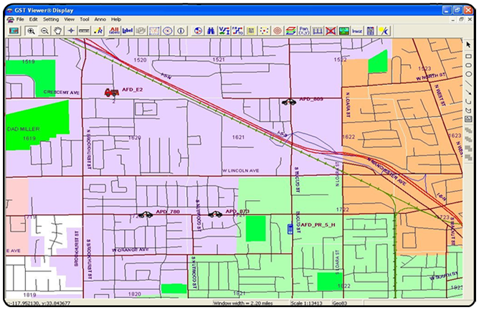

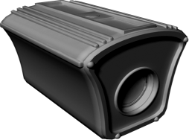
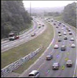
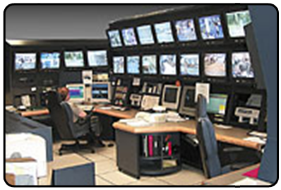


Situational Awareness
Visibility to Events in the Field
GPS/Location Tracking
Video
Notes:
Know what is going on, and where things and people are located.

Slide 7




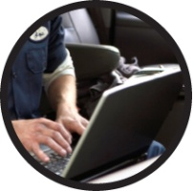
Mobile Workforce Trends
Timeline below shows the increasing demand for
embedded solutions that benefit a mobile workforce…
55.1 Million Broadband subscribers in the United States
4.9 million total embedded cellular modems shipped worldwide
39% of all cellular modem subscribers will be embedded
2007
2008
2009
2010
Over 2.8 million total embedded cellular modems shipped worldwide
100 million US workers will make up the mobile workforce
…the increase of mobile workers is driving demand for mobile broadband access anytime, anywhere, without sacrificing worker productivity.
Sources:
“In-Stat:Cellular Modem Worldwide Shipment Forecast, August, 21, 2006”, (www.in-stat.com)
“The Mobile Workforce And Enterprise Applications 2007-2012”, May 2007, The Insight Research Corporation, www.insight-corp.com
Notes:
Key Message: The market for mobile broadband continues to grow, with no end in sight.
Talking Points:
Currently, there are 54 million mobile workers in the United States.
Of that 54 million, the average is 1-3 days of travel per week, outside of the office or business setting.
Jumping ahead to the next couple of years we will experience 65% of enterprises that will deploy some kind of wireless applications to their mobile workforces.
As a result, greater percentages of a company’s IS budgets will be spent on mobile applications and key business processes will have to require exchange of real time information among the mobile workforce.
These statistics will continue to drive the demand for mobile broadband access anytime, anywhere without sacrificing worker productivity.
Transition: Now that we have assessed what’s happening in the marketplace, let’s look at the challenges that customers like you are facing.
.

Slide 8
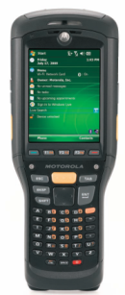
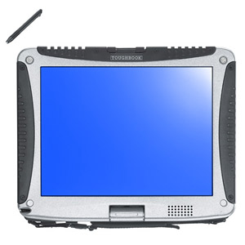
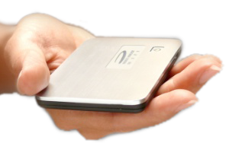
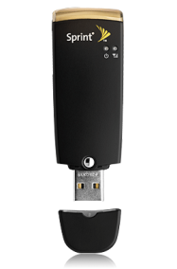
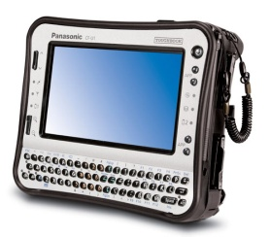
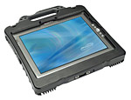
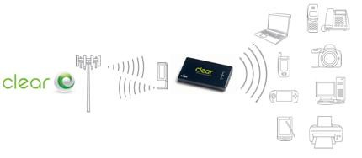
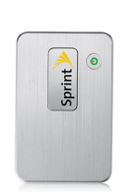
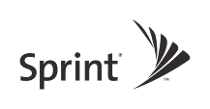
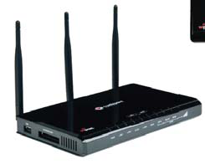
Connecting to the Network
Embedded
Connection Card
USB
MiFi
Wireless Routers
Embedded
Mobile
Broadband
WiFi
(802.11)

Slide 9



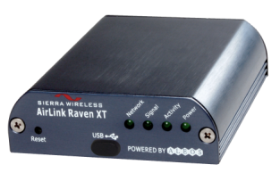




Other Examples
M2M/Telemetry/SCADA
Internal Clients
Vehicles
Department/Agency Enterprise Operations
Ambulance/EKG
Sprint
Meters
Public - Citizens
Modems /
Embedded Devices
Parking Meters

Slide 10

Telecommuting
Now Accepted
Quality of Life
Productivity/Employee Retention
COOP/BC

Slide 11
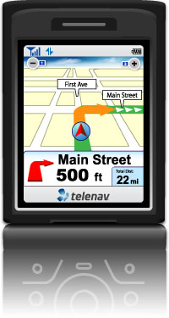
Use Case Examples
Field Reporting
Interoperability
Information Access and Sharing
Mobile Resource Management
Access to Critical Systems

Slide 12

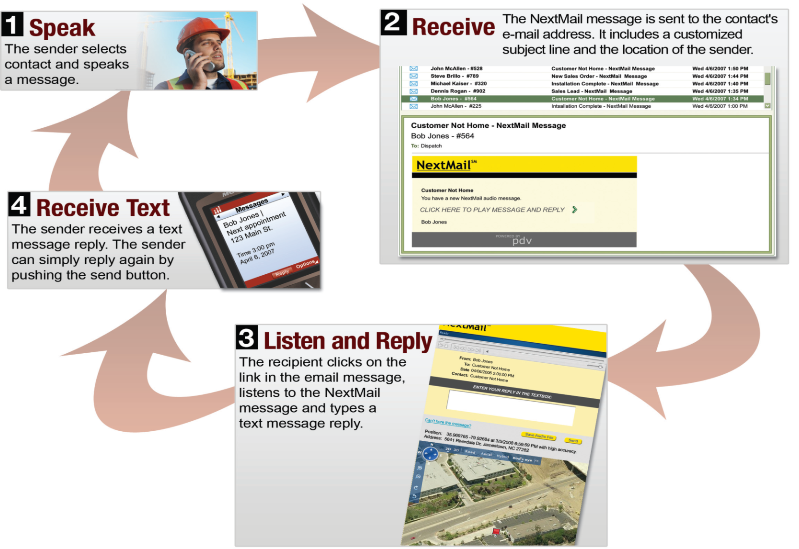
Mobile Field Reporting
Now with GPS & Photos
Push, Speak, Send

Slide 13

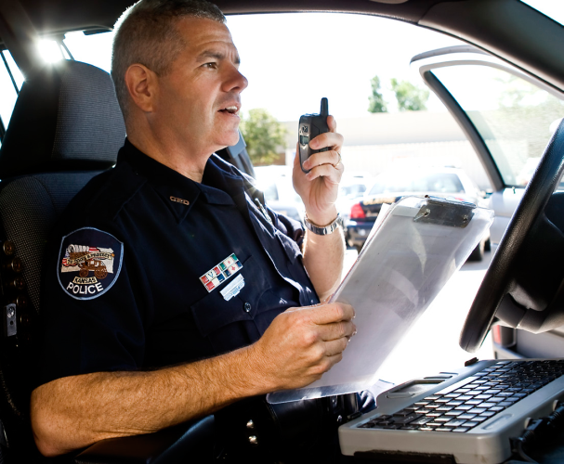
Case Study
Jersey City (NJ)
Parking Authority (JCPA)
Challenge:
Officers traveled to office daily to deliver forms and photos to handle disputes
Productivity loss from officers being out of the field
Solution:
JCPA officers speak into the phone to document violation details -Time/Date, GPS & street address
Message delivered instantly via email
Managers immediately receive complete violation information including photos
Results:
One more hour in field, one additional “boot” per day
Additional Revenue - $3,400/month per officer
Reduced fuel consumption - $40/month per officer
Revenue enhancement - $ 92,340 per month
*Land Mobile Radio
Notes:
Since completely replacing the previous communications system, the Dekalb County Water and Sewer Department has:
realized a significant return on its investment and
enhanced communications.
Initial equipment costs were one fifth of the cost of other solutions
usage is up due to the fact that handsets are more affordable.
Ongoing maintenance fees to operate the system are also significantly lower.
The flexible communications not only save on fees, but also streamline the process
Users can connect directly to the party they need to without talking to the entire group
Dekalb County Water and Sewer is considering other applications for its Nextel system including:
Bi-directional antennas (BDAs) to support more remote locations, such as lines deep under the earth’s surface, enhanced monitoring of system operations,
GPS vehicle tracking
Expanded data transmission capabilities so that work orders can bypass dispatch and go directly to field crews.

Slide 14

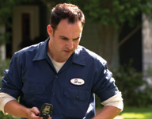
Case Study
Dekalb County (GA)
Water and Sewer Department
Challenge:
Aging LMR* system had coverage and costly maintenance issues
System shared among various departments
Employees carried multiple devices
Difficulties in handling peak loads
Solution:
Installed new dispatch console that integrated Nextel Direct Connect units with LMR system
Direct or Group Talk capability
Results:
More affordable Nextel devices are interoperable with LMR devices
Enhanced communications & reduced costs
*Land Mobile Radio
Notes:
Since completely replacing the previous communications system, the Dekalb County Water and Sewer Department has:
realized a significant return on its investment and
enhanced communications.
Initial equipment costs were one fifth of the cost of other solutions
usage is up due to the fact that handsets are more affordable.
Ongoing maintenance fees to operate the system are also significantly lower.
The flexible communications not only save on fees, but also streamline the process
Users can connect directly to the party they need to without talking to the entire group
Dekalb County Water and Sewer is considering other applications for its Nextel system including:
Bi-directional antennas (BDAs) to support more remote locations, such as lines deep under the earth’s surface, enhanced monitoring of system operations,
GPS vehicle tracking
Expanded data transmission capabilities so that work orders can bypass dispatch and go directly to field crews.

Slide 15




Case Study
City of Anaheim (CA)
Fire Department
Challenge:
Anaheim Fire has 290 full-time members with18
first-responder units
Timely and accurate tracking of vehicles and personnel
Integrate w/CAD, GIS and other systems
Solution:
Mobile GPS/mapping solution that works on handsets, Mobile Computers, PDAs, etc
Integration with CAD, GIS and other systems
Expanded to other departments (e.g., Police, Public Works) and seven surrounding cities
Results:
Inter-agency interoperability
Reduced costs, improved response times,
increased safety
Notes:
Bottom Line
The GST system and the carriers it supports have enabled the Department to leverage existing investments and reduce overall costs. As a result of superior data quality, and timeliness and the ability to integrate with the various information systems, the system has expanded and is becoming an essential tool for safety and situational awareness.
The City of Anaheim and the partner Metro Net agencies have the ability to now track approximately 500 devices including handsets, hard mounts, and Nextel ERT handsets. And because of the flexible and open platform, they can expand the system to up to 800 devices without additional servers. Anaheim continues to enhance and mature the system, for example increasing the frequency of updates received through the tracking system from every two minutes to every15 seconds/24x7. In the future, Anaheim plans to tap into next generation high-speed tracking solutions from Sprint and GST
Metro Net is the Communications Center for Orange County, California which dispatches fire and emergency medical services for more than 1.2 million citizens, covering 188 square miles within Orange County.
Metro Net is centrally located in a modern 6,000 square foot facility in the City of Anaheim, but is comprised of seven cities in Orange County including Anaheim, Fountain Valley, Fullerton, Garden Grove, Huntington Beach, Newport Beach and the City of Orange.
The Metro Net facility is equipped with the latest technology in telephone, radio, and computer equipment to assist the dispatcher in quickly processing citizens’ calls for assistance. At the heart of the system is the CAD system powered by Geospatial Technologies’ Multi-Agency Mobile Mapping and Tracking Interoperability Solution and Nextel devices.

Slide 16
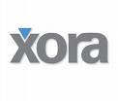

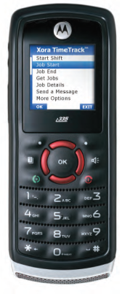
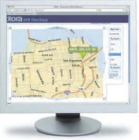
Case Study
City of Jacksonville (FL)
Building Inspection Division
Challenge:
Increased Demand
Resource Limitations
Delayed Reporting
Solution:
Inspectors clock in from first job
Managers have visibility to field activities
Job Status/Timesheet info
Results:
Daily savings of 1 hour of Travel/Office time
per Inspector
Additional 22,500 inspections per year
Annual Savings $ 38,300 Savings per inspector
Notes:
Background:
The Building Inspection Division is a governmental unit of the City of Jacksonville that reviews permit applications, issues construction permits, and performs inspections to ensure code compliance. The Division is funded entirely from revenue generated by permit and service fees—no property taxes are used—and consists of 135 employees, including 65 Construction Trades Inspectors, 15 Building Code Enforcement Inspectors, and 55 support, professional and supervisory personnel.
Bottom Line:
The City made it a priority to articulate the benefit of GPS tracking as a tool for improving productivity. Xora would be used to verify an employee’s location in response to citizen complaints regarding unsafe driving practices. If a contractor or homeowner alleged that the inspector did not visit the inspection site.
Most importantly, inspectors would now be able to report to work in the field rather than fight traffic to report to work at City Hall. The alone would save each inspector approximately one hour of office and travel time per day.
With 62 active Construction Trades Inspectors in the field, the result is a savings of approximately six man years over a 12-month period, valued at $264,000 (as compared to an annual Xora expense of $34,000). This enables the Division to gain the capacity to perform an additional 22,500 inspections per year.
The City’s ability to perform more jobs faster amounts to a critical and immensely valuable customer service benefit. Minus the need to start each day with a trip to the office, inspectors could now arrive at the inspection sites earlier each day.
Within 30 days of deploying Xora, inspectors were spending more time in the field and performing more and higher-quality inspections. By the end of January 2006, the City will have recouped the cost of the Xora service for one year by avoiding charges that would have been associated with the hiring of additional inspectors. After one year of using Xora, the City will have realized a savings of $38,300 per inspector per year.

Slide 17
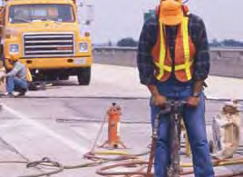
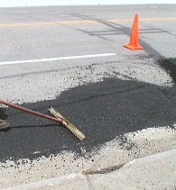
Case Study
City of Chicago (IL)
Transportation Department
Challenge:
Chicago has 3800 miles of streets
Reports to “Pothole Command Center” are plotted on computerized map
Phone GPS Tracking locates repair crews
Crews are efficiently dispatched
Solution:
Faster response time (from 20 to 3 days)
Improved Accountability, Productivity, Accuracy & Efficiency
Savings of over $3.0 Million on pothole-related incidents alone (Liability reduction, $4M to $600k)
Notes:
RESULTS:
Since deploying GPS TimeTrack, CDOT has dramatically improved customer
service by responding to 311 requests more quickly. For example, the number
of days to respond to citizen calls to fill potholes has been reduced from 20 days
to 3 days. As a result, the city has seen its liability costs for pothole-related
incidents reduced from $4M to $600K.

Slide 18

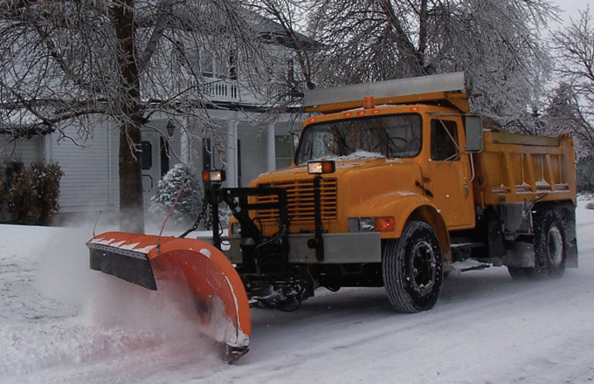
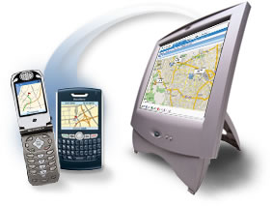
Case Study
Town of Babylon (NY)
Public Works
Challenge:
Need to track and dispatch vehicles equipment – snowplows, sweepers, etc
Hard-wired units expensive, “fixed” to vehicle
Flexibility to move from vehicle-to-vehicle
Solution:
Phone-based MRM* solution
Vehicle GPS on maps using custom web portal
Zoning maps can be overlaid
Results:
Dispatcher can deploy to critical areas first
Improved efficiency & productivity
Praise from citizens instead of complaints
Notes:
Improved efficiency
From public safety to snow removal, Babylon’s fleets are managed more
efficiently with TeleNav Track.
Increased public satisfaction
Since TeleNav Track, there were no school closures or delayed openings
due to more efficient snow removal.
Improved productivity
Town staff spends less time on logistics and more time on public
services.
• Flexibility
TeleNav Track units can be assigned to any fleet vehicle on an as-needed basis.

Slide 19




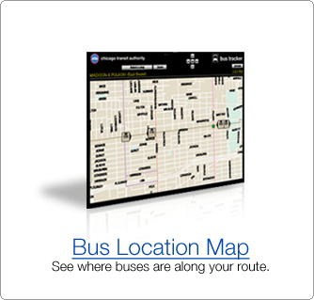
Case Study
City of Chicago (IL)
Chicago Transit Authority
Challenge:
2nd Largest Transportation System in US
154 Bus Routes/2100 Buses
1.6 Million Rides/Day
Need to provide reliable, efficient service
Solution:
Vehicle-mounted wireless modems w/GPS
Direct Connect PTT Communications
Results:
Optimized route efficiency
Field Supervisors can view bus locations
Improved real-time information to customers
and internal operations

Slide 20

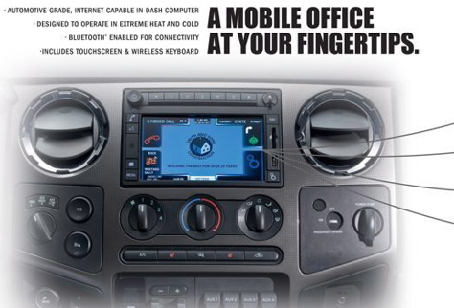
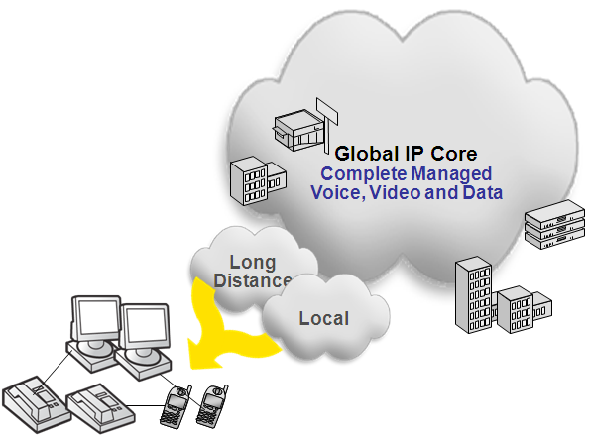
Other Examples
Unified Communications can extend IP services to mobile devices
In-Dashboard PC w/Internet Connectivity
Perform mission-critical tasks remotely at a job site increasing operational efficiencies.

Slide 21
The Next Step…. Sprint 4G WiMAX
  4G is the next generation of wireless networks that will complement third Generation (3G) cellular technologies
  WiMAX service provides “Wi-Fi like” experience in a city-sized hotspot
  It provides high speed, high capacity, IP based services for video, data and voice (Voice over IP) on an integrated global network that is based on open standards
  Utilities, enterprises, consumers and government agencies will be able to extend their Internet experience beyond home or office by using this technology
  4G is very fast delivering average speeds of 2-4 Megabits downlink and 0.5-1.5 Megabits uplink in service areas
  4G is capable of delivering peak speeds of up to 12 Megabits downlink and up to 5 Megabits uplink in service areas
4G combines the best characteristics of both current WiFi solutions and 3G mobile broadband into a new, open-standards based solution that is 3 to 5 times faster in service areas.
Notes:
KEY MESSAGE: Sprint envisions an evolution of today’s multiple, traditional wireline networks to a new ecosystem based on the convergence of IP and wireless. Sprint’s vision is based on three key principles.
The convergence of all types of business applications (voice, data, video) to a common, flexible IP core that supports real-time, any-to-any access to people and information.
The integration of wireless and wireline access methods to meet the varying needs of sites and applications across the business enterprise.
Traditional wireline access for large, high-volume locations.
Combination of wireline and wireless access for sites that need rapid implementation, move frequently need diverse redundancy for increased survivability
Wireless, mobile broadband for mobile workers or low cost machine to machine applications.
An increased focus on managed services to help businesses make the graceful migration to these new IP based services.
------------
Sprint Speed = Sprint is an technology innovator that can provides forward looking solutions targeted to help customers meet today’s business challenges, now!

Slide 22


Who Developed WiMAX?
IEEE 802.16 Working Group
Develops local and metropolitan area network standards
802.16 specifications
  802.16-2004
  802.16e-2005
  802.16 conformance
WiMAX Forum
Certifies conformance, compatibility, interoperability of IEEE 802.16 products
Network architecture specifications
The WiMAX Forum created and owns the term “WiMAX” (similar to the way “Wi-Fi” is owned by the Wi-Fi Alliance)
Notes:
22

Slide 23
4G WiMAX - Turbocharged Mobile Broadband
Connectivity
Access to the Internet and connecting to corporate networks is essential to the competitive advantage of any business
Mobility
Today’s business professional cannot afford to wait, and mobility provides convenient access for employees
Productivity
Instant access to company resources while on-the-go is critical to getting work done and increasing job satisfaction for employees
Immediacy
Modern business processes demand immediate access to real-time information and resources
Capacity
Higher bandwidth enables richer applications to be ported to the mobile environment
4G vs. 3G Speeds
14 Mbps
12 Mbps
10 Mbps
8 Mbps
6 Mbps
4 Mbps
2 Mbps
Download
Upload
Peak
Up to 12 Mbps
4G downloads average 3 to 5 times faster than today’s 3G.
Peak
Up to 5 Mbps
Average
2-4 Mbps
Average
0.5-1.5 Mbps
600-1400 Kbps
350-500 Kbps
4G latency of ~80 to 100 milliseconds,
half of 3G
Notes:
Sprint Value Presentation
KEY MESSAGE: Already available in some markets, Sprint 4G (WiMAX) will turbo charge a Mobile Broadband connection, with downloads average 3 to 5 times faster than today’s 3G network
TALKING POINTS:
Speed – Sprint 4G can deliver up to 3 to 5 times faster the upload and download speeds of current competitors.
2-4 Megabits downlink (and 0.5-1.5 megabits uplink)
Peak speed of up to 12 Mbps downlink and up to 5 Mbps uplink. NOTE: not available in every service area, always use up to
Latency - enhances the delivery of low latency applications such as voice, teleconferencing, and streaming video.
Mobility - maintains session continuity as the customer moves throughout the network, a capability that WIFI cannot deliver.
Quality of Service – WiMAX standards support Quality of Service, enabling the prioritization of packets for key business applications like voice and video, while competitors remain “best effort”.
NOTE: At this time, Quality of Service has not been implemented.
Security – retains the enterprise security standards of 3G solutions. 4G Spectrum utilizes owned spectrum vs. public spectrum for WiFi,
Therefore it is inherently more secure than WiFi since spectrum is owned and maintained by Sprint.

Slide 24





4G WiMAX…Industry Changing Opportunities
3G EV-DO Rev. A
User DL : ~450-700Kbps
User UL: ~300-400Kbps
4G WiMAX
User DL: ~1Mbps-3Mbps+ (by device)
User UL: ~500kbps-1.5Mbps+
Over 10 X Cost/Performance Improvement
Embedded Utility Applications
Automation & Control
Advanced Metering
Broadband Routers
Mobile Laptop Connectivity
External Cards
Embedded Laptops
Visual Centric
Portable Data Devices
  Enhanced External
  Cards
  Embedded
  Devices
Anywhere Broadband
for Consumer Electronics
Embedded Cameras
Camcorders
MP3s
Games
Voice / Data Handset
WAP Browsing
Sprint TV
Music downloads
Narrowband
Wireless WAN
Sub-T1 WAN Access
  Dynamic Sites
  Backup
Shared Access Routers
Broadband
Wireless WAN
Broadband Access
VoIP
Video Conferencing
Notes:
4G will expand the mobility market by
introducing new service categories with addressable markets (Home/Business broadband, expanded device portfolio, etc)
As we deploy 4G services we’ll
expand our device portfolio to include a variety of embedded solutions for portable devices.
The 4G network will have performance improvement in throughput and latency. These performance improvements will enable a great user experience such as less jitter and a smoother customer experience when viewing
4G is not a replacement for 3G.
Rather, 4G will become the primary data-centric network while
3G supports the majority of our voice traffic as well as coverage for non-4G areas.

Slide 25
WiMAX Decision & Ecosystem
Cost Structure for Mass Market Adoption
Spectrum Utilization
Higher Throughput
Less Congestion
Low Cost Platform
($/MB)
Low Cost Equipment
Significantly Lower Chipset and per Carrier Cost than 3G Systems
High Usage
(Scalability)
Scalability of Network Allows for High Bandwidth Usage

Slide 26
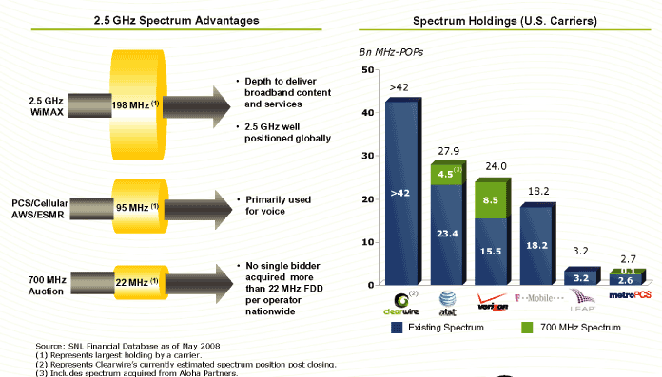
Sprint 4G’s Spectrum Holdings…
Significant spectrum provides Sprint with the depth and future capabilities to support mobile broadband needs
Notes:
Having more spectrum allows a carrier to offer higher peak speeds, serve more customers with a given cell site, or both. With our large spectrum holdings, Sprint can do both, while other carriers will be forced to choose between number of users versus high data rates.
Higher data speeds allow the use of more cool services like audio/video streaming, interactive gaming, and machine-to-machine communication. Also remember that higher 4G speeds make “normal” Internet activities like email, web browsing, and corporate connectivity work faster.
Sprint (via CLWR) has much more spectrum available for high speed data than ATT and VZW, so that puts us in a superior long term position. Our average of 120 MHz is almost 5 times the largest C block 700 purchase (VZW=22 MHz, ATT=12 MHz).
Sprint has our 2.5 GHz spectrum as a paid-for asset that we built up over years of acquisitions. ATT and VZW recently bought a small chunk of spectrum at 700 MHz in very expensive auctions, so they are out a lot of money that affects their current cash flow.
The varying sizes of the orange disks on the left hand side of the slide show how much spectrum is available for high speed data in that frequency range. The key takeaway is that Sprint invested in spectrum where we have room to grow…and VZW and ATT picked the spectrum where they cannot grow (700 MHz).
Spectrum is measured by the size of the spectrum (in MHz) multiplied by the number of people who live in the areas served by that spectrum (POPs). Bn stands for Billion. On the chart on the right hand side of the slide, 42 Bn MHz-POPs means that Sprint can cover a lot of people with a lot of spectrum for high speed data services.
ATT & VZW are already using their existing spectrum for voice and low speed data, so they can’t use it for high speed data. That means they will have 4.5 or 8.5 Bn MHz-POPs 700 MHz spectrum for high speed data while Sprint will have over 42 Bn MHz-POPs!

Slide 27
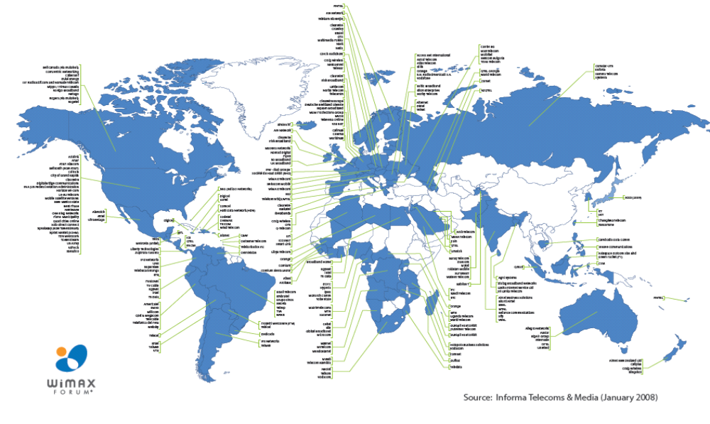
WiMAX is a Global Technology
Sources: Yankee Group, presented at WiMAX Asia, 4/07,
Informa Telecoms & Media, 3/07
Notes:
27
KEY MESSAGE: Sprint envisions an evolution of today’s multiple, traditional wireline networks to a new ecosystem based on the convergence of IP and wireless. Sprint’s vision is based on three key principles.
The convergence of all types of business applications (voice, data, video) to a common, flexible IP core that supports real-time, any-to-any access to people and information.
The integration of wireless and wireline access methods to meet the varying needs of sites and applications across the business enterprise.
Traditional wireline access for large, high-volume locations.
Combination of wireline and wireless access for sites that need rapid implementation, move frequently need diverse redundancy for increased survivability
Wireless, mobile broadband for mobile workers or low cost machine to machine applications.
An increased focus on managed services to help businesses make the graceful migration to these new IP based services.
------------
Sprint Speed = Sprint is an technology innovator that can provides forward looking solutions targeted to help customers meet today’s business challenges, now!

Slide 28
Closing Thoughts…
Network “Performance and Reliability” Highest Priority for any Carrier in Meeting Utility Voice and Data Needs
Enterprise Mobility and Advanced Automation are forcing the Convergence & Intersection of the Utility and Telecommunications Industries’ Business Needs
3G / 4G Wireless Technologies such as CDMA and WiMAX are Evolving at a Pace Un-Paralleled Historically and will have Dramatic Impact in Transforming Utilities in both Mobility and Automation
4G WiMAX is Truly Unique and Potentially Industry Changing… exceptional bandwidth, speed, and attractive cost models
Carriers Positioning themselves as a Trusted Partner in Developing Integrated Communication Solutions to solve Multiple Enterprise Applications… many data centric focused on operational excellence
Thank You!

