Slide 1
Agile Project Management
Tracy Hoerschgen
RKV Technologies Inc.

Slide 2
What do you want to know?
Introduction
What are Agile Methodologies?
When are Agile Methodologies the best fit?
How are Agile projects managed?
  Scheduling & Iterations
  Change Management & Rework
  Metrics
  Additional Considerations
  Estimation
  Project Management Frameworks
What Agile Management tools are available?
Conclusion

Slide 3
What are Agile Methodologies?

Slide 4
Agile Development Methodologies
Are iterative
  Iterations are time-boxed and are typically one to four weeks
  Each iteration creates a functional piece, albeit small, from beginning to end
  Multiple iterations create a finished product
Require close teamwork
  Smaller timeframes require project staff to communicate more frequently
Based on a concept of adaptability
  Smaller timeframes allow more rapid incorporation of requirement changes, which Agile accepts as an unavoidable truth

Slide 5
More details…
There are several key elements that provide the basis for APM. It is important to note that these techniques can also be used in traditional software development methods to improve project performance. They are:
  Visual control
  Co-located high-performing teams
  Test-driven development
  Adaptive control
  Collaborative development
  Feature-driven development
  Leadership and collaboration rather than command and control
  Move from C (cost) to R (revenue) focus
  Lessons learned
  http://www.projectsmart.co.uk/the-blending-of-traditional-and-agile-project-management.html

Slide 6
Types of Agile Methodologies
Agile Unified Process (AUP)
  Simplified version of Rational Unified Process (RUP)
  Test Driven Development (TDD)
  Agile Modeling
  Agile Change Management
  Database Refactoring
Extreme Programming (XP)
  Encourages daily communication, simplicity, feedback, respect
Open Unified Process (OpenUP)
  Open source process framework
  Contains characteristics of RUP/Unified Process: Iterative Development, Use Cases, Scenario-driven development, Risk management, and Architecture is central to this approach

Slide 7
Types of Agile Methodologies (continued)
Dynamic Systems Development Method (DSDM)
  Rapid Application Development methodology
  Emphasizes continuous user involvement
  Designed for projects with tight schedules and budgets
Feature Driven Development (FDD)
  Feature driven
  Five phased: develop model, build feature list, and according to that list plan, design and build
ICONIX
  UML Use Case driven
  Less encumbering than RUP
  Noted by robustness analysis

Slide 8
Types of Agile Methodologies (continued)
Scrum
  For managing complex projects
  Characterized by the use of “Sprints”, one to four week iterations
  Steps
    Prioritize requirements
    Team commits to which are to be included in sprint
    Team delivers demonstrable products at end of sprint

Slide 9

When are Agile Methodologies the best fit?

Slide 10
When are Agile Methodologies the best fit?
Question: When can an athlete be “agile”?
Answer: An athlete can be agile when they have experience and room to move.
Projects can be agile when, among other things, the staff is experienced and given the room to estimate, plan and collaborate.

Slide 11
When are Agile Methodologies the best fit?
 | Agile | Traditional
Criticality Level | Low | High
Developer Experience | High | Low
Requirements Change Rate | High | Low
Number of Developers | Low | High
Chaos Tolerance | High | Low

Slide 12
Benefits of Agile Methodologies:
Iterative and incremental delivery for rapid business results
Increased teamwork and collaboration for reduced waste; and increased productivity and team morale
Learning and adaptation for increased quality and flexibility to change

Slide 13
Criticisms of Agile Methodologies:
Not documentation based (does not create hearty software design)
Lack of structure
Not suitable for junior developers
Meeting intensive
Requires a high level of cultural change to adopt
Adds ambiguity to the contract negotiation process, because it is difficult to develop realistic work effort estimates
Can be inefficient, if improperly managed
Can increase the risk of scope creep

Slide 14
How are Agile projects managed?

Slide 15
Scheduling in Agile Projects
Detailed plans are only made for tasks that are soon to begin.
Staff schedule their tasks with oversight only.
Staff choose their tasks rather than being assigned tasks.
Schedule short iterations.
Schedule with requirements as the focus.
Schedule tasks involving external groups.
Include training.
Take your environment into consideration.

Slide 16
Iteration Plan
An Iteration Plan is a fine-grained, time-boxed plan; there is one per iteration. As each Iteration Plan focuses on only one iteration, it has a time span small enough to let the planners do a good job of detailing tasks with the right level of granularity and allocating them to appropriate team members.
A project usually has two Iteration Plans "active" at any time:
A plan for the current iteration, to track progress for the iteration that is underway.
A plan for the next iteration, which is built toward the second half of the current iteration and is ready at the end of it.
http://www.ibm.com/developerworks/rational/library/2831.html

Slide 17

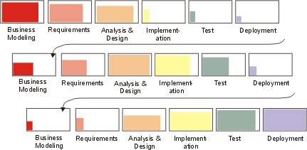
Iterations
1st
2nd
3rd
http://rup.hops-fp6.org/process/workflow/manageme/co_phase.htm

Slide 18
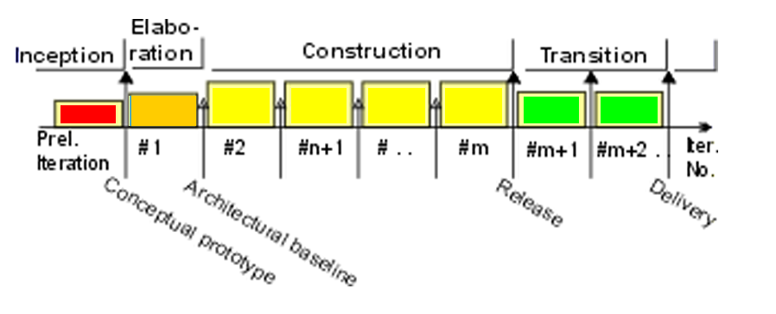
Iteration pattern: Incremental Lifecycle
Single Inception: establish scope and vision, and define the business case
Single Elaboration: requirements are defined, and the architecture established
Several Construction iterations: use cases are realized and the architecture fleshed-out
Several Transition iterations: migrate the product into the user community
This strategy is appropriate when:
The problem domain is familiar.
Risks are well-understood.
The project team is experienced.
http://rup.hops-fp6.org/process/workflow/manageme/co_phase.htm

Slide 19
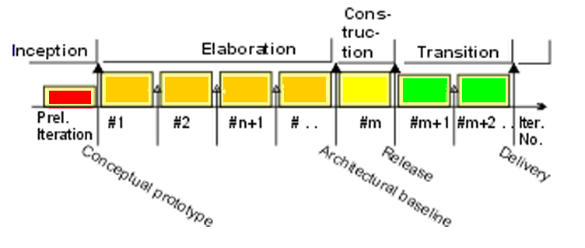
Iteration pattern: Evolutionary Lifecycle
Short Inception: establish scope and vision, and to define the business case
Several Elaboration iterations: requirements are refined at each iteration
Single Construction: use cases are realized and the architecture is expanded upon
Several Transition iterations: migrate the product into the user community
This strategy is appropriate when:
The problem domain is unfamiliar.
The team is inexperienced.
http://rup.hops-fp6.org/process/workflow/manageme/co_phase.htm

Slide 20
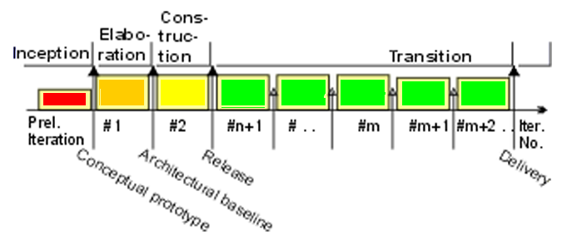
Iteration pattern: Incremental Delivery Lifecycle
Short Inception: establish scope and vision, and to define the business case
Single Elaboration: a stable architecture is base-lined
Single Construction: use cases are realized and the architecture fleshed-out
Several Transition iterations: to migrate the product into the user community
This strategy is appropriate when:
The problem domain is familiar:
    the architecture and requirements can be stabilized
    early in the development cycle
    there is a low degree of novelty in the problem.
The team is experienced.
Incremental releases of functionality
have high value to the customer.
http://rup.hops-fp6.org/process/workflow/manageme/co_phase.htm

Slide 21
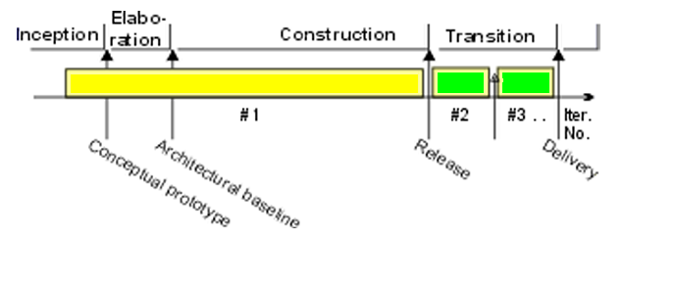
Iteration pattern: “Grand Design” Lifecycle
Short Inception: establish scope and vision, and to define the business case
Single, very long Construction iteration: use cases are realized and the architecture fleshed-out
Several Transition iterations: migrate the product into the user community
This strategy is appropriate when:
a small increment of well-defined functionality
is being added to a very stable product.
the new functionality is well-defined
and well-understood .
The team is experienced, both in the problem
domain and with the existing product.
http://rup.hops-fp6.org/process/workflow/manageme/co_phase.htm

Slide 22
How many Iterations?
 | Low | Typical | High | Very High
Inception | 0 | 1 | 1 | 2
Elaboration | 1 | 2 | 3 | 3
Construction | 1 | 2 | 3 | 3
Transition | 1 | 1 | 2 | 2
Total | 3 | 6 | 9 | 10

Slide 23
Iteration Length
People | Weeks
5 | 1
20 | 3-4
40 | 8

Slide 24
Develop Iteration Plan
Determine the Iteration Scope
Define Entry and Exit Criteria
  Specific measurements and controls
Define Iteration Activities
Assign Responsibilities
Advice:
  Shorter is better.
  Start with an uncomfortable length.
  Ignore the calendar.
  Produce something useful.
  Have as many iterations as you need.
  You can still have a firm delivery date.

Slide 25
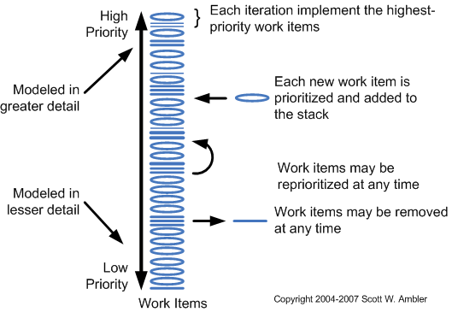
Change Management Process
http://www.agilemodeling.com/essays/changeManagement.htm

Slide 26
Rework
One of the major benefits of an iterative development is precisely to allow mistakes and experimentation, but early enough so that corrective actions can be taken.
At the end of each iteration, during the iteration assessment, the team should decide what part of the current release will be reworked. Expect rework to be allocated among phases in the following percentages, relative to the total system:
  Inception, 40%-100% - this is where you may develop throwaway, exploratory prototypes.
  Elaboration, 25%-60% in early iterations; less than 25% in later iterations, or for an evolution cycle.
  Construction, after the architecture baseline, 10% or less per iteration and 25% total.
  Transition, less than 5%.
http://www.upedu.org/upedu/process/gdlines/md_itpln.htm

Slide 27
Metrics
Burn Rate
Delivered Functionality
Velocity
Defects
Additional Considerations:
  Keep it simple.
  Metrics must add value.
  Look at trends, not absolute numbers.
  Combine metrics.

Slide 28
Agile Principles of Estimation
Increase the frequency of estimation.
Reduce the time between estimation and feedback.
Discuss constraints and assumptions.
Create multiple options.
Compare estimates.
Ongoing learning process.

Slide 29
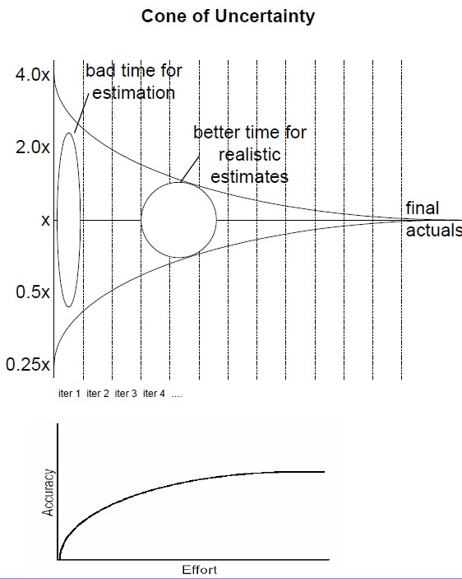
Traditional and Agile Estimates
http://www.ambysoft.com/essays/comparingEstimatingApproaches.html

Slide 30
Traditional and Agile Estimates
Approach | Advantages | Disadvantages
Traditional | Generally accepted Significant work in advance can yield a good estimate | Often not effective and projects are over budget and late anyway.
Agile | Stakeholders in control | Not currently generally accepted by senior management
Combination | Reasonable estimate. Stakeholders in control | Initial budget and schedule may be viewed as not detailed enough

Slide 31
Agile Projects and Fixed Price
Fixed price contract guarantee cost. Agile fixed price contracts deliver:
  Earlier results
  Greater flexibility
  Same price
Customer must invest more effort:
  Test features regularly
  Give timely feedback
  Be available for questions
Project Manager
  Frequent releases
  Frequent follow up
  Frequent planning
Requires constructive, honest and trusting working relationship between customer and provider.

Slide 32
Project Management Frameworks
Two Options:
1. Specific Agile Project Management Methodology (APM framework)
2. Fitting agile methods under the Project Management Body of Knowledge (PMBOK framework)

Slide 33
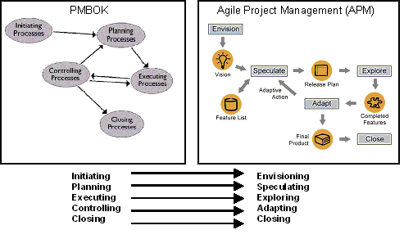
PMBOK - APM
http://www.12manage.com/methods_pmi_pmbok.html

Slide 34
PMBOK - APM
Integration Management: low detail, integrated change control
Scope Management: scope planning at beginning of each iteration, scope verification during, adjusting for changes
Time Management: high level estimates at release level, detailed estimates at iteration level
Cost Management: cost fixed, cost control at the end of each iteration
Quality Management: begins at beginning, critical
Human Resource Management: onus on management to run interference, breed motivation among team, co-location, reward group success
Communications Management: constant contact, metrics in place
Risk Management: focus on qualitative risk, at iteration planning and review
Procurement Management: purchases at beginning of project, consider contract alternatives, involve team in contracting

Slide 35
Special Considerations
Scope
  Iteration level scope control critical for agile projects
  Consistency with PMBOK clear when iterations are considered projects in themselves
  Iteration planning and iteration review allow course corrections to overall scope
Planning
  Planning essential to agile projects
  Reject scope-based planning with Gantt and PERT charts in favor of feature-based metrics like velocity
  Planning at the release, iteration, daily levels rather than at the project level
Decomposition into Tasks
  PMBOK’s emphasis on the WBS perceived as antithetical to agile methods
  Emphasis on features over tasks distinguishes agile
Documentation
  Depth of documentation not mandated, but PMBOK equivalent exists for all types
  Critical, less formal: feature backlog, velocity charts, burndown charts, iteration planning cards

Slide 36
Agile Management Tools

Slide 37
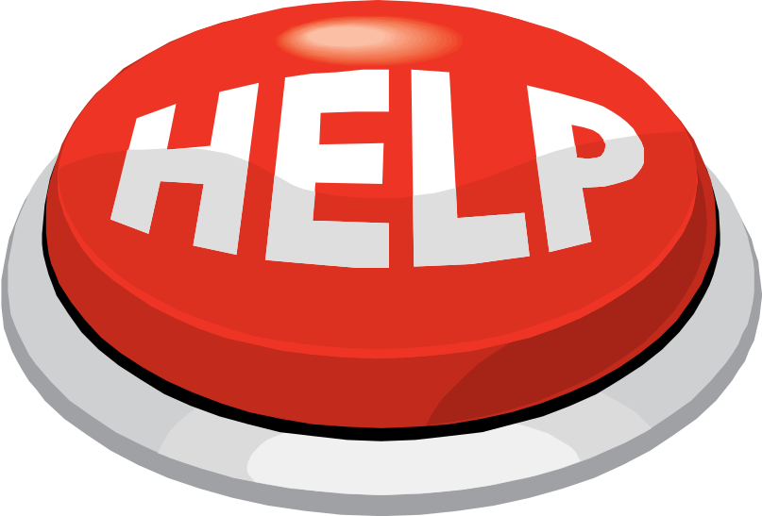
Can I get a little
here?!

Slide 38
Important Features
Iterative, Feature-driven Development: traditional tools do not enable easy changes
Integrated Agile Lifecycle Management: high-level feature planning, detailed task planning, and overall project tracking
Cross-Functional Teams: consolidated functions in a single environment
Flexible Configuration: scalable, configurable
Simplicity: should be easy to use
Enterprise Scale: robust support of thousands of items with minimal overhead

Slide 39
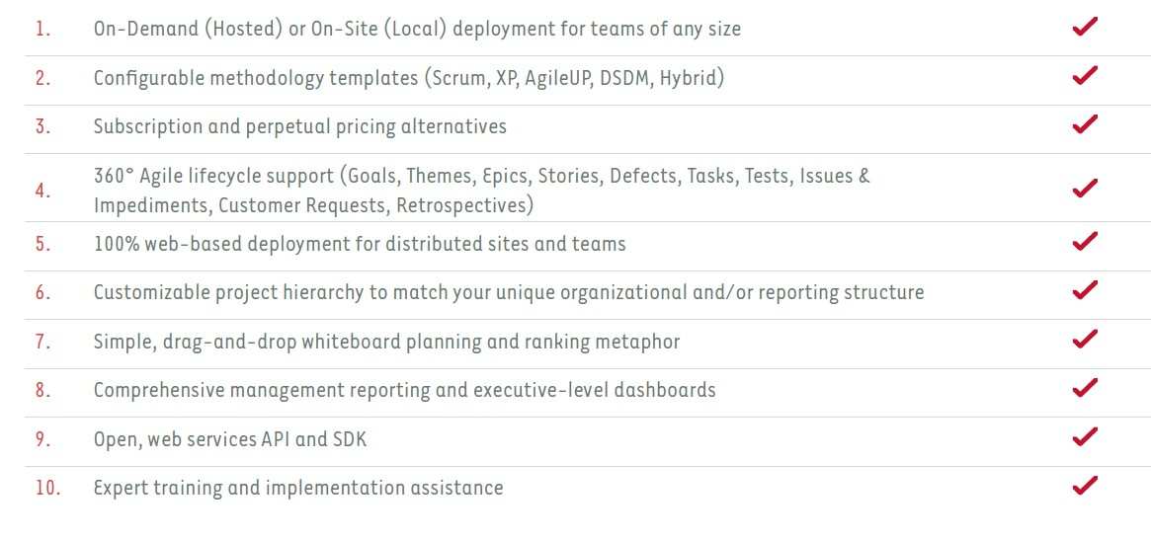
Agile Management Tool Checklist
http://www.versionone.com/pdf/AgileToolEvaluator.pdf

Slide 40
Additional Features to Seek
Test Driven Requirements
Test Driven Development
Evolutionary Design
Continuous Integration
Automated Developer Tests
Automated Functional Tests
Collective Code Ownership
Regular Refactoring

Slide 41
Popular Agile Management Tools
Team Foundation Server: A commercial suite of Application Lifecycle Management tools from Microsoft that facilitates collaborative development. It allows teams to customize the processes for their individualized implementations of Agile or SCRUM software development practices
IBM Rational Team Concert and the Jazz platform Jazz is IBM Rational’s new technology platform for collaborative software delivery. IBM® Rational® Team Concert provides real time collaboration, SCM and build management in addition to all the capabilities of the Jazz platform
AccuRev: A commercial Agile SCM, version control and change management tool
Agilebuddy: A commercial Agile project management tool, built with rich collaboration features for Scrum teams
Anthill Pro: A commercial build management and continuous integration tool
Bugzilla An open source change management tool
Cruise Control An open source continuous integration tool
Electric Cloud A commercial build management and continuous integration tool
OutSystems The industry leading Agile Platform for rapid delivery and management of web business applications built for continuous change
Rally: A commercial Agile project management tool
Subversion (Software) An open source version control tool
VersionOne: A commercial Agile project management tool
WorkLenz: A project portfolio management tool that supports agile development

Slide 42
Some signs that you are not agile…
You haven’t seen or spoken to a coworker about work for at least a day.
You email a status report to your manager, attend weekly 1-2 hour status meetings, and you and your coworkers still have no idea what each other is doing.
You write a 30-page specification (which the customer signs off on) and still don’t build the right thing.
Your project schedule contains 6 months worth of fine-grained tasks, but no one knows who estimated the work. (Or the person who made the estimates isn’t doing the work.)
You can’t remember when the last build passed without manual intervention.
You think unit testing is QA’s job.
Every time you make a relatively small change, it takes days or even weeks to integrate and regression test.
You think quality is QA’s responsibility.
You are not allowed to refactor. We are shipping release in 3 month, refactoring is too risky.

Slide 43


Slide 44
This presentation will be posted on the
GovTech website following this event.

