Slide 1

Citizen-Centric Government
Jim Taylor, Chief – eGovernment Services, Oakland County MI
Jim Hogan, Information Officer for Agency Services, Dept. IT, State of Michigan
Doug Clark, Director, Government Applications, AT&T
Notes:
Good Morning and Welcome to our session on Citizen-centric Government.
Introduce myself
Also presenting today is:
Jim Hogan from the State of Michigan
Doug Clark from AT&T

Slide 2

What is Citizen-Centric Government?
Citizen-Centric Government is…
“Providing content, services and interaction when and where it’s needed according to a Citizen’s preference.”
Notes:
So how do we do that?
2

Slide 3
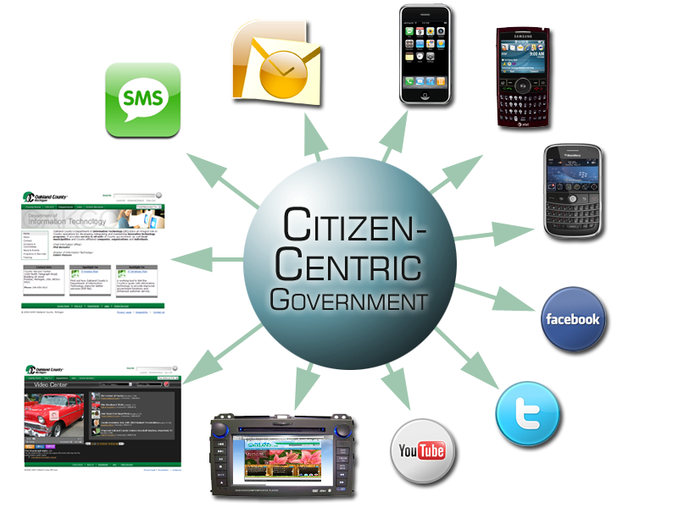
Some Examples

Slide 4
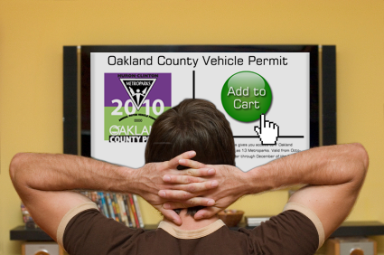

Slide 5




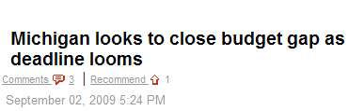
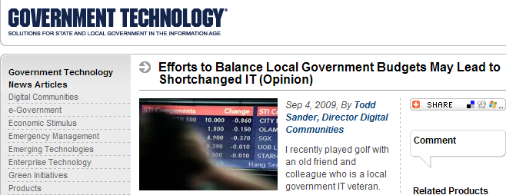
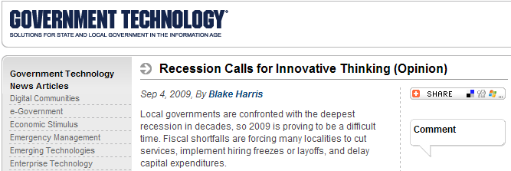
Citizen Engagement
Build Community
Better Services
Web 2.0
Lower Costs
Notes:
Government Charge:
Serve the public
Engage and build community
Deliver relevant information that improves lives and community
Communicate where, when and how public wants it

Slide 6
Solving the Dilemma:
When you don’t have money,
you have to Think…
We have to provide
more with less!
Notes:
We have a Dilemma: Citizens are expecting more and we have less money
In today’s session we will provide some ideas for doing more with less.
6

Slide 7
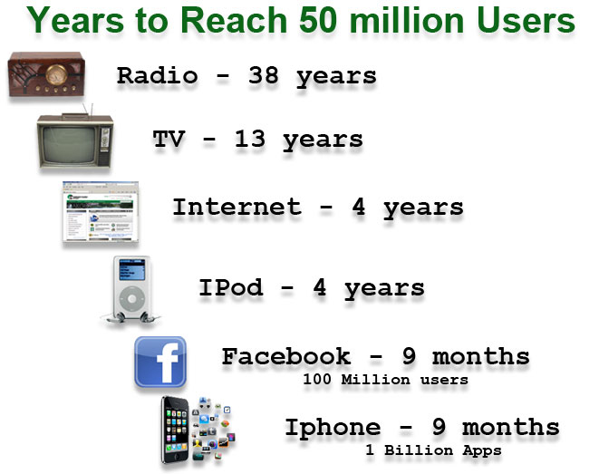
Citizen-Centric Trends Happen Fast
Notes:
A couple things about Trends….
They happen faster than ever

Slide 8

Beware of the Naysayers
That will never work!
The Internet is for “Techno Wienies”
The numbers just aren’t there
Where’s the proof?
Have you lost your marbles?
What a waste of time
And the list goes on and on…….
Notes:
The other thing about trends is if you are early, beware of the Naysayers

Slide 9
Five Steps to Success
Step 1: Identify the Trend
Step 2: Document your strategy and Plan Your Work
  What are we doing, why, and how?
  Project Plan – What tasks and resources ARE required? When?
  Do a pilot project or proof of concept
Step 3: Do the Work
Step 4: Measure your results
Step 5: Document your Lessons Learned and Fine Tune
Notes:
Five steps to success with Citizen-centric government

Slide 10
Trend: Video
Over 80% of Internet users view video online
Americans watch an average of 14.3 billion online videos per month
YouTube accounts for more than 90% of online video consumption
YouTube is the second largest search engine in the world
Video is used for entertainment, information and education
Notes:
10

Slide 11
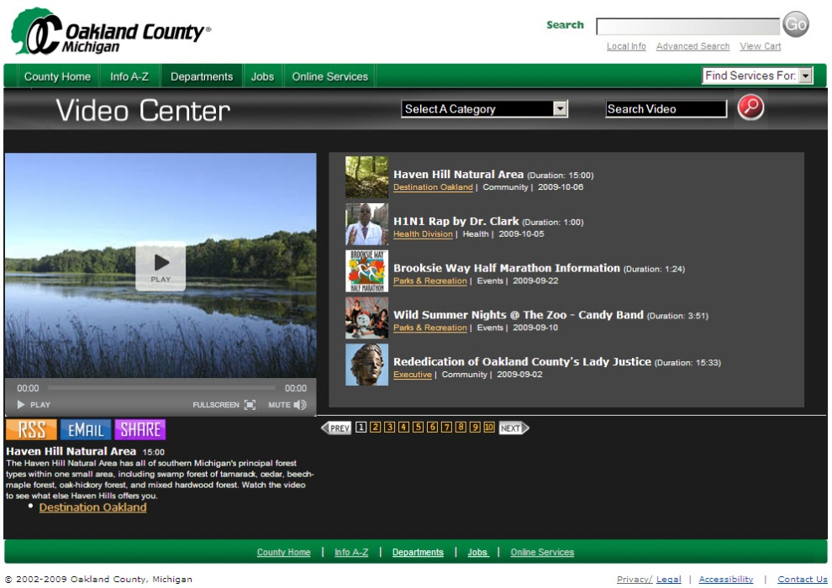
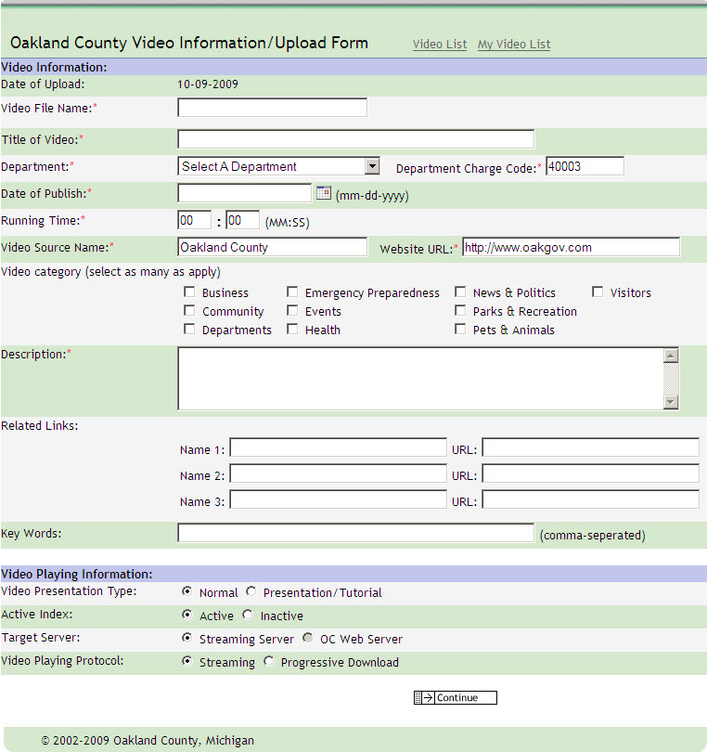
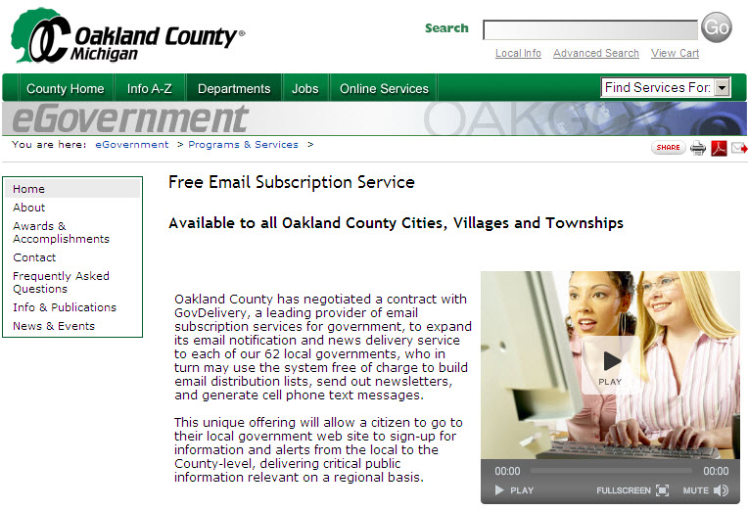
Multimedia
Video Information
Upload Form
Free Email
Subscription Service

Slide 12


Oakland County Video Center
500+ multimedia files on site
100,000+ multimedia plays
Emergency Preparedness
Health Issues
News & Politics
Special Events
Pets & Animals
Parks & Recreation
Business & Community
National Association of Counties
NACo Achievement Award
Center for Digital Government
Digital Government Achievement Award

Slide 13
Lessons Learned - Video
Develop a strategy and standards for video early
Less is more – Reduce web pages using video
Search is critical – Keyword, Text, Closed Caption, ADA
Keep Video less than 3 minutes in length
You can reduce costs by hosting video on YouTube
You don’t need an expensive studio
Source video (with permission) from everywhere
Entry costs are low
Recruit volunteers from everywhere
Measure your results
Notes:
13

Slide 14
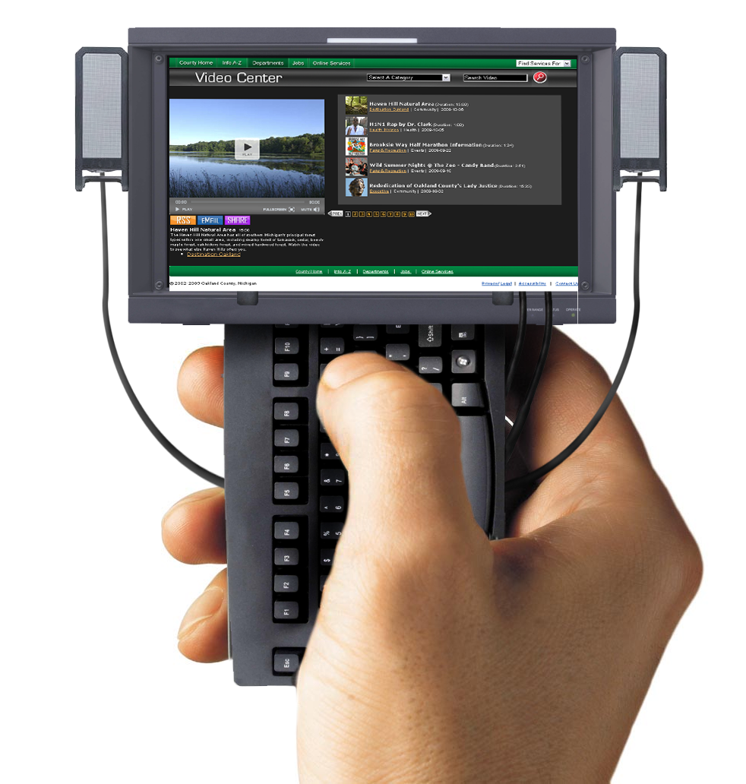
Trend: Mobile
Mobile is…a computer in the palm of your hand
93% of Adults own a cell phone or other web-ready mobile device
By 2020 the mobile device will be the world’s PRIMARY connection tool to the Internet
Newer mobile devices support video for entertainment, information and education
Notes:
14

Slide 15


Alternative Development Process
Mobile Services created through
educational partnership with MSU
Limited budget & resources
Dedicated student team
Successful project
& beneficial new
citizen-centric service

Slide 16
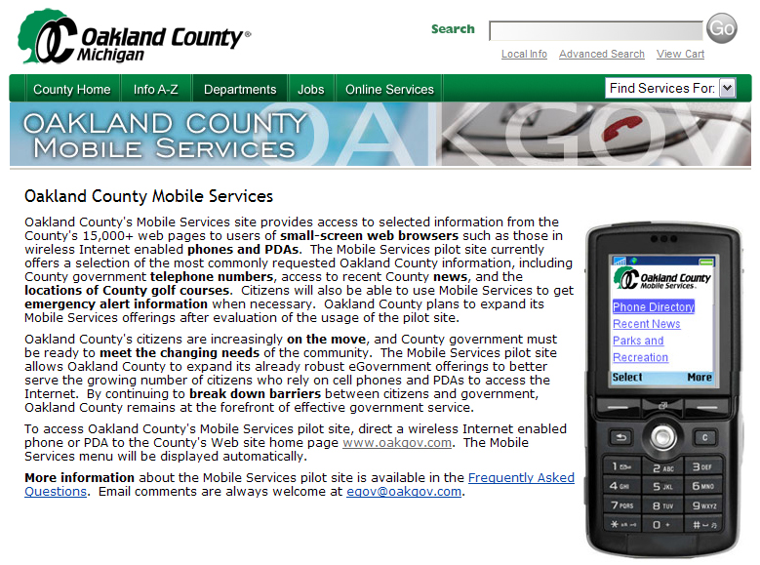
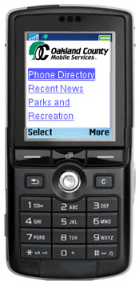
Going with citizens wherever they go…
wireless
text alerts
Email
subscription
mobile.oakgov.com

Slide 17

Partnership Cost/Savings: Mobile
Purchased
software
$1,500
National Association of Counties
NACo Achievement Award
County
staffing
$15,904
MSU student contribution
260 work hours
(no cost to County)
Center for Digital Government
Digital Government Achievement Award
Estimated County Savings
$31,720

Slide 18
Lessons Learned: Mobile
Develop a strategy and standards for mobile early
Standardize on mobile browsers, not hardware
Plan to support Text, Touch & Full Screen browsing
Include audio & video in your mobile site
Don’t forget about eCommerce
Recruit volunteers from everywhere
Measure your results
Notes:
18

Slide 19

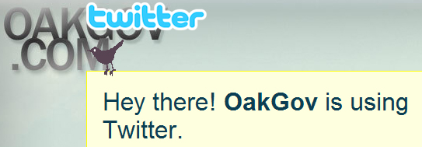



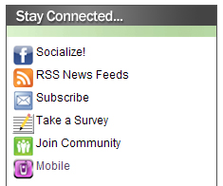

Social Networking:
Connecting with citizens in their own networks…

Slide 20


Social Networking is about fishing where the fish are
Where are your Constituents?
Notes:
Some final thoughts….

Slide 21

We are all in this together
Let’s Collaborate
and Share
Notes:
Some final thoughts….

Slide 22

Notes:
Talk about using technologies to extend reach.

Slide 23

As the needs of the citizens
change…
so does the way we
deliver services.

Slide 24
Sources & Statistics
Apple product news & usage statistics
http://www.apple.com/hotnews/
comScore – market research & digital marketing intelligence
http://www.comscore.com/
Facebook usage statistics
http://www.facebook.com/press/info.php?statistics
Grunwald Associates Kids’ Social Networking Study
http://www.grunwald.com/surveys/sn/index.php
Mashable Social Media Guide
http://mashable.com/
Pew Internet & American Life Project
http://www.pewinternet.org/
Socialnomics Social Media Blog
http://socialnomics.net/

Slide 25


Slide 26
Citizen Centric Government
The future of government services
and the technologies, approaches and innovations that are leading the way
Michigan Digital Government Summit
October 15, 2009

Slide 27

Agenda slide
On tap today…
The changing landscape of
government
  Economic cause and effect
  Evolving technology trends
  Solutions you can share
  Anticipating the next opportunity

Slide 28

Key Factor
Today’s economic crisis is changing the landscape of government services
Skyrocketing unemployment has proven to be a catalyst for service transformation
Notes:
Reference revenue losses, staffing reductions, and increased demand for services

Slide 29

15.2%
Unemployment rate in Michigan
Unemployment claims up 80% over 2008 levels

Slide 30

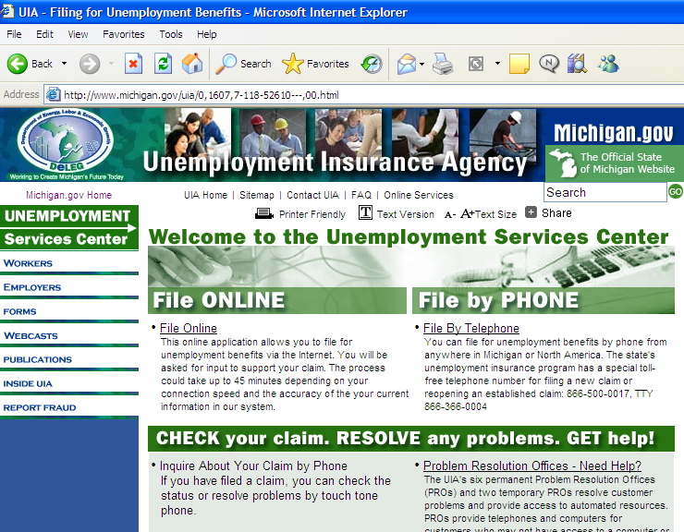
Unemployment
Online Tools
Employers and claimants now
have 24 x 6 access to critical information
Self Service
Internet and telephone intake are now the primary channel for filing a claim
Notes:
Provides 24 x 6 access
- Employers: Tax, wage and UI account info
- Claimants: Benefit status, monetary determination, help
Enables citizens to certify work search status
via e-Marvin tool

Slide 31
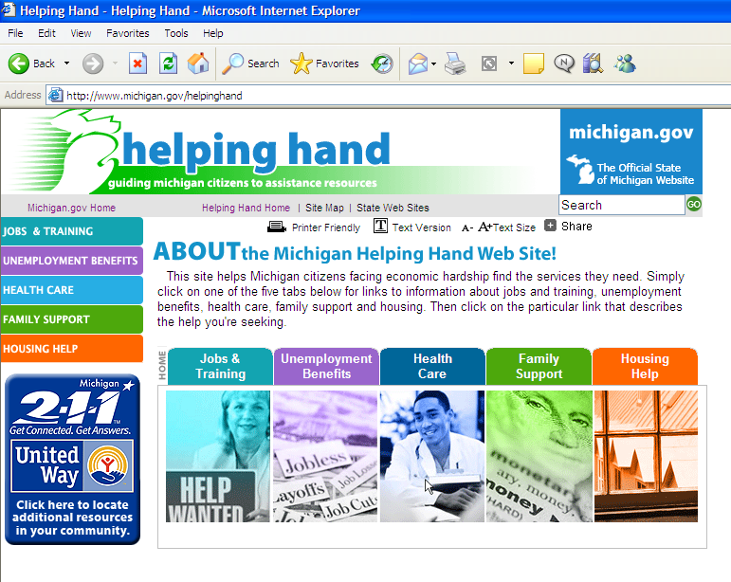
Public Assistance Tools
Search for programs,
submit an application for food assistance,
and check application status
Self Service
Public Assistance Tools
Search for programs
Submit application for food assistance
Check application status
Citizen services thru this site will continue to grow

Slide 32

Technology Trends
A major factor influencing the landscape for citizen services is how people are using technology

Slide 33
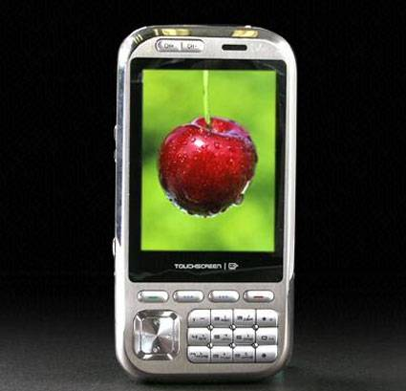
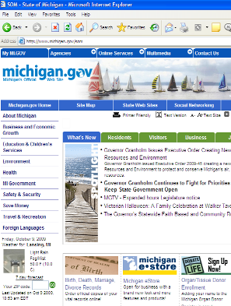
Mobile access to the Web
The new Michigan.gov “mobile”
site is optimized for Wireless enabled
devices like PDAs and cell phones
Technology
Mobile access to the web
Mobile access to the web
Michigan.Gov has a “mobile” site optimized
For wireless enabled devises
Text alerts and 24 hr mobile fishing license
Access has doubled in the past 12 months.

Slide 34
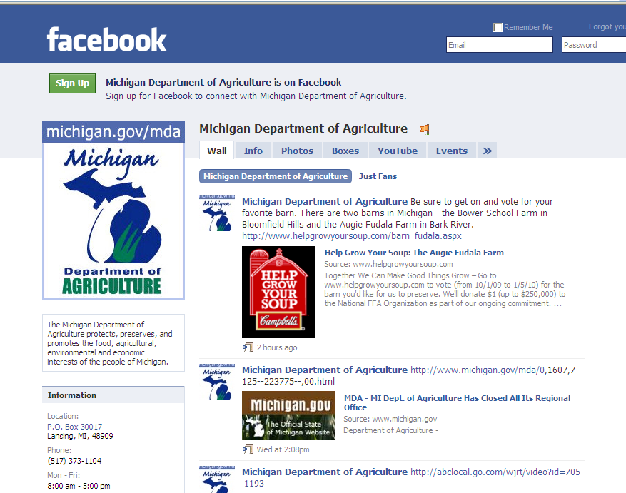
Social Networking
Michigan agencies now use
Facebook and Twitter
to keep citizens informed
Technology
Social Networking
Michigan citizens now use
Facebook and Twitter to keep
Citizens informed.
Social Networking is BIG
Visits to social networking sites have tripled in past twelve months

Slide 35
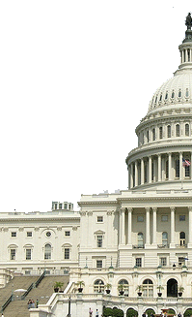
Shared Solutions
Solutions shared across government are delivering significant cost savings and helping to counter shrinking staff resources

Slide 36

Pooling IT Tools
Through Project Management
Offices in each agency,
solutions from one organization
are extended to others
Shared Solutions
Pooling IT resources
Enterprise Project management office
helps identify common problems and
single solutions
The FileNet Center of Excellence leverages best practices for record and document management
Notes:
1. On average, ETL versus custom coding saves 60% development time based on projects to date
2. Department of Treasury noted 10-25% in data quality improvement over existing processes
3. Department of Treasury has estimated 500-1,500 fewer incorrect tax audits due to improved data quality
4. Potential additional $13 to $33 Million in additional tax revenue recovery
5. Because no one project is bearing the total environment cost, SOM has been able to set up a central three level development environment. This has resulted in improved quality of code moving to production and reduced the number of production outages.
6. Existing Shared Services staff augmentation contracts provide flexibility and efficiency for project managers when acquiring additional project staff
7. To date the centralized ETL shared solution has potentially saved the SOM more than $3M in startup costs over if the agencies had pursued separate environments (based on known agency projects).
8. ELT tool has reduced the dependency of the SOM to specific data platforms
9. ETL license and administration maintenance savings for departments estimated at $200-$250K per year (based on a known ETL licensing and support costs for a single agency).

Slide 37

Centers of Excellence
Developed around “in demand”
technologies, these centers
reduce reliance on third party solutions
Shared Solutions
Centers of Excellence
Developed around “In-demand” technologies, these centers reduce
reliance on third party solutions.
A 1,500 hour Treasury project is reduced to 300 hours thanks to the sharing of an ETL tool set

Slide 38

What’s next for citizen centric services?
MDIT turned to the experts.
We asked some
Gen Xers that very question...
Notes:
Reference revenue losses, staffing reductions, and increased demand for services

Slide 39
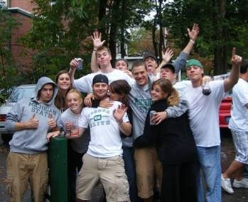
Collegiate Insight
We engaged MSU students in
developing citizen centric
social networking
Future
Collegiate Insight
We engaged MSU students in
Developing citizen-centric
Social networking

Slide 40

High School Visionaries
We also discovered some
exciting ideas among
high school IT projects
Future
High School Visionaries
We also discovered some
Exciting ideas among high school IT projects

Slide 41
Questions?
Questions ?

Slide 42

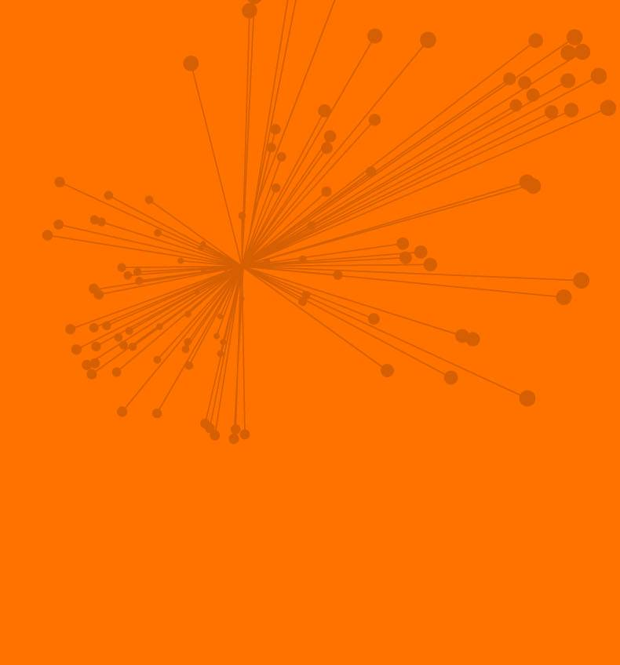

Citizen Centric Government and Mobility
Doug Clark
Government Solutions Practice
AT&T Business Solutions
© 2009 AT&T Intellectual Property. All rights reserved.
AT&T, AT&T logo and all other marks contained herein are trademarks
of AT&T Intellectual Property and/or AT&T affiliated companies.
Notes:
42

Slide 43
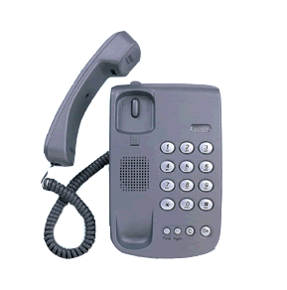

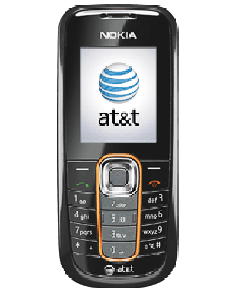
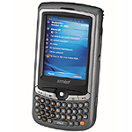


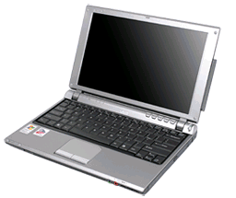
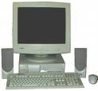

Human nature drives the need for mobility
Notes:
Source: Frost & Sullivan - Mobile and Wireless Predictions for 2008, November 2007
Global wireless subscribers: 3.5 B in 2011

Slide 44
M-Government stakeholders
Users
Field
Management
Citizens
Government
Federal
State & Local
Businesses
Other Gov
Internal
External

Slide 45
E-Government leading into M-Government
Are your employees productive while on the field? Do they make the most out of their day?
Could you make processes simpler, more efficient?
Are you contributing to a greener government?
AND
How do you communicate with residents, visitors and businesses? Are you reaching out?
M-Office tools
    Remote access to case data
    Work orders
    Clock in/out
M-Learning
M-Video Streaming
M2M
G2C & G2B
  User generated content
  Records made available
  Departments’ locator
  Awareness programs
  Simple m-transactions
Internal
External

Slide 46
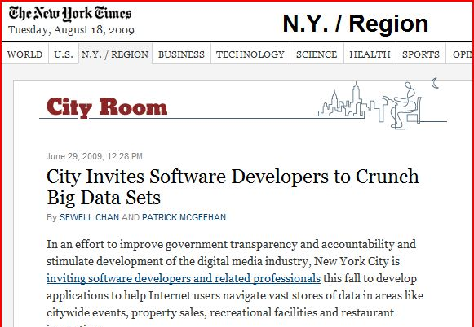




G2C initiatives on the way

Slide 47
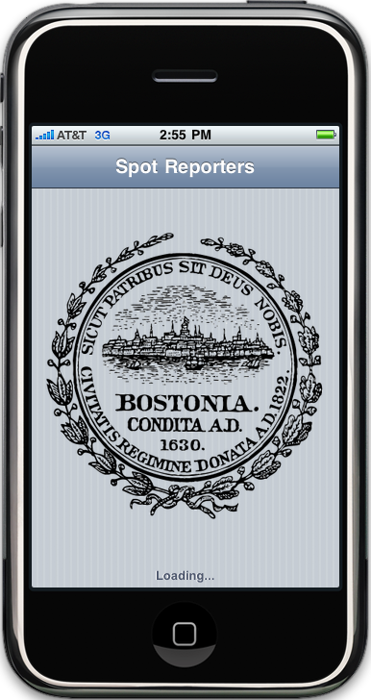
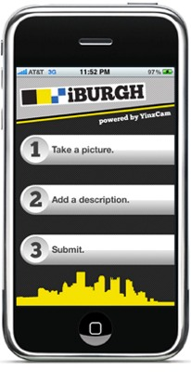


Slide 48
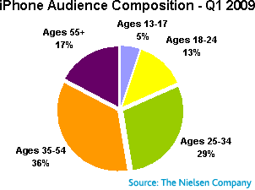
Not as young as you may think
65%

Slide 49

UI is the killer application

Slide 50

Mobile County Sheriff’s Office
An initiative was developed that effectively fights meth production through education, enforcement and pharmacy compliance. This initiative deploys new, high-tech tools in order to access real-time information and lead to arrests; these technologies include MethText, the nation’s first text-message-based reporting program of its kind.
• Interactive text scripting allows citizens to quickly report
meth
• E-mail alerts and databases allow law enforcement to
immediately act on tips
• Advertising and marketing materials boost results while
educating the public
• Innovative placement intercepts meth activity at precursor
point-of-purchase
• Computerized pharmacy system tracks purchases

Slide 51
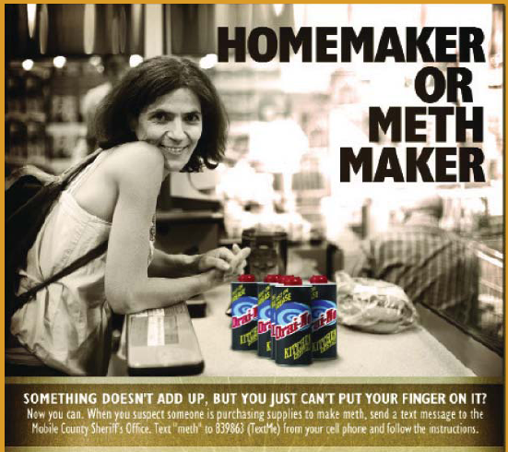

Slide 52

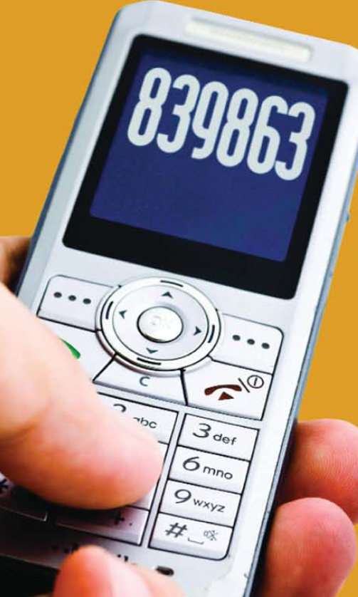
The Mobile County Sheriff ’s Office Meth initiative has already led to 275 arrests.
This includes 205 arrests for manufacturing meth and 39 Federal prosecutions

Slide 53

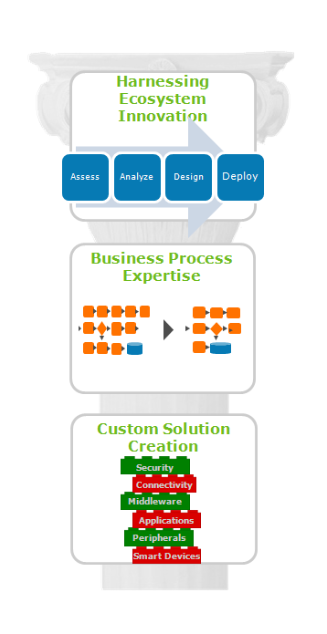
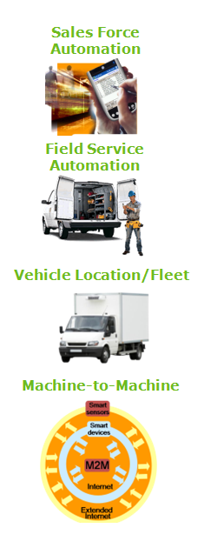
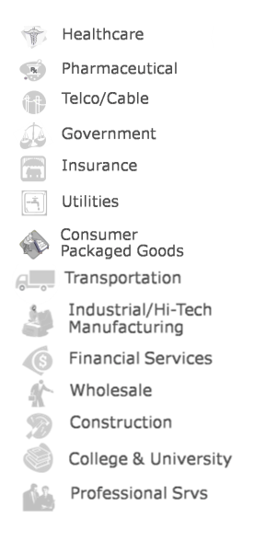
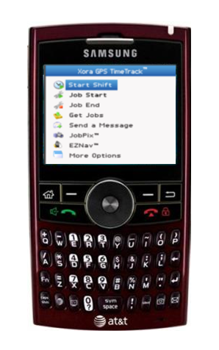

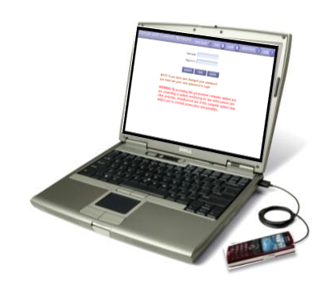
AT&T Business Value Creation
Notes:
53
53

Slide 54

Thank you!
douglasfclark@att.com
Velocity. Delivered.
Page 54
Notes:
54
54
54

