Slide 1



Citizen Centric Government and Mobility
Doug Clark
Government Solutions Practice
AT&T Business Solutions
© 2009 AT&T Intellectual Property. All rights reserved.
AT&T, AT&T logo and all other marks contained herein are trademarks
of AT&T Intellectual Property and/or AT&T affiliated companies.
Notes:
1

Slide 2
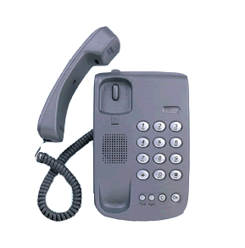
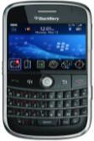
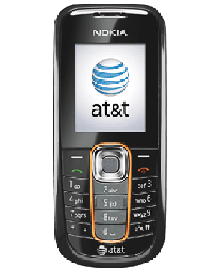
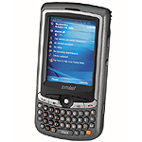


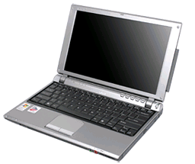


Human nature drives the need for mobility
Notes:
Source: Frost & Sullivan - Mobile and Wireless Predictions for 2008, November 2007
Global wireless subscribers: 3.5 B in 2011

Slide 3
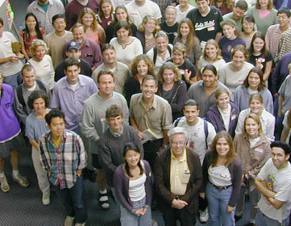
Citizen-Centric Government
Focus on needs of the citizen and businesses:
    Improve citizen satisfaction with government services
    Improve communication with constituency
    Realize essential efficiency gains from online service delivery
    Improve delivery of public policy outcomes

Slide 4
M-Government stakeholders
Users
Field
Management
Citizens
Government
Federal
State & Local
Businesses
Other Gov
Internal
External

Slide 5
E-Government leading into M-Government
Are your employees productive while on the field? Do they make the most out of their day?
Could you make processes simpler, more efficient?
Are you contributing to a greener government?
AND
How do you communicate with residents, visitors and businesses? Are you reaching out?
M-Office tools
    Remote access to case data
    Work orders
    Clock in/out
M-Learning
M-Video Streaming
M2M
G2C & G2B
  User generated content
  Records made available
  Departments’ locator
  Awareness programs
  Simple m-transactions
Internal
External

Slide 6
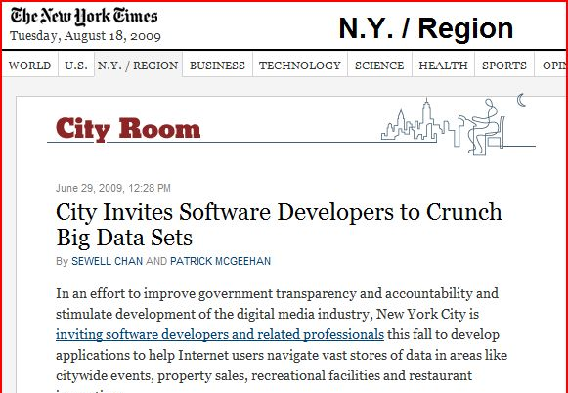




G2C initiatives on the way

Slide 7
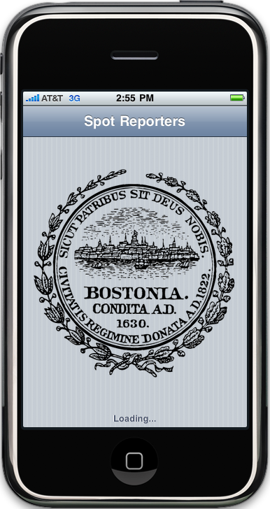
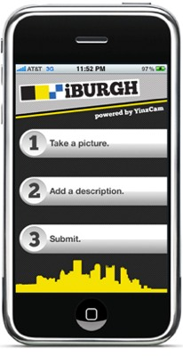


Slide 8
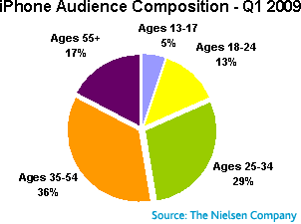
Not as young as you may think
65%

Slide 9

UI is the killer application

Slide 10

Mobile County Sheriff’s Office
An initiative was developed that effectively fights meth production through education, enforcement and pharmacy compliance. This initiative deploys new, high-tech tools in order to access real-time information and lead to arrests; these technologies include MethText, the nation’s first text-message-based reporting program of its kind.
• Interactive text scripting allows citizens to quickly report
meth
• E-mail alerts and databases allow law enforcement to
immediately act on tips
• Advertising and marketing materials boost results while
educating the public
• Innovative placement intercepts meth activity at precursor
point-of-purchase
• Computerized pharmacy system tracks purchases

Slide 11
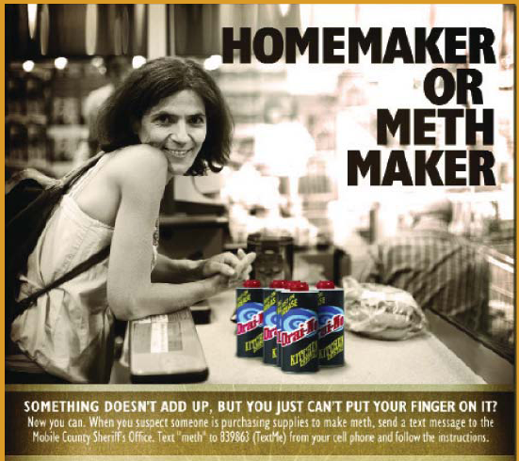

Slide 12

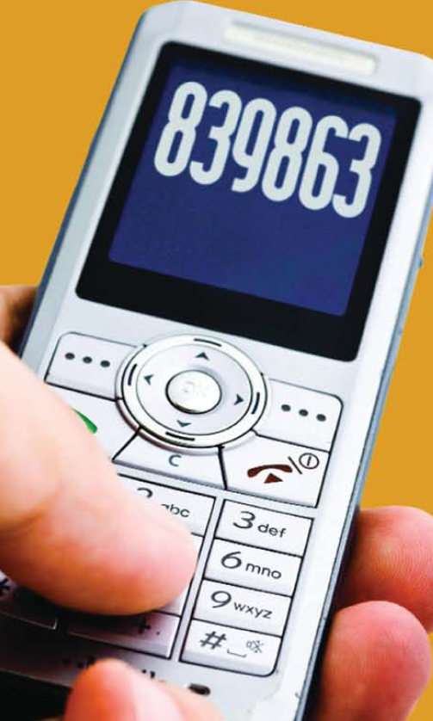
The Mobile County Sheriff ’s Office Meth initiative has already led to 275 arrests.
This includes 205 arrests for manufacturing meth and 39 Federal prosecutions

Slide 13

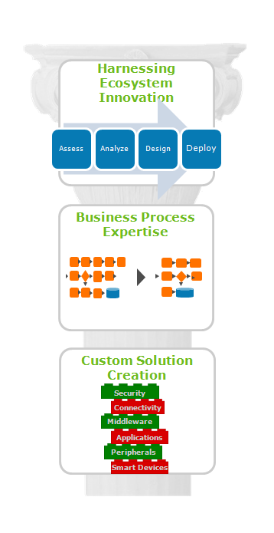
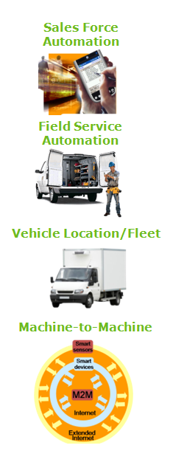
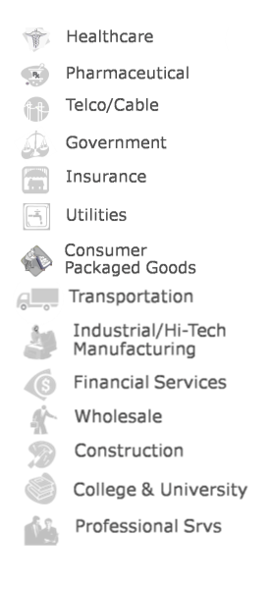
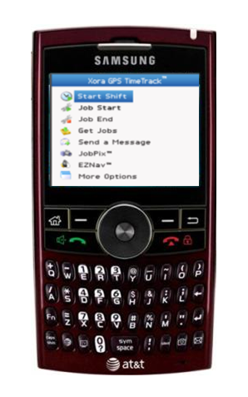

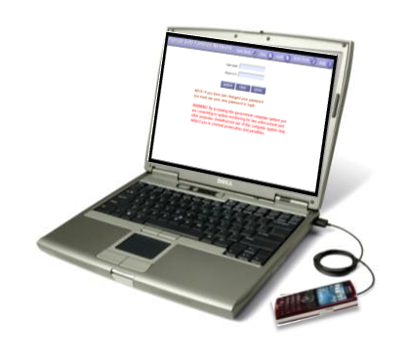
AT&T Business Value Creation
Notes:
13
13

Slide 14

Thank you!
douglasfclark@att.com
Velocity. Delivered.
Page 14
Notes:
14
14
14

