Slide 1



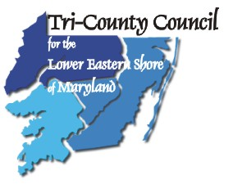


Making Data Available: GeoDASH
Michael S. Scott, PhD, GISP
Eastern Shore Regional GIS Cooperative
Salisbury University
June 24, 2009

Slide 2
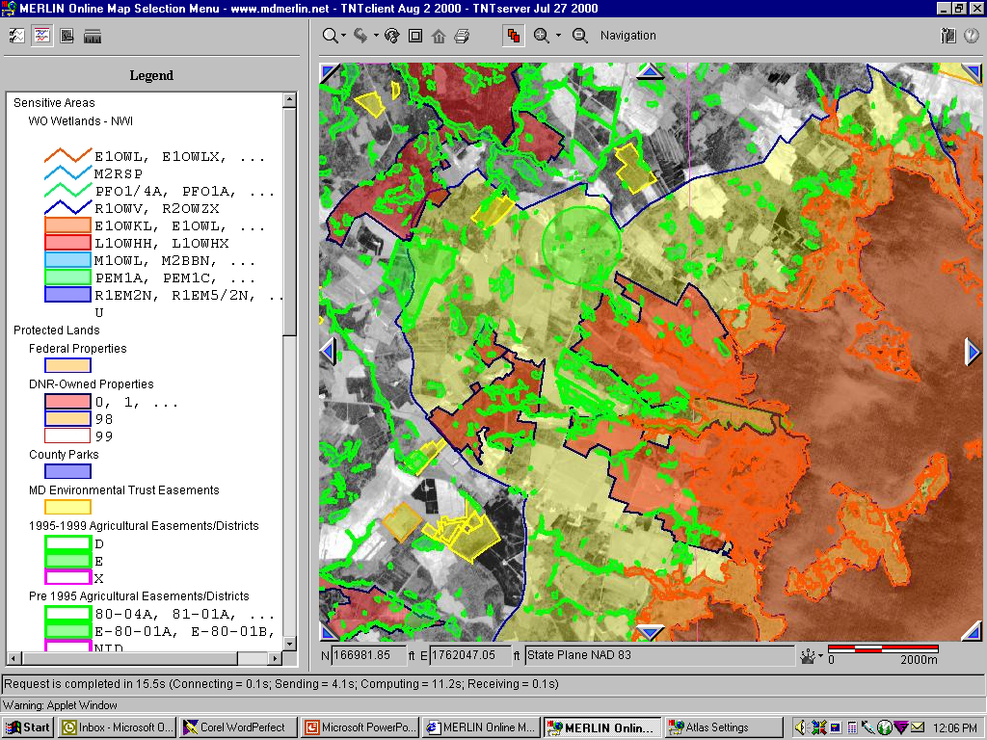
GIS: A Dichotomy
GIS, as an integrative and synthesizing technology, can create a great deal of high value information very quickly
Unfortunately, that information is often dense, complex, and in a unfamiliar, nonintutive format

Slide 3
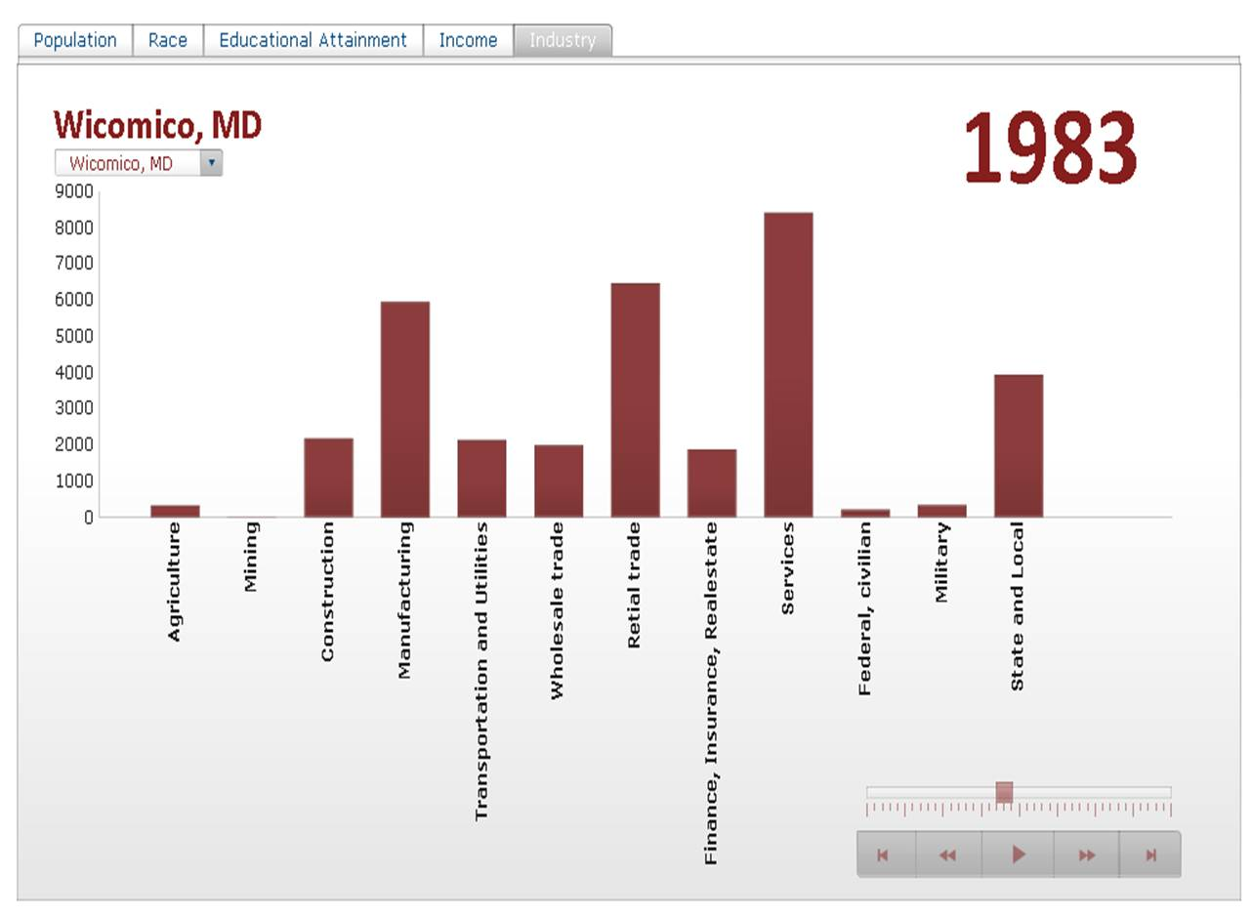
Regional Economic Development
Regional Councils on Maryland's Eastern Shore had a need to create information for decision-makers that would enhance regional economic development
To support the governor's MFR initatives, MDBED has a need to create economic development progress indicators in a powerful way

Slide 4
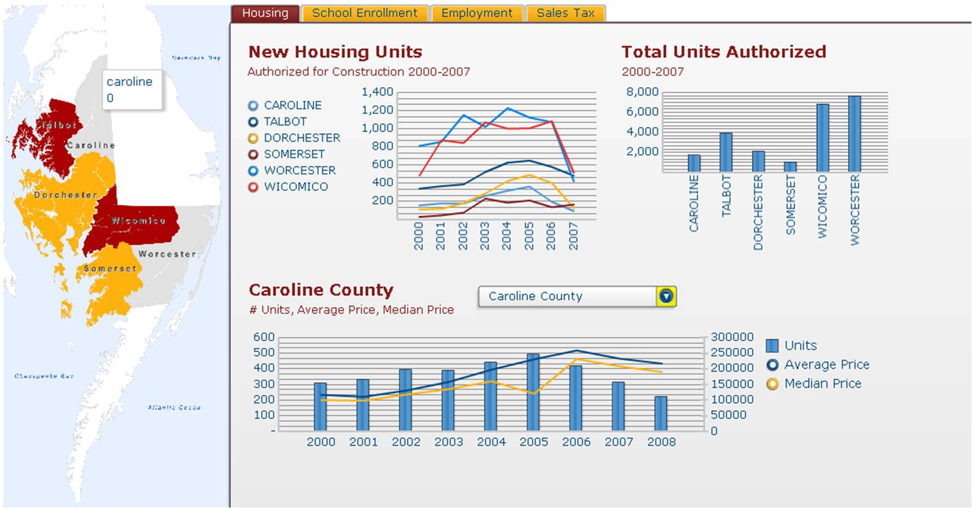
GEODash: GIS-linked Dashboards
A 3-year proposal was funded by the US EDA and MDBED to explore the use of dashboard visualizations to support economic development decision-making and reporting on Maryland's Eastern Shore
A collaboration between SU's ESRGC, SU's BEACON, the Tri-County Council of the Lower Shore and the MidShore Regional Council

Slide 5
Early Tangible Benefits of GEODash
Transportation Planning: Mass Transit
Transportation Planning: Freight Services
Alternative Energy Exploration: Biomass
Social Services: Foster Care
Economic Development: General Indicators
Economic Development: Sales Tax Collections
Impediments to Economic Development: Crime Analysis
Dynamic (Monte Carlo) Scenario Analysis

Slide 6
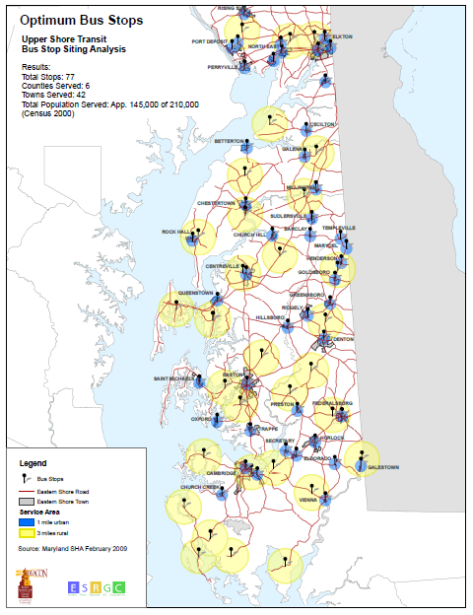
Transportation Planning: Mass Transit
Using GIS and Dashboard Technologies in transportation planning.
Testing GIS/Dashboard based determination of optimal bus stop locations in the region based on population and traffic counts.

Slide 7
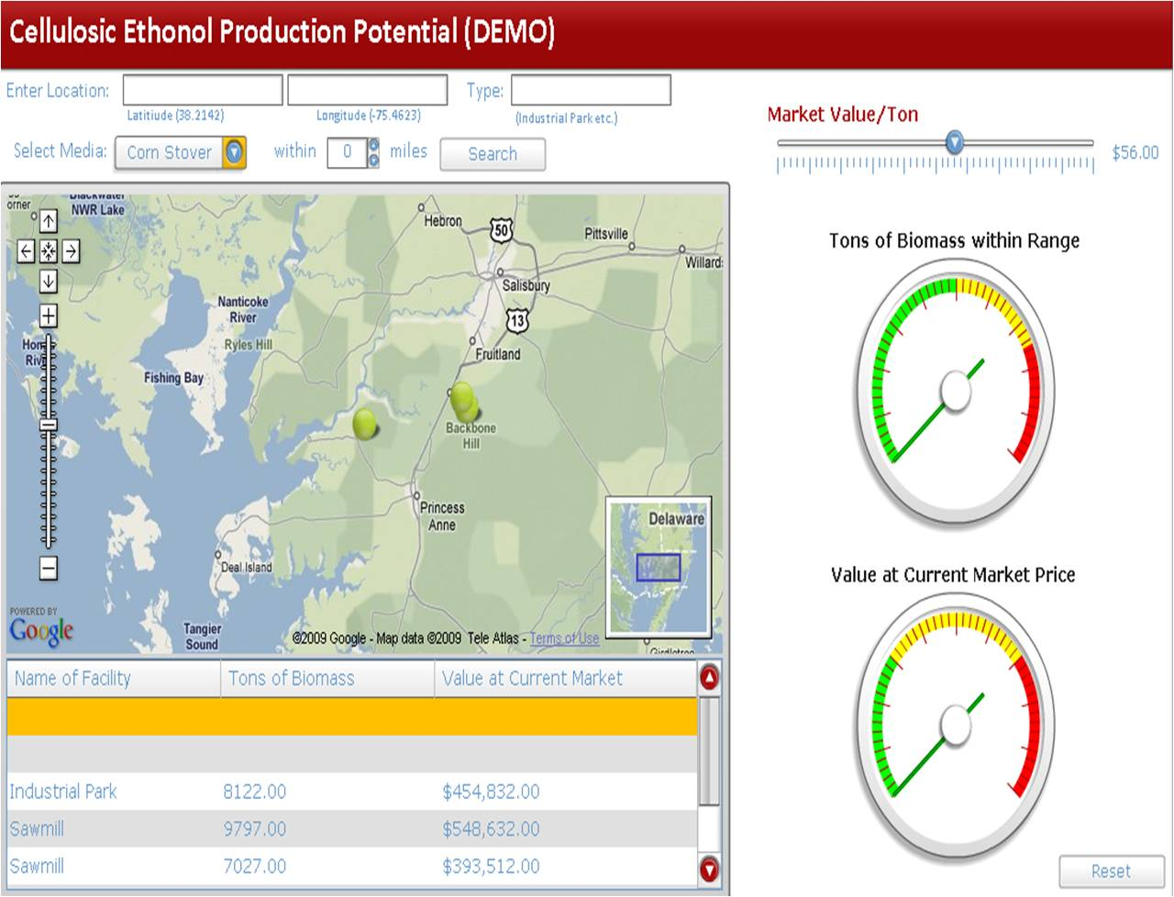
Alternative Energy Exploration: Biomass
MDE & MES
Developing a regional biomass dashboard that will assist in making business venture feasibility decisions regarding the optimal locations of alternative energy ventures in the six-county region that would use biomass as primary or secondary inputs.
Develop a functional GIS to manage and analyze spatial data
Collaborating with BEACON and with Dr. Danny Ervin of ShoreENERGY at Salisbury University.

Slide 8
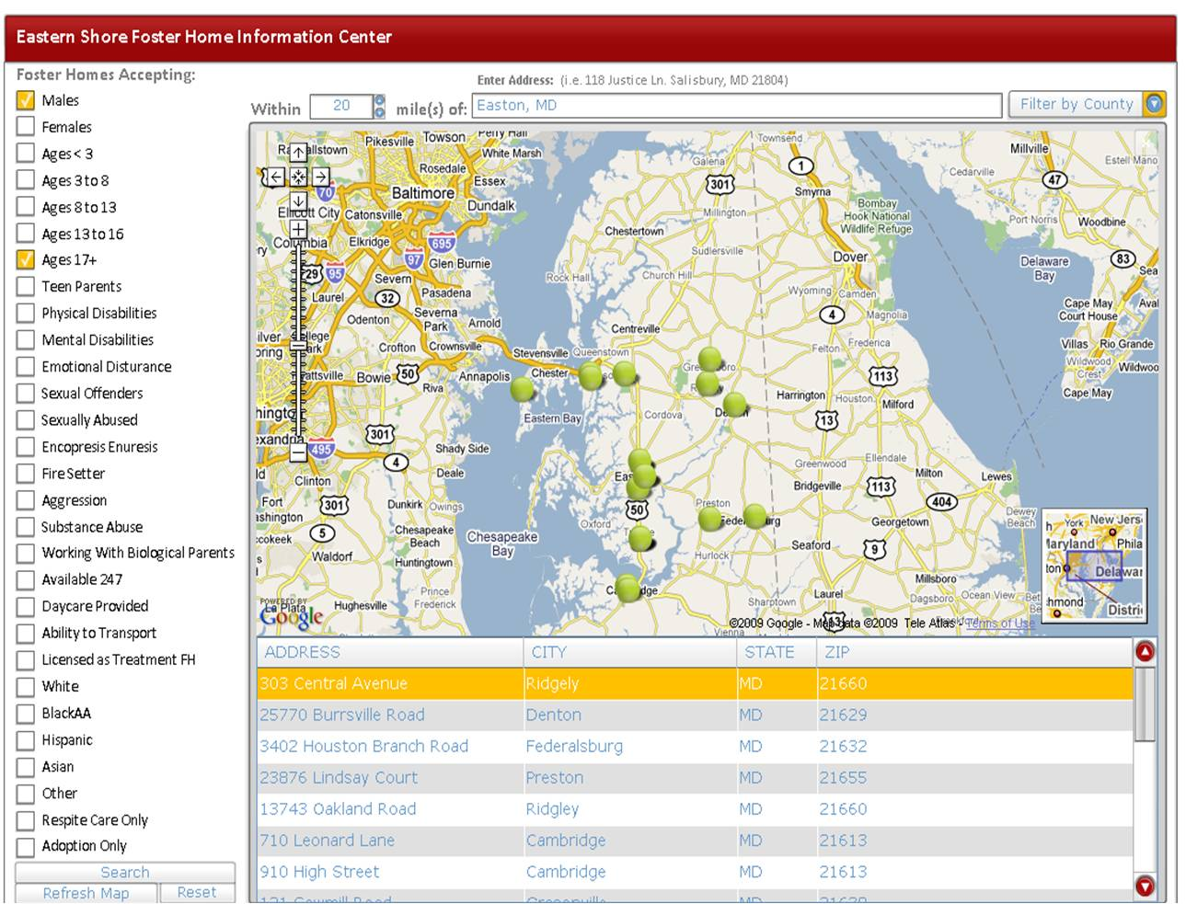
Social Services: Foster Care
Combining the analytical power of GIS with the succinct information delivery capability of Dashboards that allows users to search for Foster Homes operated by the private sector vendors that meet certain criteria.
The functions developed will be widely applicable in other private sector venture applications in the future.

Slide 9
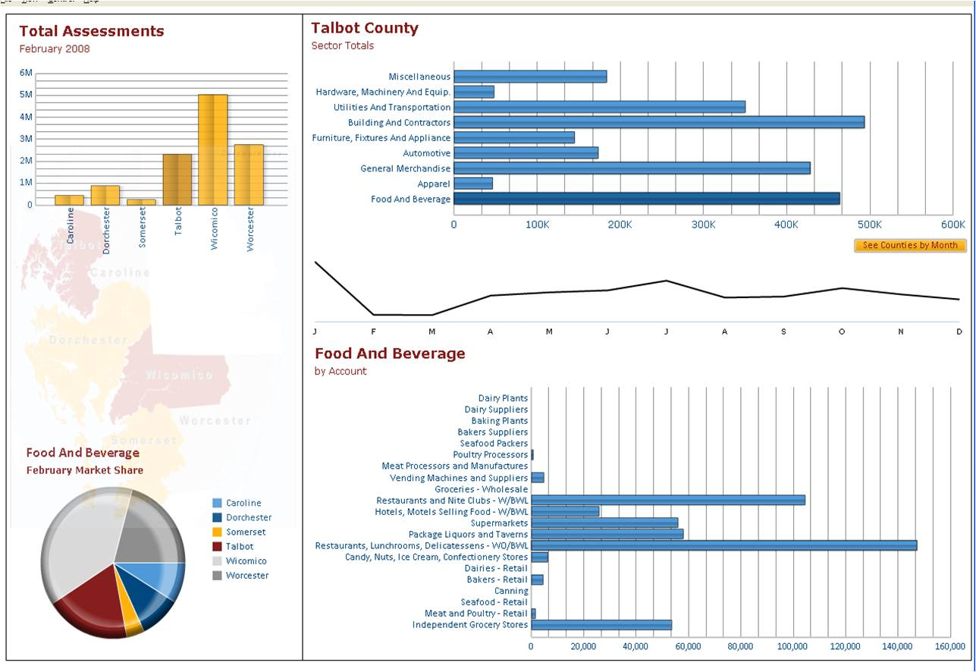
Economic Development: Sales Tax Collections
Developing a Sales Tax Dashboard with data provided by the comptroller’s office. This will provide a decision making support tool to data users in the six counties.
The Comptroller’s office has agreed to continue providing data to this effort at a finer scale than their typical report.

Slide 10
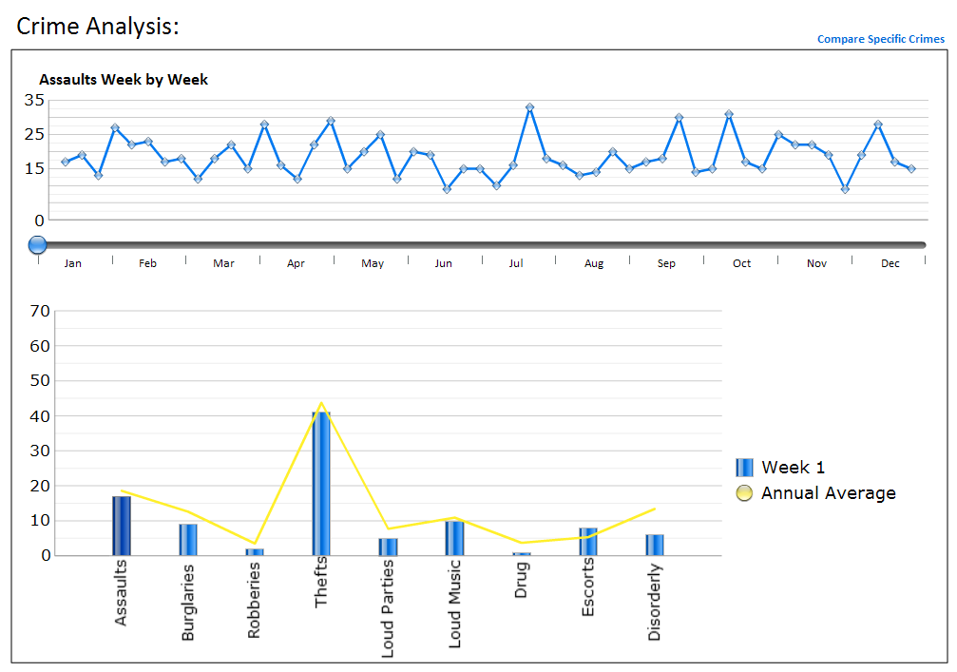
Impediments to ED: Crime Analysis
Developing a dashboard that will display data on various crime occurences for law enforcement personnel in the region.
Working to incorporate the GIS analysis component

Slide 11
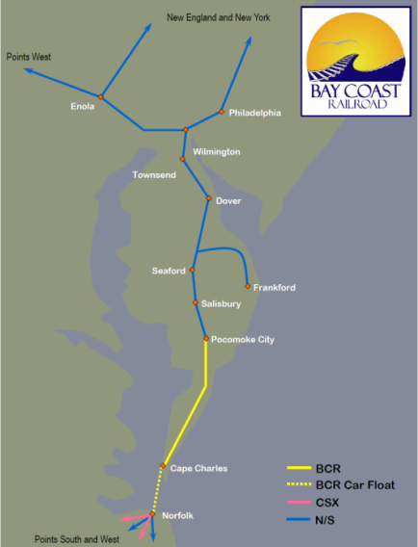
In Development: Freight Services
Bay Coast Railroad
Conducting a comprehensive analysis on the economic impact of adding a spur to the existing main line track to support the Regional Business Incubator being developed at the Wallops Flight Facility.
Bay Coast has asked BEACON to put together a proposal for a GeoDASH project for the purpose of displaying the findings of the study interactively online and in public hearings, using the latest dashboard technologies.
Will involve economic scenario analysis
Notes:
When completed, this project will serve as a “Show & Tell” tool for GeoDash to demonstrate the capabilities of the various technologies and skill sets GeoDash brings to the economic development and transportation planning arenas.

Slide 12
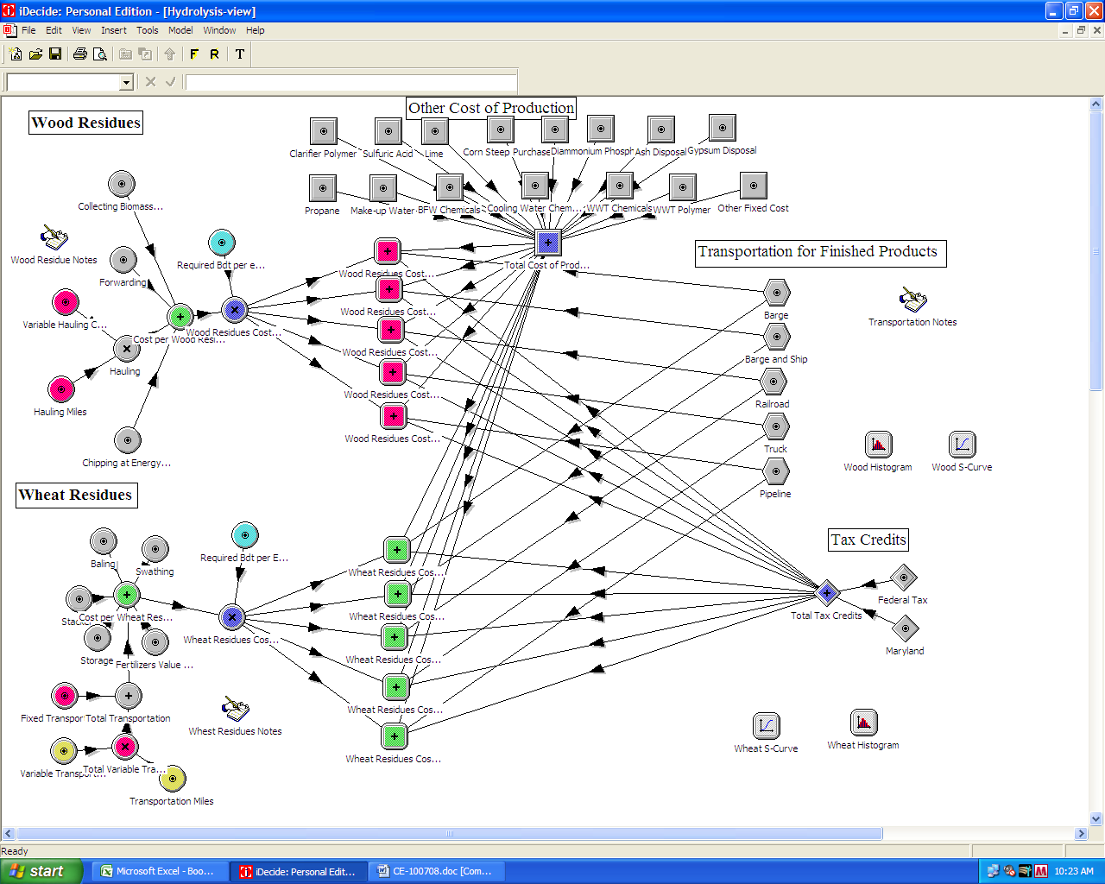
In Development: Dynamic (Monte Carlo) Scenario Analysis
State of Maryland Service Optimization Study
Partnering with a BEACON Team we will be working with key decision makers from three direct service agencies in the State of Maryland to develop a scenario analysis model with a nested resource allocation model to explore the feasibility of cost savings and service improvements under differing service delivery and organizational structure scenarios.
This project is a proof-of-concept and capacity enhancement opportunity for GeoDASH.

Slide 13
Thank You!
For more information, go to: beacon.salisbury.edu/template/gd.asp
Special Thanks to GEODash staff - Jim Garrity and Sarah Bunch

