Slide 1
Buckets, Strings, Fishing and Things
Steven W. Jennings, CIO
Harris County, Texas

Slide 2
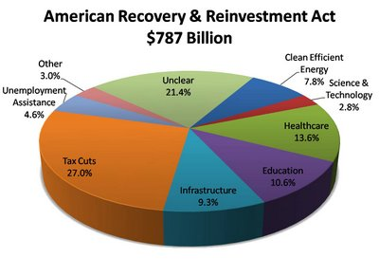
The Opportunity
American Recovery and Reinvestment Act…HR1 $787 BILLION
equal to 6% of the GDP

Slide 3


Some of the Buckets
$53.6 billion to forestall layoffs among political subdivisions
$100 Billion funds for Public Works
$36.2 Billion for clean energy
$48 Billion for Transportation
$150 million for Economic Development
$2.5 Billion for Distance learning, Telemedicine and Broadband programs
$4.7 Billion for Broadband Technology Opportunity Projects ( BTOP)
2.5 Billion for Broadband administered by AG Dept. Rural Utility Service *
Notes:
Would like to discus three areas

Slide 4

Some of the Strings
Grants will be awarded based on:
  Competitive proposals
  Awarded by formula (Current)
  Awarded by Discretionary Competitive proposal
  State determined
  Awarded by formula ( to be determined)
  Awarded by formula to the states with sub-allocation to local govt.

Slide 5

Strings on Steroids
Federal Program | Purpose | Funding | Distribution
State Fiscal Stabilization Fund www.ed.gov | 81.8% must be used to restore state education funds to their FY 08 or 09 levels through the regular elementary and secondary education formula. Can be used to prevent layoffs. Remaining funds can be used for public safety and other government services and distributed to local education agencies and can be used plus school modernization, renovation and repair. | $53.6 billion $48.6 billion by formula $5 billion competitive | 61% based on state share of individuals aged 5 to 24 and 39% on share of population. To be awarded in two phases. And includes a maintenance of effort provision.

Slide 6

Fishing
For some there isn’t a lot of change
All we are doing is adding more fish to the pond
For others it’s almost like a “Brave New World”

Slide 7

Other stuff ( Transparency)
Section 1512, Federal Reporting
OMB creating a website Federal Reporting.gov for compliance
Guidelines for procedures and accounting are being developed as we speak
Dates to remember:
  July 31-Preliminary reporting deadline.
  How funds have been spent
  LIVE REPORTING Oct.10th

Slide 8
To get a clear picture of how to understand and navigate these muddy waters:
John Miri, Senior Fellow, Center for Digital Government
  Mapping the Economic Stimulus Landscape
  Mapping Funds
Rod Massey, Former Chief Information Officer, Clark County, NV & Global Vice President for Public Sector, SAP, Inc.
  Transparency, Metrics and outcomes.

