Slide 1



IT Consolidation:
Fact vs. Fiction
Steve Kaplan, VP
Data Center Virtualization
11/05/09

Slide 2


Steve Kaplan, VP Data Center Virtualization
Co-authored numerous
books on VMware & Citrix
(all official guides –
Osborne/McGraw-Hill)
Scores of published articles
And whitepapers on IT Topics
Used to run RYNO
Technology, Named Citrix
Partner of the Year for the
U.S. for 2000
Microsoft MVP for
4 years.
VMware vExpert
For virtualization news, follow me on www.twitter.com\roidude

Slide 3
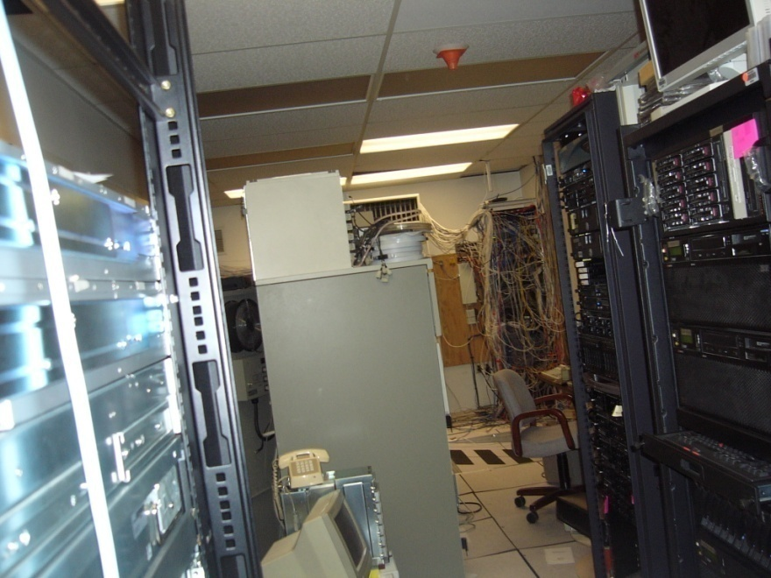
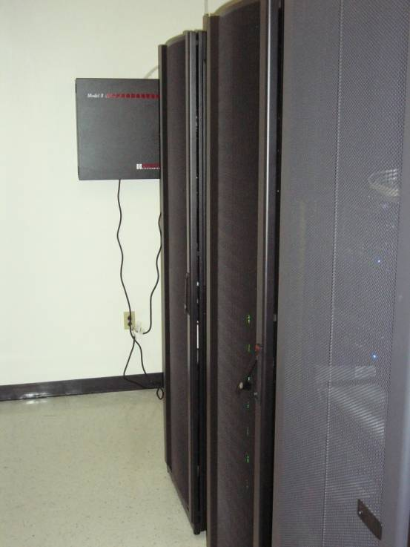
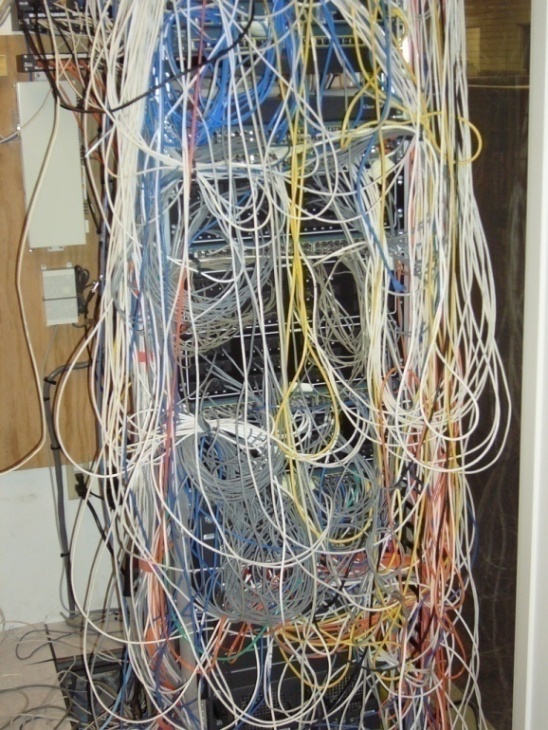
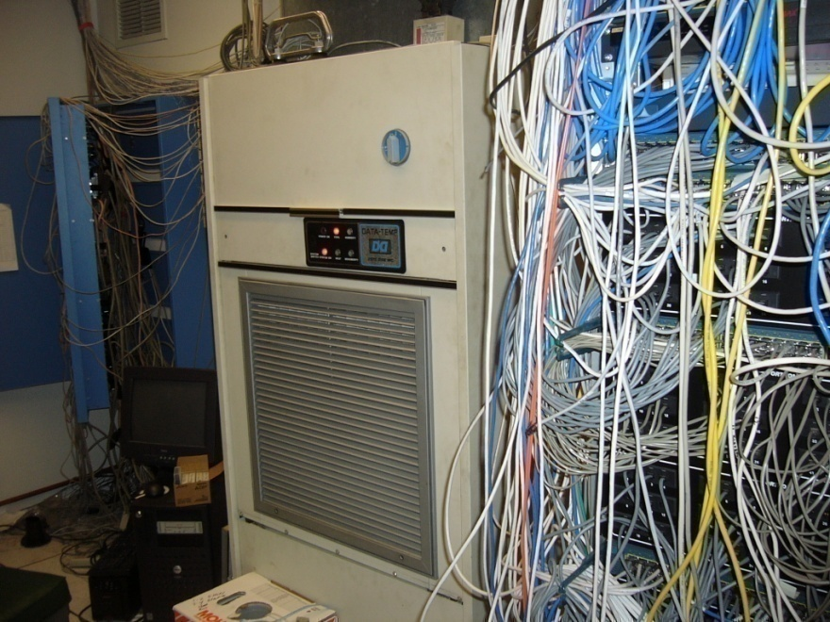
BAAQMD: B & A Virtualization
Virtual
Physical

Slide 4
BAAQMD: B & A Virtualization
Physical
Virtual
60 x86
Physical Servers
7
Physical Virtualization Hosts
325 tons
of annual C02 emissions
38 tons
of annual C02 emissions
NO
server clustering
HA
for all servers
Unproven backups
& limited back up windows
Extremely reliable
& fast backups with no constraints
No DR
Cloud DR
for all servers

Slide 5

Myth #1: Virtualization adds application layer & slows down servers
Some virtualization products do add layers
Only purchase “bare metal” hypervisors
Combine with top X86 multi-core processors

Slide 6


Myth #2: Virtualization is Expensive
Virtualization much less costly than physical
Virtualization can be deployed as needed
ROI analysis is essential to show
enterprise financial impact

Slide 7
5-Year Savings for 100 Servers
Unit Cost
Physical
Virtual
Savings
Servers (Existing)
$8,000
$800,000
$90,000
$710,000
New Servers (10/yr)
$8,000
$400,000
-
$400,000
Power/Cooling Servers
$75
$450,000
$27,000
$423,000
Power/Cool New Servers
$75
$112,500
-
$112,500
Maintenance
$1,000
$100,000
$46,591
$ 53,409
Windows Srvr (50 Std)
$ 719
$ 59,917
-
$ 59,917
Windows Srvr (30 Ent)
$ 2,334
$ 233,400
$47,620
$ 185,780
SQL Srvr (5 Std)
$ 5,737
$ 47,808
-
$ 47,808
-
SQL Srvr (4 Ent-8 CPU)
$23,910
$ 318,800
$159,400
$ 159,400
-
Total
$2,522,425
$370,611
$2,151,814

Slide 8
Virtualization Investment
Sample Investment
Unit
Cost
Virtualization & virtual switch licenses
$ 55,000
Storage
$200,000
6 New 5500 Series Servers
$ 90,000
Services/Training
$ 70,000
Total
$415,000
Versus savings of $2,150,000
ROI=418% over 5 years. 11.6 month payback

Slide 9

Myth #3: MS SQL Server & Exchange can’t be virtualized
Today’s hypervisors & multi-core technologies allow virtualization of even the largest workloads
Understand the technology
Proper planning

Slide 10
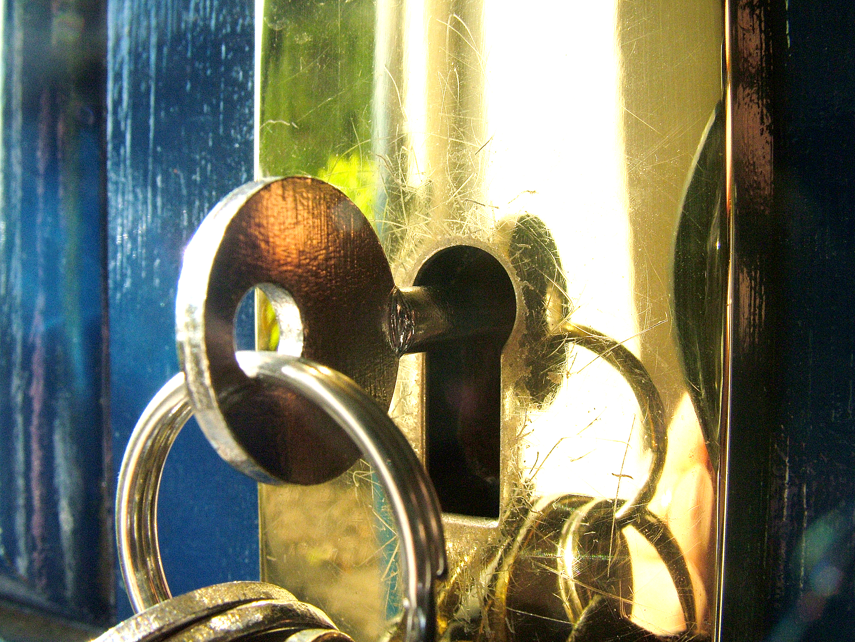
Myth #4: Virtualization is Not Secure
U.S. Department of Defense provides guidelines
Proper architecture & planning key

Slide 11

Myth #5: Consolidation ratios most important criterion
Vastly improved
disaster recovery
High availability
for all servers
Enhanced
performance
Significantly reduced
staff time requirements
“Green IT” benefits

Slide 12
Myth #6: Virtualization is Just for Servers
A Holistic Virtualization
Data Center
Servers
Storage
-Network
Disaster
Recovery
Desktop

Slide 13

Myth #7: Desktop Virtualization has no Return on Investment
IDC study shows $602 saved per desktop per year
Improved security
Ubiquitous desktop access
Enhanced user productivity
Improved Disaster Recovery
Reduced remote site network
infrastructures

Slide 14

Physical Desktops: The Bane of IT
Support Challenges
Management Challenges
Security Challenges
Cost Containment
challenges
Disaster recovery
challenges

Slide 15
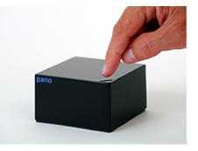
What is Virtual Desktop Infrastructure?
Running desktops as virtual machines in the data center along with physical servers
Virtual machines assessed via protocols such as RDP, ICA & PCoIP
Users access virtual desktops via multitude of devices including PCs, Macs, thin-clients & zero-clients

Slide 16

VDI Advantages
Same look and feel
Complete application isolation
Easily managed with familiar tools
Experience close to that of
a rich desktop
Flexible scalable –
tremendous industry support

Slide 17
5-Year Costs: Physical vs. VDI
Unit
Physical
Virtual
Savings
PCs (2,400 @ $700 every 4 yrs)
$2,100,000
-
$2,100,000
Laptops (600 @ $1.000 every 3 yrs)
$1,000,000
-
$1,000,000
Electricity
$ 187,000
$ 9,000
$ 178,000
Purchasing Panos as PCs die
$ 864,000
< 864,000>
SNS on VMware View (75% concurrency)
$ 504,000
< 504,000>
SNS on Panos
$ 360,000
< 360,000>
Refreshing UCS blades
$ 376,000
< 376,000>
IT Help Desk HW-Related Support
$4,320,000
$4,320,000
Backup license costs
$ 525,000
$ 525,000
Total
$8,132,000
$2,113,000
$6,019,000

Slide 18
Sample VDI Investment
Unit
Cost
VDI Licenses
$635,000
Storage
$300,000
UCS: 21 blades & 3 chasses
$465,000
Services/Training
$150,000
Total
$1,550,000 vs. savings of $6M
ROI=289% over 5 years. 15.4 months payback

Slide 19
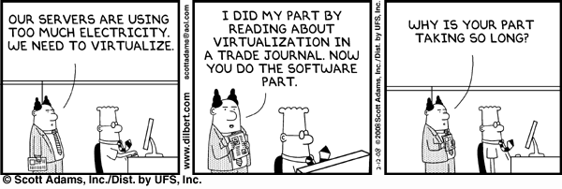
Myth #8: Virtualization is Bleeding Edge
IDC/Forrester: 30% of servers now virtualized
Gartner: $63B VDI market by 2013 = 40% of professional PC market

Slide 20


Network and Physical Servers Today
Myth 9: Virtualization is simple
X86 Virtualization
The Access Layer is Still There, But It’s Now Virtual
Switch
Hypervisor
Hypervisor
Switch
Soft
Switch
Switch
Soft
Switch
Server
Server
Server
Server
Server
Server

Slide 21
Myth 10: Storage is Storage
  Inadequate Spindle Count
  Resolution: Use MetaLUNs, Aggregates, etc.
  Zoning
  Resolution: One HBA & one-to-many targets
  Storage Management
  Resolution: Use Management SW such as Lifecycle Manager or Hyper9
  Backup
  Resolution: Backup at .vmdk level

Slide 22

Roadmap to Virtualization Success
Envisioning
Assess
Plan
Train
Pilot
Managed roll-out

Slide 23
Additional Resources
You can find additional information about the topics and products covered in this session at the following links:
    vmware.com
    citrix.com
    Microsoft.com
    dabcc.com
    Inxi
    bythebell
    www.twitter.com/roidude
Other resources
    steve.kaplan@inxi.com

