Slide 1

Building Tomorrow’s Applications
Wisconsin Digital Government Summit
Jeff Bradfield and Wil Carroll
Deloitte Consulting LLP
December 2, 2008

Slide 2
The age of the intentional silo is long gone. Today, secure, integrated and adaptable services are the foundation for data sharing, online offerings and cost savings. What are the most effective approaches and practices? What is Service Oriented Architecture (SOA) and what does it offer? This session will look at techniques, strategies and practices that are fundamentally changing government applications.

Slide 3
Point of View – Building Tomorrow’s Application
Service Oriented Architecture (SOA) is an important part of, but not the complete answer to building tomorrow’s applications

Slide 4

Quick Quiz #1:
According to Gartner, name a top reason organizations have decided to implement SOA

Slide 5
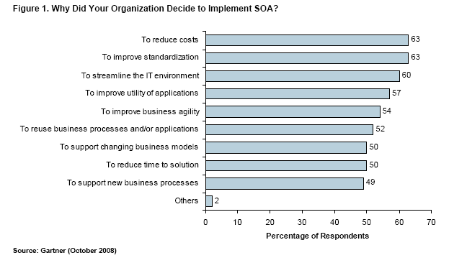
Here’s what people have told Gartner

Slide 6
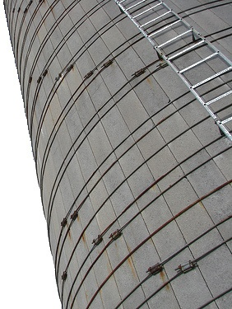
What are people attempting to overcome?
Applications that are:
  Expensive
  Non-standard
  Not streamlined
  Not agile
  Not reusable
  Not flexible/adaptable
  Take a long time to implement

Slide 7
Where did these silos come from?
“Silo” applications are the result of more fundamental silos that exist within the broader context of Government:
Organizational Silos: In many cases much more rigid then in the private sector by design
Technology Silos: Hardware, software and networks that don’t or simply can’t connect
Legal and Policy Silos: In place to protect citizen’s information and confidentiality and to achieve specific policy goals
Funding Silos: Existing in part as a result of the way the Government (particularly Federal) budgets for
In order to design applications of the future, these silos must be recognized and carefully planned for

Slide 8
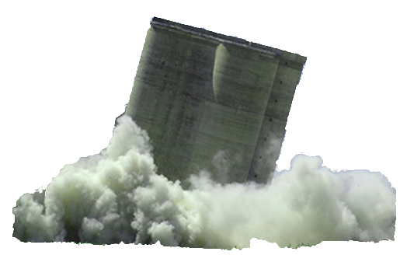
The Challenge – Breaking Down the Silos
Building applications that avoid the influence of, and in some cases even break down, these silos
Organizational Silos
Build Constituent Centered Applications as Opposed to Organization Centric Applications
Technology Silos
Leverage Service Oriented Architecture (SOA) to promote application re-use
Legal/PolicySilos
Promote Data Sharing and Integration
Funding Silos
Identify Creative Approaches to Cost Sharing and Allocation

Slide 9
Breaking Down Technology Silos
The Role of a Service Oriented Architecture (SOA)

Slide 10
Quick Quiz #2
Order the following by the number of Google hits received by searching on the term:
Barack Obama
Britney Spears
SOA

Slide 11
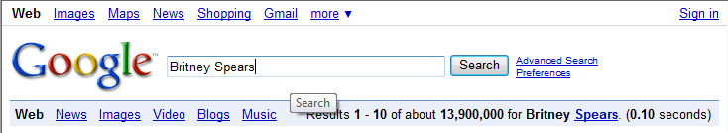
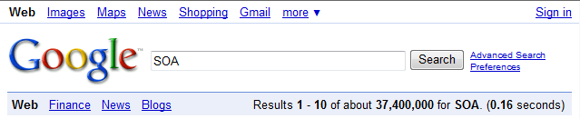
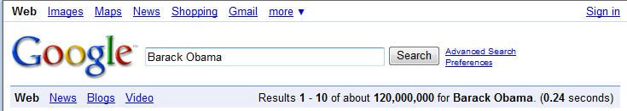
Higher than Britney, lower than the President Elect

Slide 12
In computing, Service-oriented architecture (SOA) provides methods for systems development and integration where systems group functionality around business processes and package these as interoperable services. SOA also describes IT infrastructure which allows different applications to exchange data with one another as they participate in business processes. Service-orientation aims at a loose coupling of services with operating systems, programming languages and other technologies which underlie applications.
– Wikipedia
“Quote” (optional)
  – Quote source

Slide 13
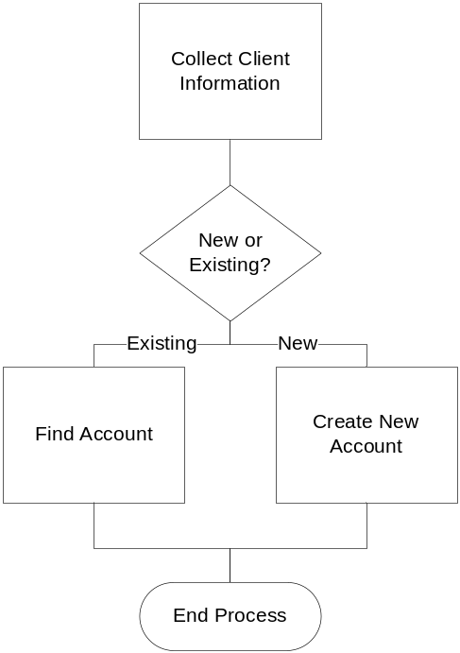
So What Does this Look Like?
Based on this one (and by no means only) definition of SOA, what does this look like in practice?
Functionality Grouped Around Business Process
Package it to Make it Interoperable
Exchange Data
Loose Coupling
Service A
Service A
Service A
Client Account
OS
DB
Service B

Slide 14
But the Truth About SOA…
You can build a perfect “silo” application using a Service Oriented Architecture
Organizational Silo
Service A
Service B
Technology Silo
Service C
Legal/Policy Silo
Service D
Service E
Funding Silo
Service F
SOA for SOA’s Sake

Slide 15
So What Is SOA Getting Us?
Business process defines how the technology is grouped and packaged not vice versa
Forcing us to define and standardize the inputs and outputs
Providing a common “language” for applications to communicate between each other
Makes us less dependent on the underlying technical infrastructure
If you can break a hole in the silo, it gives the “service” the ability to live on its own
Service A
Service B
Service C
“Hi World!”
Service D

Slide 16
Approaches and Practices to Breaking Open the Silos
Organizational Silos
Massachusetts Virtual Gateway Case Study
Technology Silos
Building a Technical Reference Model
Legal/PolicySilos
Common Application Case Study
Funding Silos
Open Discussion

Slide 17
Breaking Down Organizational Silos
Through Constituent-Centric Applications:
Massachusetts Virtual Gateway Case Study

Slide 18
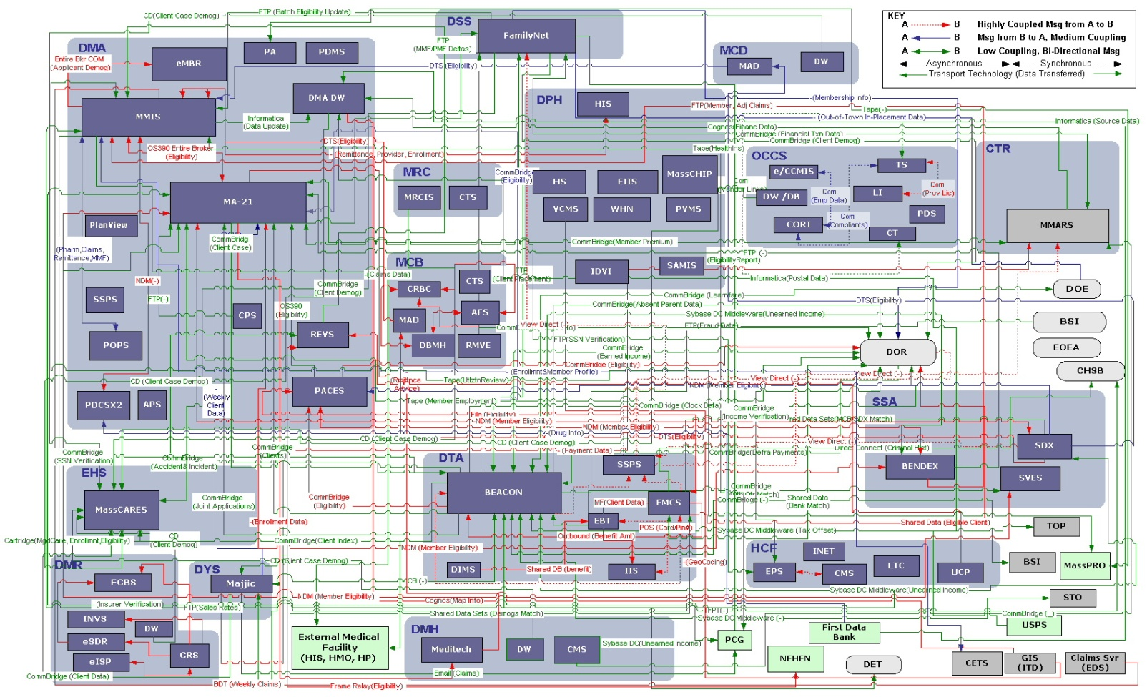
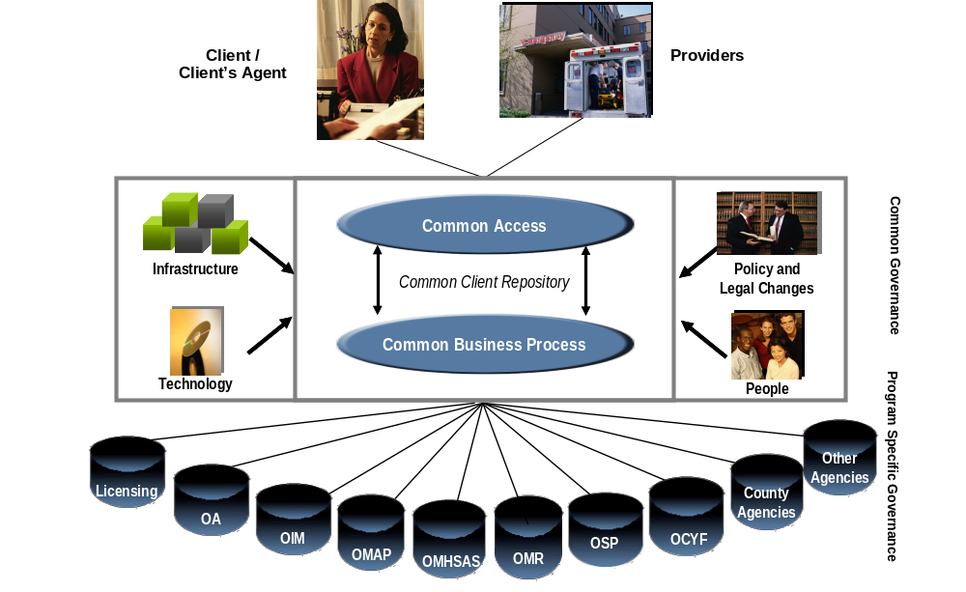
The Mission
Build a ‘Virtual Gateway’ to Human Services using Internet technology to ease access for citizens and providers and create one virtual front door to Government:
A coordinated single point of access for citizens and providers
Transform from a complicated maze of technology and processes……to:

Slide 19
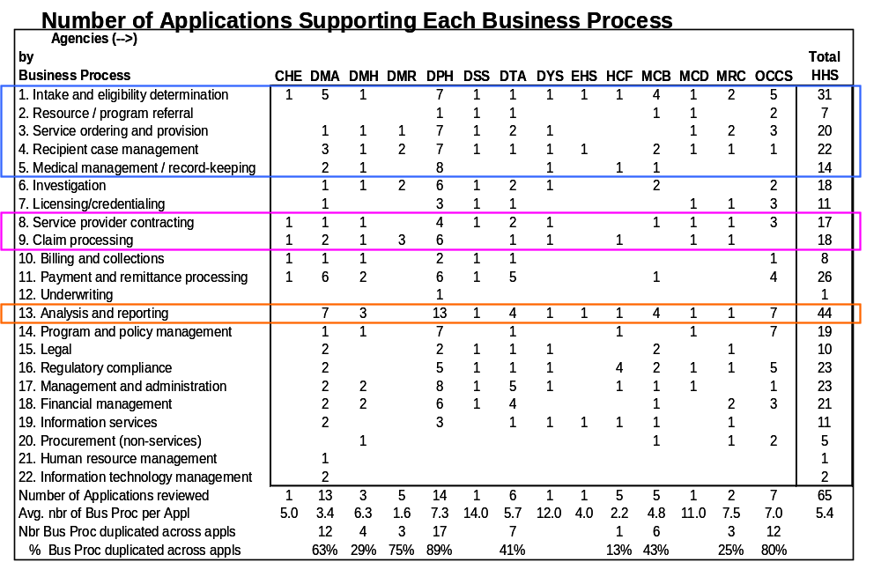
The Approach – Start with Common Business Processes
Identify the highest impact business processing and enable them through the Virtual Gateway using an incremental approach. Seek out opportunities to deploy application functionality as re-usable services instead of building more siloes.
Intake and eligibility determination, for example, is supported by 31 different systems (May 2003)
  Indicates individualized solutions for specific programs
Information is not easily integrated across HHS as a result, due to fragmentation of operational support of business processes
Funding sources are scattered and unnecessarily duplicative

Slide 20
The Ground Rules
None of which are rocket science, but they have been key to the Virtual Gateway’s success
Unified role based security
Web based
Customer/client centric taxonomy and design
Adherence to a single look and feel
Leverage Service Oriented Architecture (SOA) as a guiding architectural principle

Slide 21
The Resulting Application Solution
2004
2005
2006
2007
Current Activities
in 2008
New Services: Program Catalog Screening Common Intake - Provider | New Services: Resource Information Locator | New Service: Common Intake – Citizen | New Services: My Account Page | New Services: Streamlined Renewals Third Party Intake
New Programs: Food Stamps MassHealth Child Care Women’s Health Network Substance Abuse (Screening Only) WIC | New Programs: Services for the legally blind Services for those with a mental health condition Services for those with mental retardation Services for the deaf and hard of hearing Vocational rehabilitation services Home Care for Elders Services for Veterans’ | New Programs: Food Stamps (Citizen) Housing (Citizen and Provider) | New Programs: Men’s Health Network Substance Abuse (Intake) Family Planning Early Intervention | New Programs: My Account Page (Citizen) Streamlined Renewals (Citizen)
Milestones: Go Live! Successfully supports Uncompensated Care integration into MassHealth Positive Globe Editorial | Milestones: Roll out to all acute hospitals and community health centers complete 100,000th Application ComputerWorld Honors Laureate | Milestones: Shared Insights Portal Excellence Award Finalist 300,000th Application | Milestones: Successfully supports Healthcare Reform Commonwealth Care roll out 350,000th Application | Milestones: 500,000th Application Ability for online renewal of MassHealth Applications
Graph Represents Cumulative # of Applications Received By Month
Notes:
In general, the point of this slide is to illustrate that IE&R has been a continued work in progress with incremental additions each year since go live
The dark blue area of the curve is the projected volume for the remainder of 2008 based on the average monthly volume for the past 3 months

Slide 22
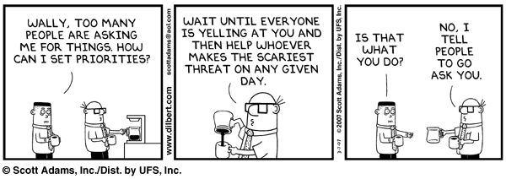
Virtual Gateway Governance Lessons Learned
Multiple Team Approach
Defining Roles and Responsibilities

Slide 23
Governance – Multiple Team Approach
Representation | Steering Team | Management Team
EOHHS IT | Tom Curran Sharon Wright | Ken Maxwell
EOHHS Security | Jennings Aske | N/A
Office of Medicaid | Tom Dehner | N/A
Operations | Russ Kulp | Don Novo
Finance | TBD | N/A
EOHHS PMO | Sharon Reidbord | IT PMO Designee
Program Offices | MMT Designees* | MMT Designees*
Meeting Chair | Medicaid Director or Designee | TBD
Meeting Schedule | Bi-Monthly | Weekly
Steering Team (MMT)
Management Team
  Set the strategic direction for systems
  Review and approve/deny Project Scope Documents
  Review and approve/deny Project Business Assessment Documents
  Review and approve/deny release plans
  Review and contribute to Project Scope Documents
  Review and contribute to Project Business Assessment Documents
  Propose release plans
  Manage change control process
  Bundle and prioritize maintenance items and defects
  Mitigate risks and resolve issues and action items
  Allocate resources to project teams
*Note: Representatives should only attend if they are stakeholders in active projects.
Neither team should attempt to be “all inclusive”. Members need to have a vested interest, buy-in to the process and a willingness to commit to making it work

Slide 24
Governance – Defining Roles and Responsibilities
*Note: Involvement by these groups will be ‘as needed’.
 | MassHealth IT Steering Team | MA21 Management Team | Executive Sponsor | MassHealth Project Support Unit | EOHHS IT Architecture Team | EOHHS Security Team | EOHHS IT PMO | MassHealth IT | MassHealth Operations | Legal* | Publications* | Finance*
Project Intake
Create Project Scope |  |  | A/R | C
Collect Project Scope Feedback |  |  |  | A/R
Provide Project Scope Feedback |  |  |  | A | R | R | R | R | R | R | R | R
Review and Approve/Deny Project Scope | A/R |  | C
Create Business Assessment Document |  |  | A/R |  | C | C | C | C | C | C | C | C
Provide Business Assessment Document Feedback |  |  |  |  | C | R |  | R | R | R | R | R
Create Proposed Release Plan |  | A/R | C
Review and Approve/Deny Release Plan | A/R | I | I | I | I | I | C | I | I | I | I | I
Maintenance & Defect Management
Document Defects |  |  |  |  |  |  |  | R | R
Document Maintenance Items |  |  |  |  |  |  |  | R | R
Assign Items to Bundles |  | A/R
Prioritize Bundles |  | A/R |  |  |  | C
Assign Bundles to Releases |  | A/R
Key: R=Responsible A=Accountable C=Consulted I=Informed

Slide 25
Breaking Down Technical Silos
Building a Technical Reference Model

Slide 26
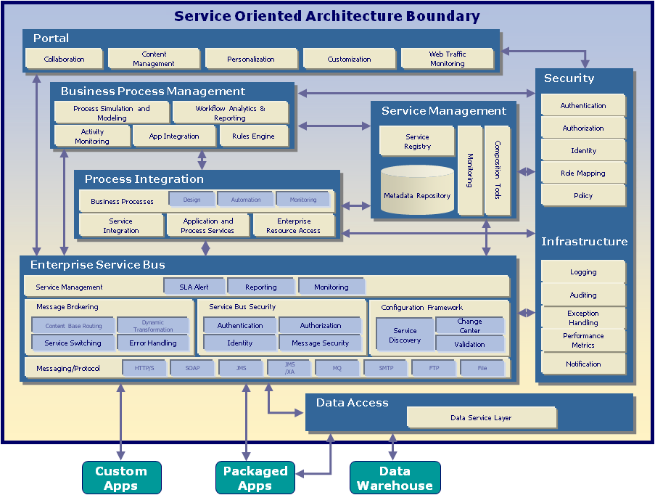
Target State – SOA Capable Enterprise Architecture

Slide 27
Getting There – Tips from the Other Side
Assessment
Develop Framework
Develop Roadmap
Current Capabilities and Future Needs
Develop the TRM
Incremental Roadmap Based on Implementation Priorities
A cohesive TMR can not be grown organically, it requires planning and governance
A TRM is not simply standards. It must include solutions and can include multiple options
Don’t let your vendors decide this for you! A vendors lowest cost solution that does not adhere to the TRM may be higher

Slide 28
Breaking Down Legal/Policy Silos
Common Application: “In the Weeds” Case Study

Slide 29
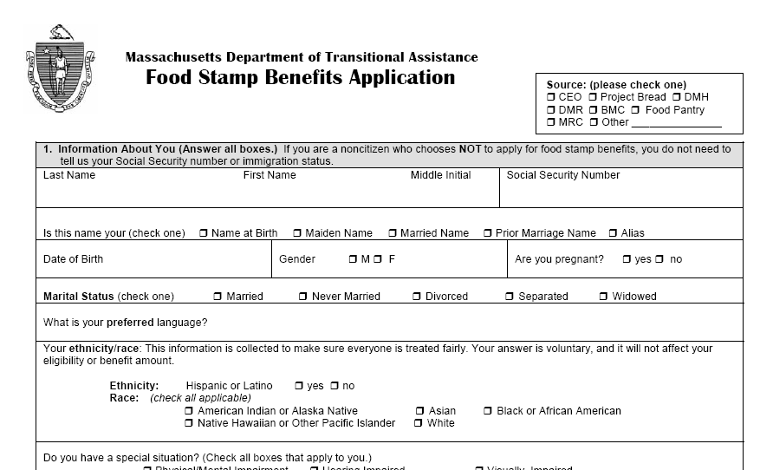
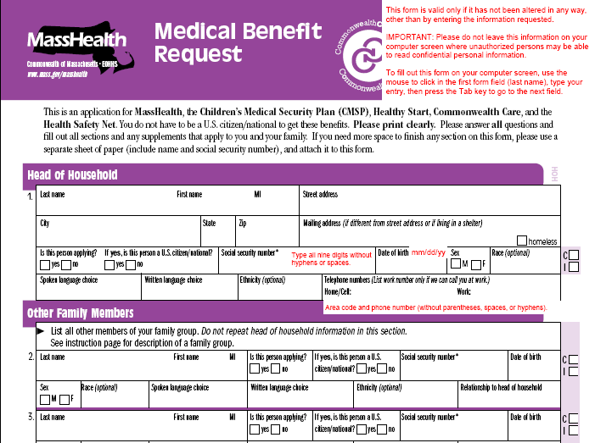
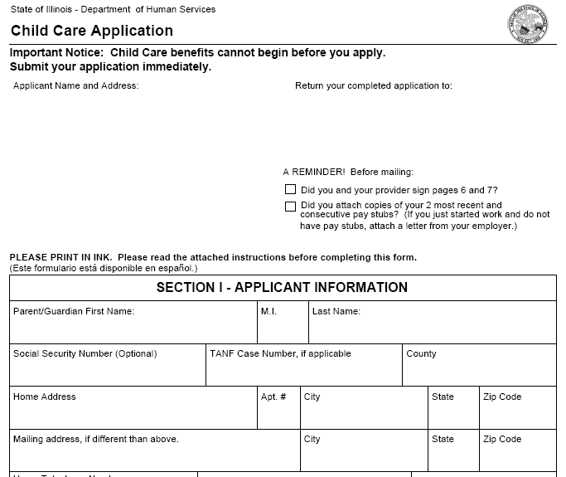
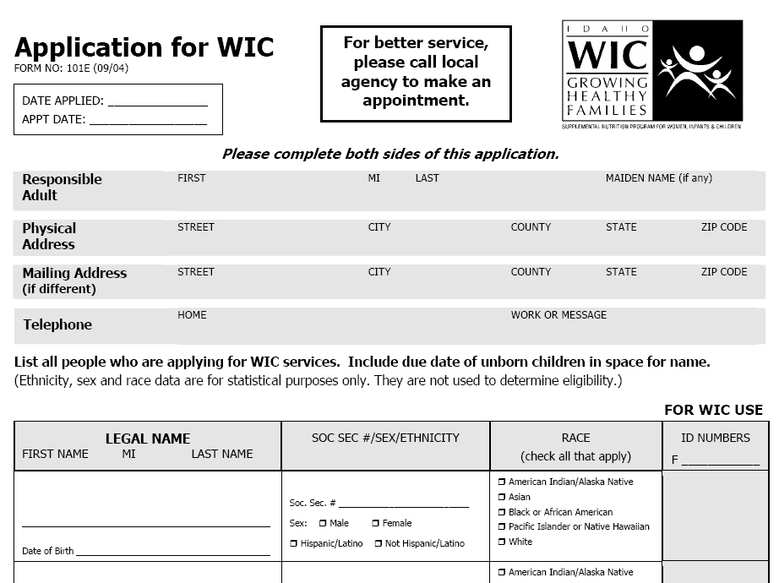
Business Problem: Repetative data collection, entry, storage

Slide 30
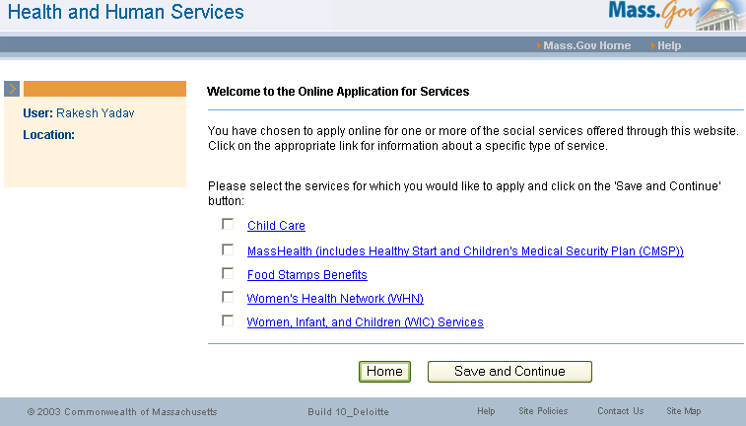
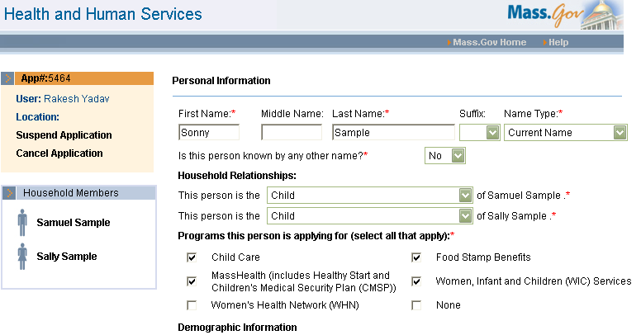
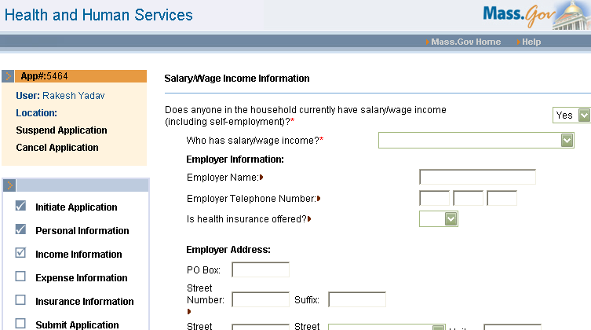
Solution: Common online application for services
Provider initiates application for one or more Programs/Services
Provider enters personal, income, expense and insurance information for each person in the household…
30

Slide 31
Common Intake: Data Sharing Issues and Challenges
What?
How?
Why?

Slide 32
Common Intake Challenge – What?
Medicaid
Food Stamps
What?
Child Care
WIC
Are you or any family member currently working or seasonally employed?
How?
Capture the Universe
Rationalize
Are you or is anyone living with you presently working, or were you or anyone else living with you working in the last 60 days?
Why?
Common Form

Slide 33
Common Intake Challenge – What?
What?
Are you or any family member currently working or seasonally employed?
Are you or is anyone living with you presently working, or were you or anyone else living with you working in the last 60 days?
How?
1. Does anyone in the household currently have salary/wage income (including self-employment)?
2. Who has salary/wage income?
Why?
3. Wage Type

Slide 34
Common Intake Challenge – What?
What?
What Kind of Income?
Medicaid Income
Day Labor
Earned Wages
Sheltered Workshop
Self Employed
Conditional Wages
Food Stamps Income
Americorps OJT
Federal Work Study
Full Employment Income
JTPA
Non-Federal Work Study
Self-employment
Sheltered Workshop
Student Earnings
Summer Youth E & T
Youthbuild
How?
Why?

Slide 35
Common Intake Challenge – What?
What?
Compromise, Map and Block
Common Value | Mapped Medicaid Value | Mapped Food Stamp Value
Americorps OJT | BLOCKED | Americorps OJT
Day Labor | Day Labor | Wages
Federal Work Study | BLOCKED | Federal Work Study
Full Employment Income Program | BLOCKED | Full Employment Income
JTPA | BLOCKED | JTPA
Non-Federal Work Study | BLOCKED | Non-Federal Work Study
Self-Employment | SLFEMP | Self-employment
Sheltered Workshop | SHELTR | Sheltered Workshop
Student Earnings | Wages (Conditional) | Student earnings
Summer Youth E & T | BLOCKED | Summer Youth E & T
Wages | Earned Wages | Wages
Youthbuild | BLOCKED | Youthbuild
Seasonal Employment | BLOCKED | Wages
How?
Why?

Slide 36
Common Intake Challenge – Why?
What?
I also give permission to DTA to share information about me, my dependents under age 5 and anyone pregnant in my household with the Department of Public Health so that these individuals are referred to the Women, Infants and Children (WIC) Program for nutrition services.
We use the information you give us only for the administration of MassHealth. This means that we may need to share this information with our contractors and other entities.
How?
"I understand that other EOHHS agencies may use the information I have provided in this application in future applications if I apply for other EOHHS services. I understand that EOHHS/applied programs may share with a hospital, community health center, other medical provider, or the other applied programs the status of my application(s) when that is necessary for treatment, payment, operations or the administration of the program I am seeking services from.
Why?

Slide 37
Breaking Down Funding Silos
Open Discussion

Slide 38
Funding the Application of Tomorrow – Open Discussion
Funding the development and operation of SOA infrastructure is the single largest governance challenge that State Governments face. This challenge typically exists at two levels:
Internal Cost Allocation - Deciding how to cost allocate up-front investments and downstream operations across organizational boundaries (i.e., across Departments that share services, or even within Departments across Divisions)
External Cost Allocation - Working within the Federal Cost Allocation Methodologies when sharing services with programs that receive federal funding

Slide 39
Funding Challenges:
Funding the development and operation of SOA infrastructure is the single largest governance challenge that State Governments face.
This is primarily a cost allocation challenge that exists at two levels:
Challenges:
Common Perceptions:
Internal Cost Allocation - Deciding how to cost allocate up-front investments and downstream operations across organizational boundaries (i.e., across Departments that share services, or even within Departments across Divisions)
“If I’m the first one to subscribe to a service, I will pay more of the up-front costs than anyone else that follows.”
“It would just be cheaper to continue to develop my own applications rather than share services.”
“I can buy these services cheaper elsewhere.”
External Cost Allocation - Working within the Federal Cost Allocation Methodologies when sharing services with programs that receive federal funding
“Federal funding rules don’t allow me to share costs across other program areas.”
“My program area will pay disproportionately more for up-front costs because of the availability of federal funding.”
“We may be audited if we share services across program areas.”

Slide 40
The Reality:
The issue of cost allocation/cost sharing is a challenge, but one that is surmountable:
Internal Cost Allocation Best Practices:
Develop allocation criteria that align costs with the levels of service and value received by the consumers of the services
Develop incentives (i.e., preferable pricing) for people to consume services, and penalties for those that don’t
Collaboration between IT and Finance arms of the organization to ensure there is agreement on the ROI for services and sound justifiable savings
External (Federal) Cost Allocation Best Practices:
Develop a funding strategies that leverages federal funding streams, but works within the rules defined by federal cost allocation methodologies
Look for lessons-learned from existing federal programs (i.e., Medicaid) that have embraced SOA and developed robust cost allocation rules
  CMS has created the Medicaid Information Technology Architecture (MITA), a SOA-based reference model for Medicaid. Enhanced federal funding is available for States that develop their Medicaid architectures consistent with the model and the principles.

Slide 41
Closing Thoughts:
Government applications of the future must shift from being organization-centric to being more constituent centric
SOA offers an architectural approach to developing constituent-centric services, but it is not a silver bullet
  Technology is the least of your worries in this transition. Organizational, Policy, and Funding barriers are more complex and will be the most difficult silos to break down
Don’t do SOA for the sake of doing SOA – there needs to be a strong business case and a structured roadmap
Take a business process approach to identifying high ROI candidate services. Focus on those first, build momentum, and go from there
Pay attention to the governance issues

Slide 42
Questions/Discussion?

Slide 43


Copyright © 2008 Deloitte Development LLC. All rights reserved.

