Slide 1
Virtualization
Glen Coleman
Enterprise Architect, Security Officer
Ohio Department of Health

Slide 2
Discussion Outline
Virtualization 101
  Adapted from an article by Kevin Lo, October 2007
General Comparison
How We Chose To Deploy Virtualization
Q & A

Slide 3
Virtualization 101
Imagine only being able to run one software program at a time on your computer. What if, in order to check your E-Mail, you had to turn off your Office application? What if you had to close your PDF reader in order to surf the Internet?
While we take for granted that we can use more than one software application at a time, we seldom consider running more than one operating system at once. Yet the burgeoning field of virtualization software — programs that allow you to run multiple operating systems simultaneously on a single computer — is allowing organizations to turn one computer into many, saving time, money, and space.

Slide 4
The Virtual Experience
Although virtualization is not the only method of running multiple operating systems, (another way is to partition your hard drive and create a PC that can run two or more operating systems), it has the distinct advantage of being fairly easy to use.
Under the hood, virtualization software runs like any other application. To get started, you power up your PC, load the virtualization program, and install a "guest" operating system from its install CD or DVD (When you install operating systems in an emulated hardware environment, they're called guest operating systems or "virtual machines," while the main operating system is called the "host.")
Once the virtualization software is running, each subsequent operating system you install on your PC will act like a new computer. For instance, you might run Vista on your PC, two Windows 2003 Server VMs, and three Windows 2008 Server VMs — for a total of six ‘computers’ (five guests (VMs) and one host (PC)) – all of which you could access at simultaneously. On the network, each server would appear as a unique system. You could run programs, share files, and do anything on these guest systems that you could do with a real computer.

Slide 5
The benefits of virtualization
Depending on your IT architecture, the nature of your work, and your IT budget, virtualization software can offer a variety of advantages to your nonprofit.
Server Consolidation
  One of the primary benefits of virtualization software is that it allows you to increase the scale of your server infrastructure without purchasing additional pieces of hardware. (Keep in mind, however, that you may still need to purchase software licenses for the virtualization software, depending on the package you choose.)
Energy Conservation
  In addition to savings in hardware costs, virtualization software may also save you money on your energy bill. According to Energy Star, the energy costs for running a server for a year will soon exceed the price of acquiring it.
Improving Ease of Management
  Managing virtual machines is a lot easier than managing “real” machines, since hardware upgrades, for example, can be done with the click of several buttons, rather than having to power down the machine, install the hardware, verify the change, then power up again. Moreover, managing virtual machines can often be done via a console server, thereby reducing the time needed to deploy them.

Slide 6
The benefits of virtualization
(Continued)
Reducing Backup and Recovery Time
  Since virtual machines are essentially files, backing up and restoring them is a lot less time-consuming. And while the files can be huge, a directory of many 2-GB files is still easier to restore than a real machine of the same specifications. Moreover, hardware failures ― such as a failed hard drive ― will not affect virtual machines in the same way they would a physical machine. (Of course, the real hard drive on which the virtual machine reside needs to be backed up as usual.)
Testing Software Configurations
  Another way you can use virtualization software is for testing software configurations before deploying them on a live system. If you needed to verify whether a program is incompatible with your existing setup, for example, you may try testing in on a virtual machine first. This can be immensely useful for organizations that have legacy systems or applications and must test out systems before deploying them. Virtual machines can also interact with one another in virtual networks, allowing you to test server-client applications virtually.
Maintaining Legacy Applications
  If you do have old applications that have compatibility issues with newer software or that must run on a certain version of an operating system, you can dedicate a virtual machine just for those tasks. That way, your IT architecture and planning won't be constrained because of a few applications.

Slide 7
The benefits of virtualization
(Continued)
Maintaining a Cross-Platform Office
  It is not uncommon for offices that run mostly Macs to need to run one or two Windows-only programs; in this case, virtual software can be an affordable, easy way to do this. Note, however, that the reverse is not applicable; many virtualization applications for PCs allow you to run Linux, but not Mac operating systems.
Space Savers
  Not only is acquiring maintaining multiple computers costly, it can also take up a great deal of office space. Virtualizing your machines can free up space and reduce electronics clutter.
Despite its many benefits, keep in mind that virtualization software is not for everyone. There is a learning curve in both conceptualizing how virtual machines will function in your network and organization, as well as managing them reliably and cost-effectively. If your staff already has difficulty with “real” computers, you may need to consider the method for making which machine is the guest and which is the host extremely transparent to your staffers, or finding a way of explaining to them, in simple terms, how this will impact their day-to-day work, if at all.

Slide 8
Virtualization: a general comparison – the primary vendor options
The Virtualization Technology provider you choose will depend on what you need to accomplish with the technology. Other factors to consider include how many computers you currently have, your level of technical expertise, and the kind of technical support available at your organization.
If your organization is considering Virtualization technology, here are two most popular options you may wish to consider:
VMware
  ESX 3.5 Server
Microsoft
  Windows Server 2008 Hyper-V

Slide 9
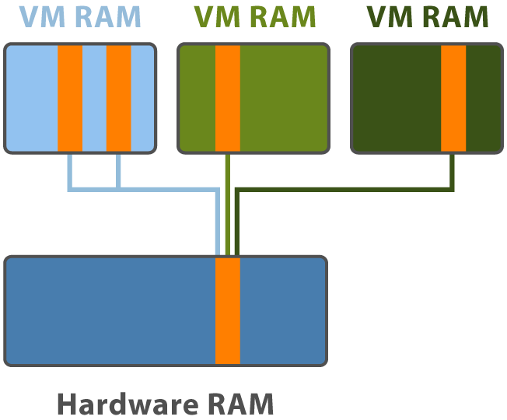
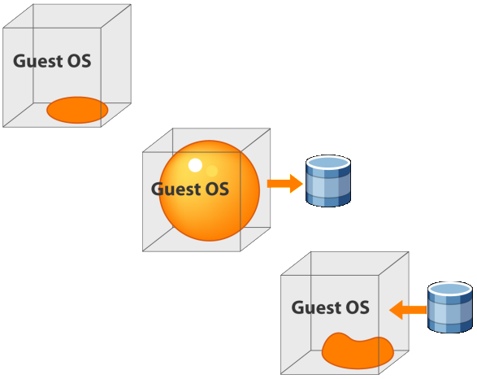
Virtualization:
The vmware perspective
Smarter Memory Management = Greater VM Density
TCO per VM is the Critical Metric!
Host system memory is usually the resource bottleneck
VMware memory management technology allows an average of 2 to 1 memory overcommit (and very often greater than 2 to 1)
Transparent Page Sharing
Memory Ballooning

Slide 10
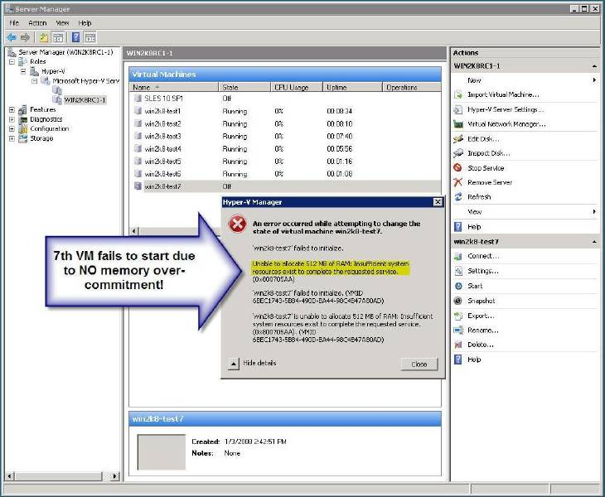
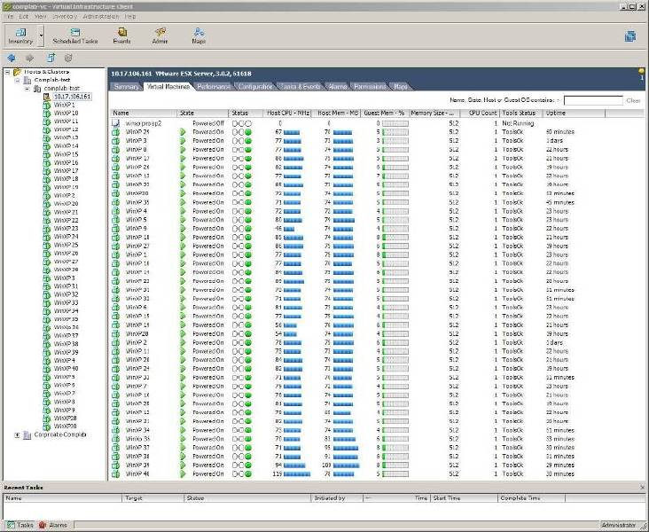
Virtualization:
The vmware perspective
Light workload*: 512MB VMs on Server w/ 4GB RAM Each
Microsoft Hyper-V:
With No Memory Overcommit
VMware VI3:
With Memory Overcommit
Error message after 6 VMs
40 VMs on VMware – No Errors!
* Windows Pinball Demo Mode

Slide 11
Virtualization:
The vmware perspective
Better VI3 Scalability Beats TCO of Free Competitors
 | VMware VI3 Enterprise | Microsoft Hyper-V | Citrix XenServer | Virtual Iron | Oracle VM | Red Hat RHEL5
2-way server (4GB RAM) | $6,000 | $6,000 | $6,000 | $6,000 | $6,000 | $6,000
Guest OS licenses¹ | $5,998 | $5,998 | $5,998 | $5,998 | $5,998 | $5,998
Virtualization license | $5,750 | $0 | $2,600 | $1,598 | $0 | $0
Subtotal | $17,748 | $11,998 | $14,598 | $13,596 | $11,998 | $11,998
Total VMs² (512M each) | 15 | 7 | 7 | 7 | 7 | 7
Cost per VM | $1,183 | $1714 | $2,085 | $1,942 | $1,714 | $1,714
plus …
VI3 Enterprise Edition includes management capabilities like VMotion, Storage VMotion, DRS, HA, Consolidated Backup, Update Manager, and DPM that competitors don’t have.

Slide 12
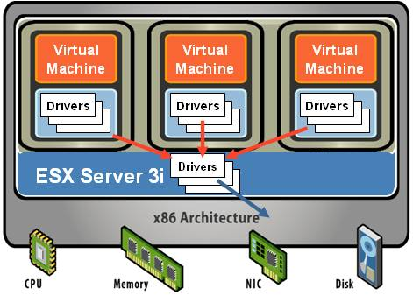
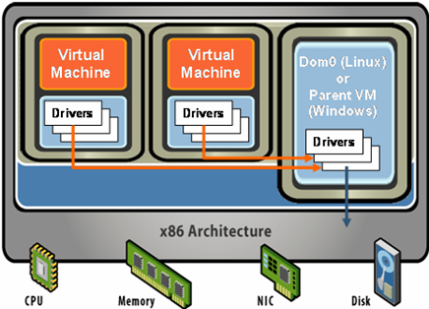
Virtualization:
The vmware perspective
ESX Hypervisor: Robust, Reliable Foundation
Hypervisors are NOT commodities
MSFT / Xen
VMware Architecture
MSFT / Xen Architecture
True thin hypervisor
No general purpose OS
Direct Driver Model = I/O scaling
Drivers Optimized for VMs
Page Sharing = Greater Density
Bloated general purpose OS in the Management partition
Indirect Driver Model
Generic Drivers in the Management partition
I/O throughput degradation under increasing load

Slide 13
Virtualization: some additional VMware Capabilities for Lower TCO
VMotion – Enables VMs to be migrated live from server to server
  For Planned Maintenance
Storage VMotion
  For Storage Management
Distributed Resource Scheduler (DRS)
  For Load Balancing Across a Cluster
High Availability (HA)
  For Automatic VM Restart After Unplanned Downtime
Update Manager for Patch Management
Site Recovery Manager (SRM)
  For Disaster Recovery Testing and Automation

Slide 14
Virtualization:
ODH's solution
In early 2006, when ODH determined that Virtualization was a technology worthy of review and was mature enough for deployment, we performed a great deal of research, to include the available information from both the public and private sectors, as well as researching Gartner’s perspective. We also reviewed the solution choices in the overall Virtualization market, and found that, from every perspective, the clear leader, at that time, was VMware’s ESX Server. We found that VMware already possessed a multi-year history in the marketplace, a mature solution with a wide customer base and were considered far and away the dominant choice for Virtualization software.
With that in mind, ODH contracted with a local vendor to perform a Virtualization Assessment – this is intended to outline, within your environment, the potential candidates for virtualization (i.e. the servers most ‘ripe’ for being made into virtual servers).

Slide 15
Virtualization:
ODH's solution
Once the vendor completed the Virtualization Assessment, we collaboratively developed a robust architecture to incorporate the Best Practices designs, allow for system growth and created a Disaster Recovery solution.
We’ve created one ‘Data Center’ containing groups of servers that deliver services in the external (a.k.a. the Demilitarized Zone (DMZ)) zone, in the internal zone (a.k.a. the ‘Inside’ or ‘Trusted’ area) and we’ve deployed a robust server for Test Lab services. We’ve deployed sufficient hardware such that we can withstand several physical server outages while maintaining server related services to each of the 2 primary zones (Inside and DMZ).
Disaster Recovery is a primary concern for ODH. To continue the discussion on Disaster Recovery, let me reintroduce:
Dan Griggs, Solutions Architect, Virtualization,
Servers & Storage Solutions Practice, Ohio Valley, CDW-G

