Slide 1

Geographic Information Systems
(GIS)
City of Lincoln\Lancaster County

Slide 2
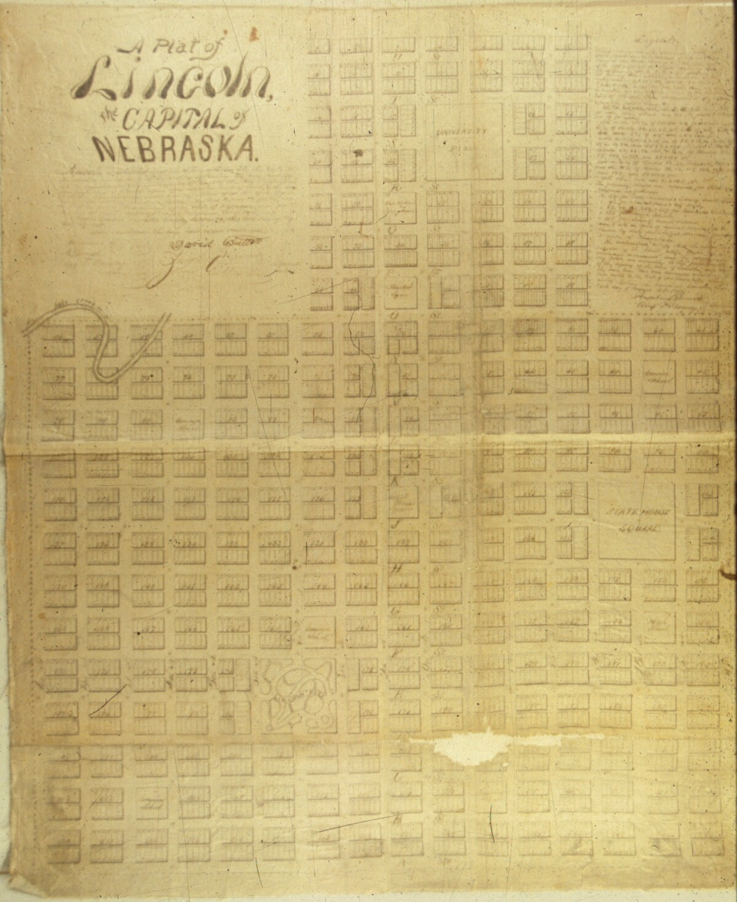



Agenda
Background\History
GIS Manager
Roles
Projects
Game Plan

Slide 3
Background/History
1980
1990
2000
“Most Communicative Map” Winner at ESRI International User Conference
County-wide Property GIS Website
Core departments develop common files, create network, and begin data sharing
GIS Administration Committee Formed via Inter-local Agreement
“Special Achievement in GIS” Award at ESRI International User Conference
Departments are added to network, with expanded training available
Engineering departments set geographic foundation (GPS & surveying) and begin developing “land base” files
Notes:
1989 - GPS Foundation @ Engineering to begin Landbase
1993 - Core Depts. Develop common file structure & data sharing
- “Most Communicative Map” Award
1998 - ESRI SAG Award
1999 - GIS Administration Committee formed via Interlocal Agreement
Planning, County Assessor, LES, County Engineering, Public Works, Information Services

Slide 4
Background/History
2000
GIS Program Manager
Position created
Departmental
GIS User Surveys
And
Beyond!
User-Based “GIS Visioning” Session
GIS “Tiger Teams”
formed
GIS Program
Manager Hired
GIS Admin. Team “Retreat”
GIS Master Plan created
Administrative “GIS Visioning” Session
Notes:
Around this time, the Admin. Team Recognized that the GIS system had “plateau’d” and that there was a need to have more of a common operating picture towards GIS
2003 – ESRI Hosted “GIS Visioning Workshop”
Develop a Master Plan
Unification of Landbase
Infrastructure Inventory & Database Development
Formalize Workflow
2003 – Admin. Team hosted User-Based “GIS Visioning Workshop”
GIS Strategic Plan
GIS Management Office
Training
SDE\Geodatabase Development (database)
Data Repository
2005 – GIS Master Plan hired out to PlanGraphics (because as a collective group, we all had our own jobs, none of which specialized in GIS, just common interests) From this study, a review was presented of options for the GIS Management & recommended that keep existing structure with proposed Manager position coordinating efforts between agencies. Centralized office was considered, but rejected.
Inter-local Agreements
GIS Program Management
Enterprise GIS Repository
Workflows
Training\Education
2006 – GIS Program Manager Position created
2008 – GIS Program Manager Position hired (January 2008)
2008 – Departmental GIS User Surveys
2008 – GIS Advisory “Retreat”
2008 – “Tiger Teams” formed based upon outcome of the Advisory Retreat
More to follow on this!

Slide 5
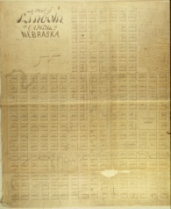





Administration Team
Team consists of representatives from:
  Planning Department
  County Assessor
  Lincoln Electric System
  County Engineering
  Building & Safety
  City Public Works
  Information Services
  Lower Platte South Natural Resources District
Notes:
The full responsibility of GIS does not fall onto a single agency represented above… The purpose of this team is to provide collaboration between all agencies, as opposed to “silo’ing” GIS-related data\resources.
As a sign of how this team operates in a collaborative effort, the GIS Manager position is fully funded by 1/7th representation from each agency

Slide 6
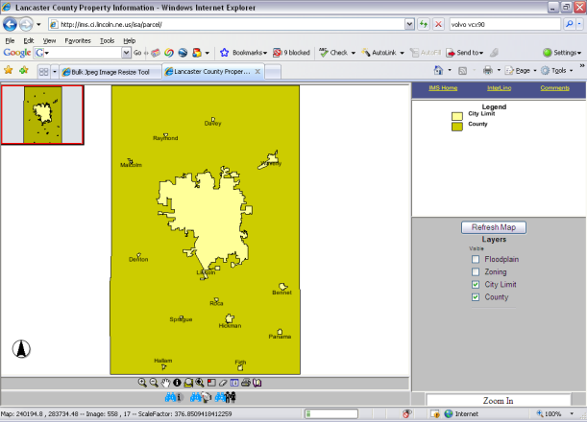
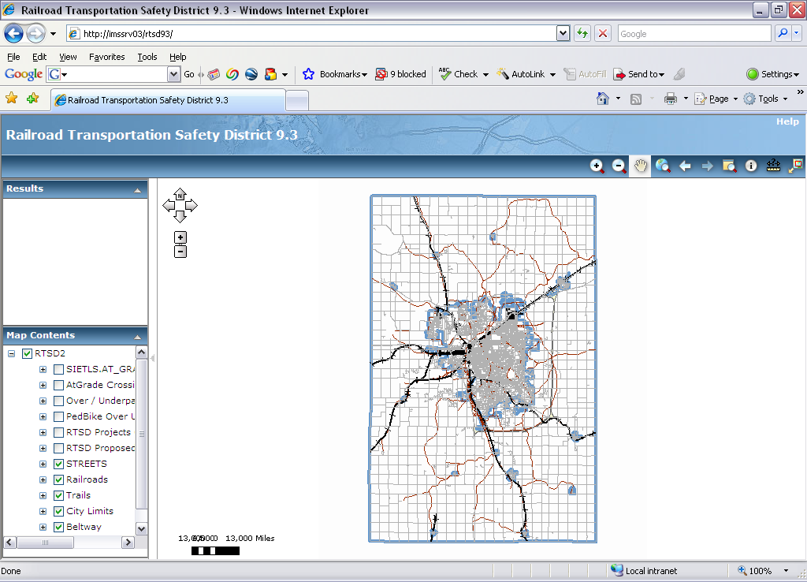
GIS Program Manager Role
Coordinate the management of the GIS Program
Plan for future of GIS Program
Marketing of GIS internally & externally
Maintain technical viability of GIS Program
Identify Cost Savings, Efficiency through existing resources
Eliminate Redundancy
Notes:
Focus on

Slide 7
Priority List
Landbase
Training
  Technical & User Group Meeting
Metadata Catalog
  What is out there
  Who owns it
  When was it last updated
  Where is it
SDE Geodatabase
  Technology review (admin & user)
  User understanding
  Criticalness of data
  Oracle support\staffing
  Failover\redundancy
  Architecture of the GIS File Server
Workflow
IMS\ArcGIS Server Issues
  Building ArcGIS Server applications
  “re-vamp” external IMS site
Communication Issues
  Executive Support
  Get User buy-in to Vision
Development Services Center (DSC)
Software\Hardware Coordination
GIS Product needs calendar
  Annual list of what the needs are
  Quarterly report of projects ongoing
Data Sharing Policies
Addresses
  E911 address vs. Bldg & Safety Address
Application Development
  Programming language Standards
  Support
Street Centerlines
Emergency Preparedness
  Police\Emergency Mgmt.\Fire\etc.. where can GIS benefit all groups most effectively?
Helpdesk
  Develop contact list for user questions
Accessibility to GIS Data
  Define Security Levels
    1-3 levels
    1-5 levels
    IMS
    Editor
    Administrator
  GIS Access Form
    Integrate with security level access
      How do we determine this?
    Redraft to account for access structure
GIS Admin Committee in Writing
  Where’s the Hammer?
  Roles of Admin. Team\GIS Program Manager
  Prioritization of projects – learn when to say ‘No’
  Commitment of Parties
    Dollars & Bodies
  Make sure GIS Program Manager Succeeds
Good of the whole vs. good of the self
  Political Standard
Marketing
  Identity Branding
Improve CAD\GIS Integration
Renegade databases
Funding
  Grants
  Reality of Funding due to tight budgets
Written Standards
  Consultant input\export (ie. Antelope Valley data received in multiple formats)
  Enforcement
    (see #1a in Low Priority list!)
Revamp MOU\Inter-Local Agreements
  To meet security needs
  To define roles
    (see #1a in Low Priority list!)
Notes:
Armed with the Visioning sessions, GIS Master Plan, and the series of User meetings, the GIS Administration Team met in the spring of 2008 to wrap this all into a list of items. THIS list is not in any particular order, but what the team did was prioritize these into 3 categories – High, Medium & Low. The following projects were identified as the top 4 of the “High” category.

Slide 8
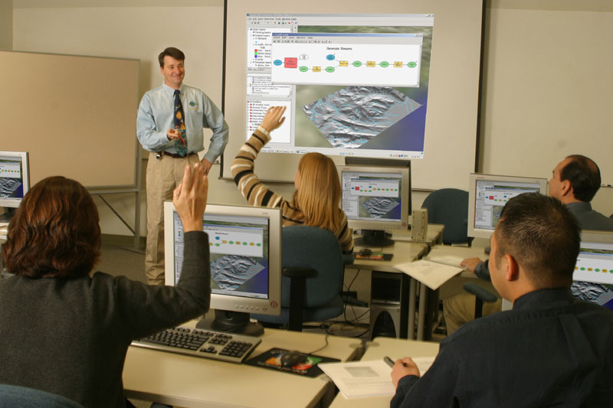
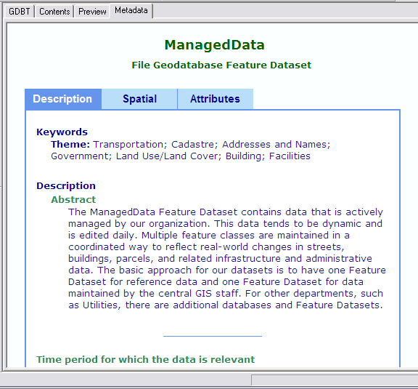
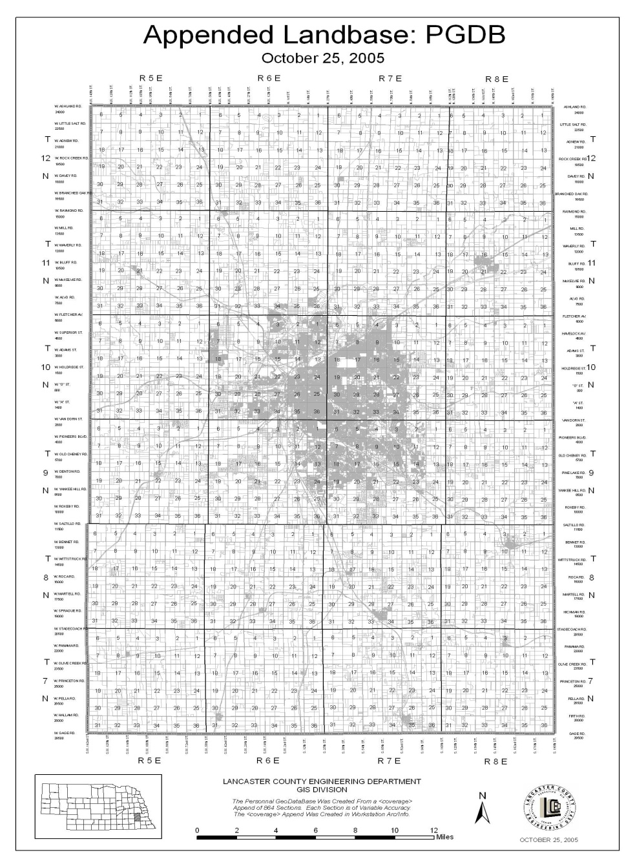
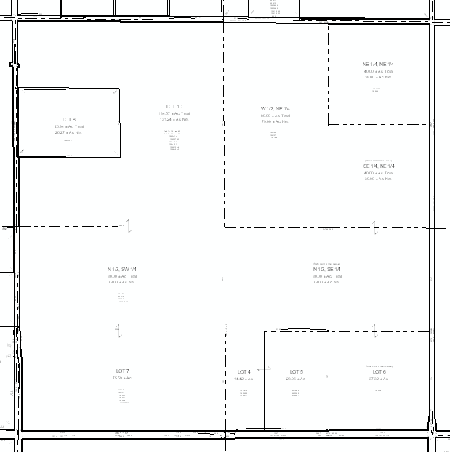
Priority Projects
Technical & User Group Training
Unified Landbase
Geodatabase
Metadata
Single, Integrated Repository of GIS Data
Planning
Water
Sewer
County
Engineering
Bldg & Safety
County
Assessor
Internal Network
External Network
Lower Platte South
NRD
LES
Sharing Build Enterprise GIS Timeliness of Updates Ownership Single Repository
Facilitate User Group Meetings Solicit User Feedback Respond To User Needs
Increase Efficiency Reduce Redundancy Increase Accuracy Single Repository
Document Data Ownership, Currency, etc. Tools to locate information Standards
Notes:
Other projects include participation in the following;
Fire Department GIS
Multiple Public Works GIS Conversion\Integration projects
Landfill
Water
Storm Sewer\Watershed Management
Sanitary Sewer
Traffic
Markings
2007 Aerial Project Delivery
Reviewing Licensing
Costs (new purchases, maintenance)
Upgrading (bring users to current versions)

Slide 9





Previous Departmental GIS “Selling”
People
Software
Data
GIS
Procedures
Hardware

Slide 10

..or SILO’s of Data can be brought together using GIS

Slide 11
Result = Departmental GIS’s
Planning
Department
Water
Department
Wastewater
Department
Bldg & Safety
County
Engineering
County
Assessor
Health
Department
Lincoln
Electric
System
Traffic
Operations
Watershed Management
Lower Platte South
NRD
Storm Sewer

Slide 12
..or SILO’s of GIS!

Slide 13
Current GIS “Selling”
Billing
System(s)
Single, Integrated Repository of GIS Data
Planning
Water
Sewer
Permitting\
Licensure
County
Engineering
Bldg & Safety
County
Assessor
CAMA
Internal Network
External Network
Citizen
Information
Lower Platte South
NRD
LES
Notes:
Focus on Integration with GIS at the core

Slide 14


Game Plan
Finalize Tiger Team Recommendations
Admin. Team Prioritize recommendations
Further the concept of “Enterprise GIS”
Identify GIS Integration Possibilities
Continue to identify efficiencies
GIS Software Updates
GIS Software Licensing
Education\Training
Notes:
Begin User Groups – this will initiate a “Enterprise Community” approach to GIS

Slide 15
Questions?
Notes:
Because the DSC is in its infancy, and we are unsure of where it will end up, it’s our belief at this time that the stars are aligning themselves to allow the City of Lincoln\Lancaster County Enterprise GIS program to become a more efficient tool for decision making.

