Slide 1

Server Virtualization
Gene Mortensen
Enterprise Architect/Chief Architect
Bob Erdelen
Industry Standard Server Specialist

Slide 2
Agenda
What is Virtualization
Business Advantages of Server Virtualization
Industry adoption
Technical Overview of x86 Virtualization with VMWare
Operational Advantages
Challenges of Virtualization
Desktop Virtualization
Financial Advantages of Virtualization
TCO Study
Futures

Slide 3
What is Virtualization
Virtualization - a broad term that refers to the abstraction of computer resources (Wikipedia)
Types of Server Partitioning and Virtualization
  Hardware Partitioning – HPUX NPARs, Sun Domains
  Operating System level Virtualization - where the kernel of an operating system allows for multiple isolated user-space instances
    Sun Containers/Zones
    Linux VServer
    IBM AIX WPARs
    HPUX Resource Partitions
  System virtual machines (VMs) - allows for the sharing of a servers underlying physical resources between different virtual machines
    Involve a hypervisor technology
    Each VM contains a complete operating system
    Allows for multiple operating systems on a single physical server
    HPUX Integrity VMs, HPUX VPARS, AIX LPARS, Sun LDOMS, Microsoft VM, VMWare, etc.

Slide 4
Server Virtualization Advantages
Business Value
  More effectively utilized environment resulting in cost savings and rapid application deployment
  Enables more types of applications to share a server vs. investing in dedicated hardware
  Allows for more cost effective software licenses
  Provides isolation between applications while consolidating physically
  Positions application’s hosting environment to be de-coupled from underlying hardware
  Reduced infrastructure tools and associated build time and costs
  Reduced cost from storage sharing on consolidated servers

Slide 5
Server Virtualization Advantages
Business Value - Continued
  Increased Standardization in the environment
  Higher shared server utilizations due to dis-similar workload profiles
  Establishes platform standards to consolidate and retire servers to reduce legacy footprint
  Limits variation of products installed on servers, both physical and virtual

Slide 6
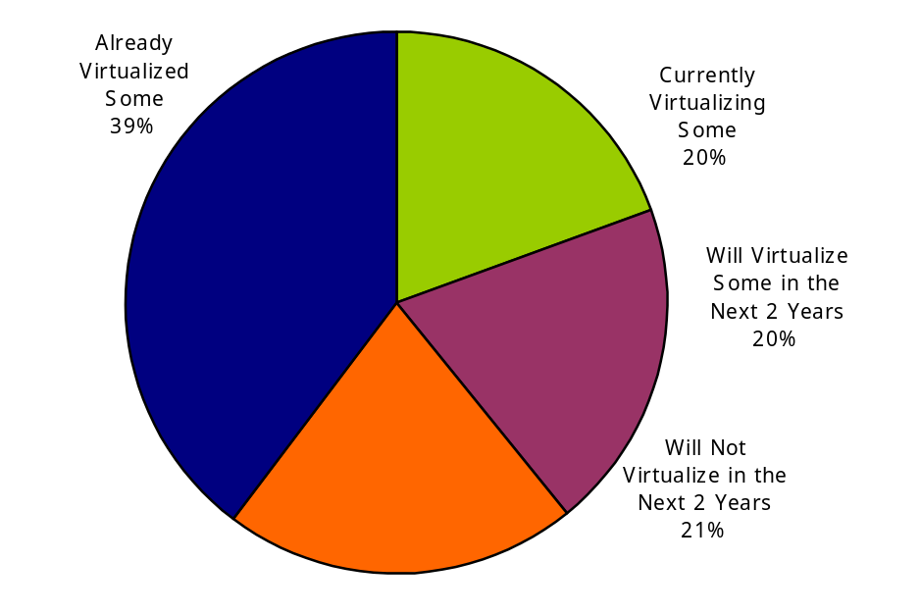
Virtualization Is Mainstream
Businesses will spend $15 bn by 2009 and $20 bn by 2010 (IDC 2007)
4 million virtual images by 2009 (Gartner 2007)
The number of virtual servers will grow by 41% from 2007-2010 (IDC)
More than 15% servers shipped in 2010 will undergo virtualization up from 5% in 2005 (IDC)
Respondents of a 2007 Forrester survey said that 24% of servers are virtualized; 48% within 2 years
59% of
Datamonitor
survey respondents
deployed sever
virtualization as a
means of achieving
infrastructure
flexibility
(Sept 2006)
Virtualization
Penetration
The top 4 reasons to virtualize are equally important (Gartner, Dec 2006):
Access underutilitized server capacity
Demand for increased server bandwidth
Increase application deployment speed
Reduction in capital hardware expenditure
Source: Gartner survey, Dec 2006

Slide 7
Industry Adoption of x86 Virtualization
Early Adoption
Mainstreaming
Standardization
Test &
Development
Server Consolidation
Infrastructure Management
High Availability
Management & Automation
Virtual Infrastructure
Virtual Infrastructure
Hypervisor
Hypervisor
Hypervisor
1st generation
1998 – 2002
2nd generation
2003 - 2005
3rd generation
2006- 2008

Slide 8
x86 Virtualization with VMWare
Notes:
Use this layout to divide sections within the presentation.

Slide 9
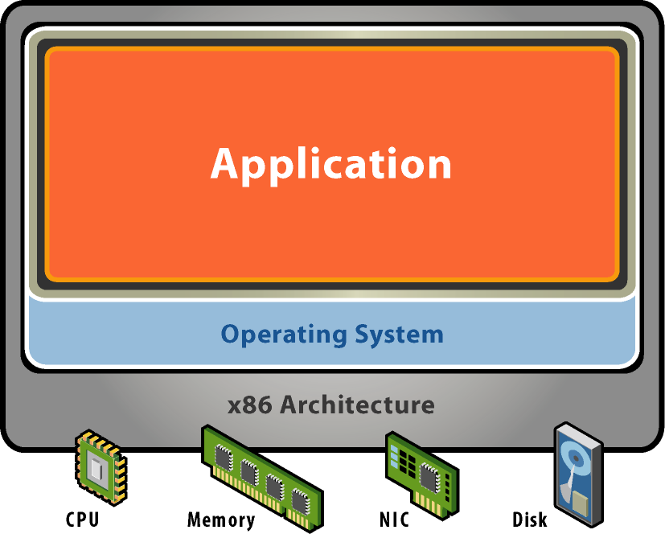
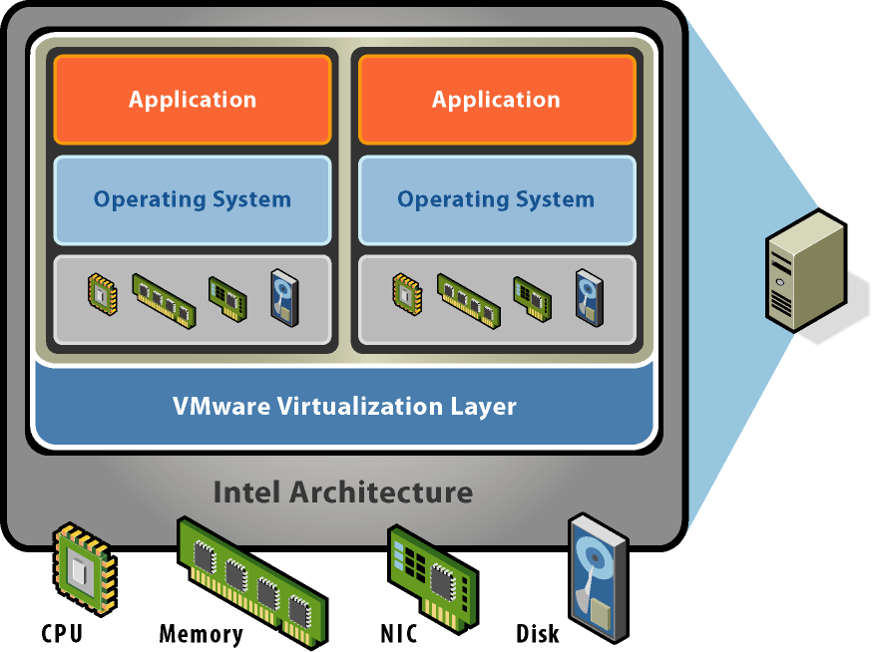
VMware Virtualization Basics
System without VMware Software
System with VMware Software
  Separates BIOS, operating system, and applications from physical hardware
  Allows many virtual systems to share same physical hardware
  Standardizes multiple generations of multi-vendor hardware

Slide 10
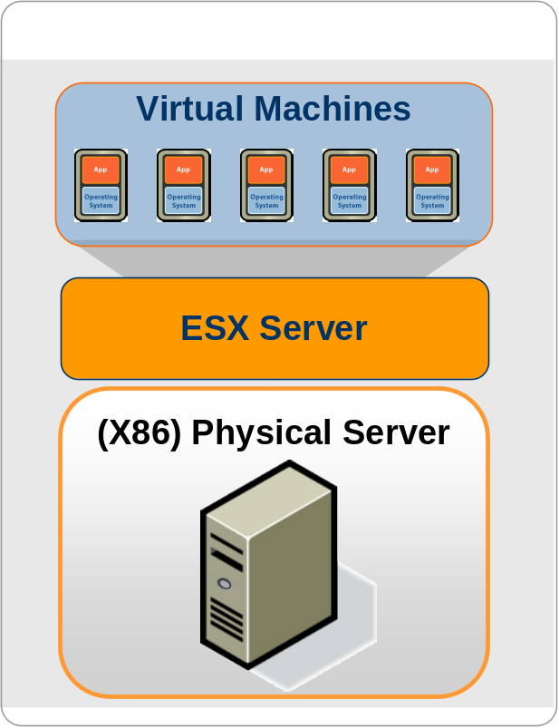
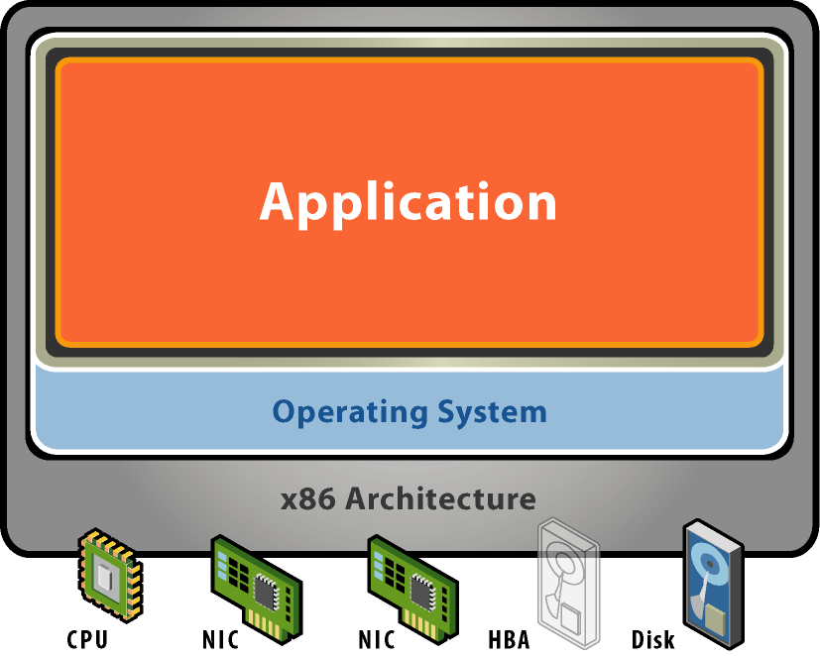
Anatomy of a Virtual Machine
Each Virtual Machine is a complete system encapsulated in a set of software files
Unmodified
Application
Unmodified
OS
Virtualized
Hardware

Slide 11

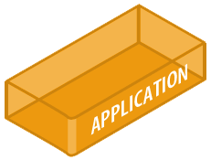
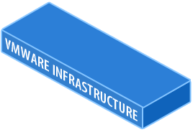
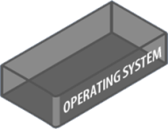
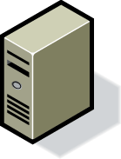
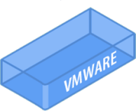
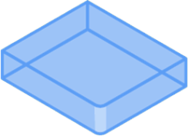
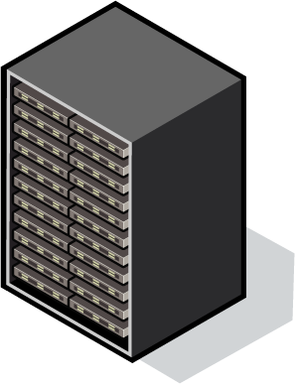
Virtualization: Fundamentally Better
Run several operating systems on a single machine.
Create shared pools of resources to optimize your infrastructure.

Slide 12
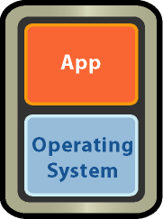
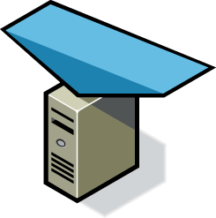
VMware High Availability
What is it?
  Automatic restart of virtual machines in case of host
  server failure or guest
  OS failure
Customer Impact
  Cost effective high availability for all applications
  No need for dedicated
  stand-by hardware
  None of the cost and
  complexity of clustering
X
Resource Pool

Slide 13
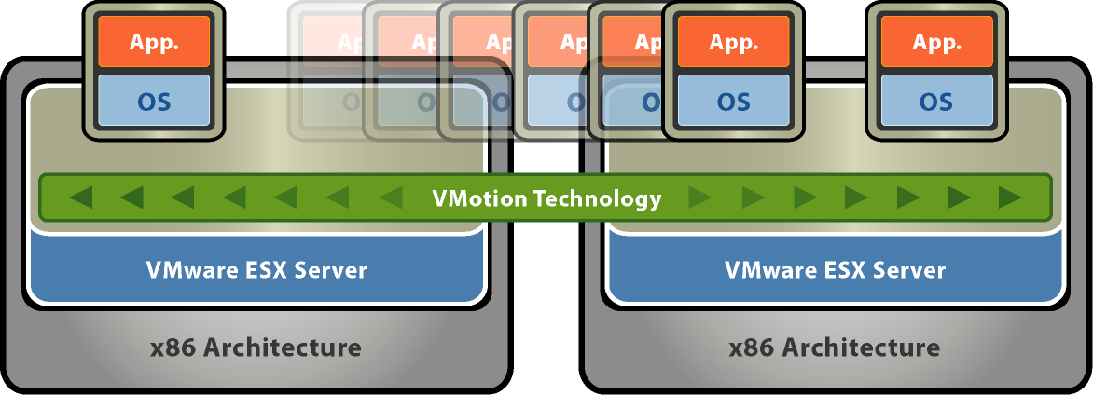
VMware VMotion
What is it?
  Live migration of virtual machines with VMware VMotion
Customer Impact
  Zero downtime
  Continuous service availability
  Complete transaction integrity
  Supported on Fibre Channel and iSCSI SAN and NAS

Slide 14
VMware Distributed Resource Scheduling (DRS)
What is it?
  Dynamic balancing of computing resources across resource pools
  Intelligent resource allocation based on pre-defined rules
Customer Impact
  Align IT resources with business priorities
  Operational simplicity; dramatically increase system administrator productivity
  Add hardware dynamically to avoid over-provisioning to peak load
  Automate hardware maintenance
Business Demand
Resource Pool

Slide 15

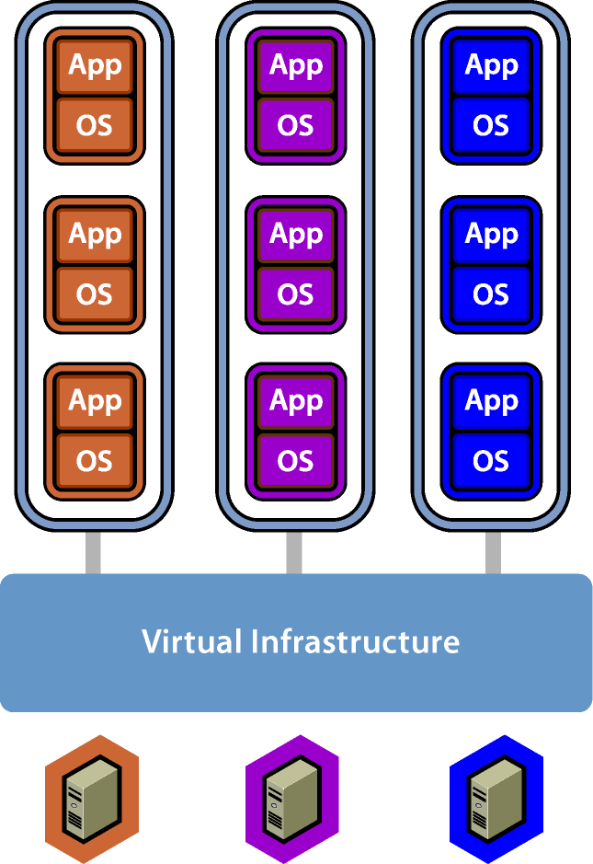

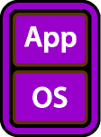



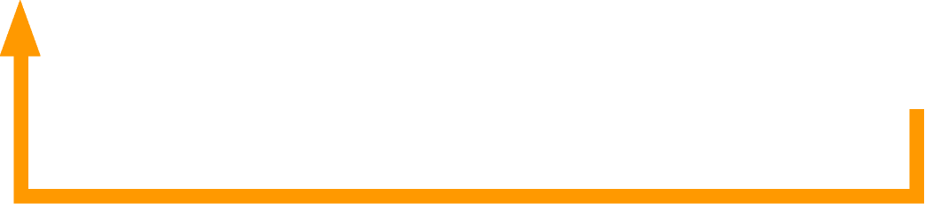
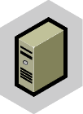
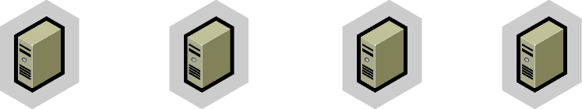
VMware DRS for Capacity on Demand
Resource Pool
CPU 50 GHz, Mem 70GB
Priority HIGH
Resource Pool
CPU 50 GHz, Mem 70GB
Priority HIGH

Slide 16

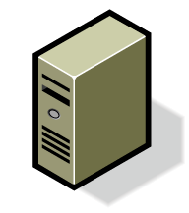
Zero-downtime Maintenance
Use VMotion to evacuate hosts
  Move running applications
  to other servers without disruption
  Perform maintenance at
  any time of day
Automate with DRS maintenance mode
  Automates moving virtual machines to other hosts
  Automates re-balancing
  after maintenance complete
VMotion
VMotion
Activate Maintenance Mode
for physical host
DRS migrates running virtual machines to other hosts
Shut down idle host and
perform maintenance
Restart host; DRS automatically rebalances workloads
Notes:
[

Slide 17
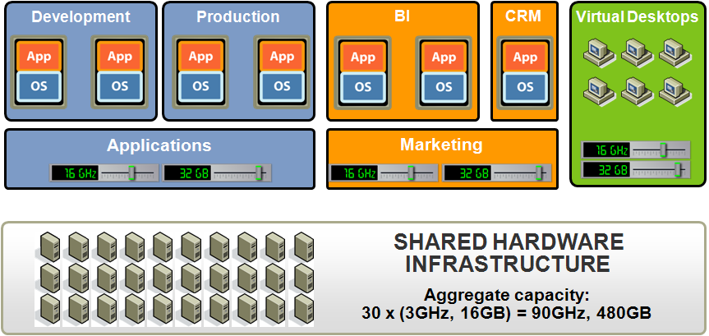
Manage Capacity, Not Servers

Slide 18
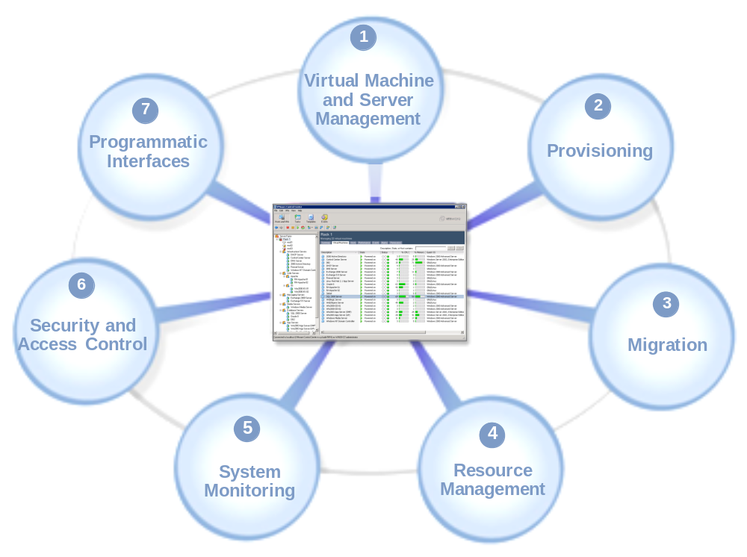
Centralized Management

Slide 19

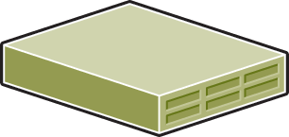
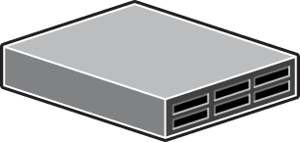

Moving Physical Server to Virtual Servers
Direct
Physical Sources
Virtual target
P2V
Image Based
P2I
I2P

Slide 20
Operational Advantages
Capacity Management
  Minimal to no hosting and application effort to move application to a server with increased capacity
  Easily level various capacity needs of multiple application across multiple servers
  Ability to automatically move applications between severs in a farm without impacting the application
Server Refresh
  General ability to decouple application and operating environment from underlying hardware platform
  Ability to move from Physical to virtual with minimal application impact
  Minimal effort and application impact to move an application from one virtual server to another virtual server on a new hardware platform, significant reduction in application effort and costs

Slide 21
Operational Advantages
Supporting Infrastructure
  Reduced storage costs and decreased provisioning times from shared storage pools across multiple hosts
  Reduced Back and Restore impact on application hosts from centralized back technology
  Reduced infrastructure support costs and time to deliver from fewer tools
Provisioning
  Ability to quickly clone a complete operating environment for new or upgraded virtual server.
  Live template eliminates the need to install OS and many tools in each new virtual machine, significantly reducing provisioning and setup time
  Reduced wiring and setup time
  Reduced OS and tools deployments
  Reduced one time costs

Slide 22
Challenges
Notes:
Use this layout to divide sections within the presentation.

Slide 23
Virtualization Challenges and Considerations
Business Issues with Sharing Servers - Issues
Does your business structure/budgeting allow sharing of servers across departments/business units?
How will budgets be managed
How will capacity be procured and managed?
What is the bill-back method?
  Per VM?
  What about differing VM Sizes (CPU and Memory allocation)?
  Utilization?
Complex bill-back schemes can cause increased people resources

Slide 24
Virtualization Challenges and Considerations
Business Issues with Sharing Servers – Possible Solutions
The most cost savings will be to centralize the procurement, management and utilization of your virtualized resources
Develop a centralized Utility approach
  Offer the virtualized environment as a “service” to applications
  Allows for the most cost effective use of resources
Depending on your size and budgeting constraints, a departmental/business unit approach maybe a more viable option
  Have each department procure capacity for the utility
  Confine VM movement (e.g. HA, DRS, etc.) within department servers
  Common standards and central management is the best approach

Slide 25
Virtualization Challenges and Considerations
Change Control and Release Management - Issue
What will be your change control process in a shared server environment?
Will you have a central authority to authorize changes?
Will change be allowed at the VM level, independent of other VMs on the server or in the environment?
Utilize management features (e.g. DRS, HA, maintenance mode) to minimize change impact to multiple applications
Prove the capacities work and adjust change control processes accordingly
Institute change governance and authority
Change Control and Release Management - Solutions

Slide 26
Virtualization Challenges and Considerations
Operations Management and tools - Issue
How will you track VMs?
Are your operational tools (e.g. Monitoring, inventory, service delivery, software tracking, etc.) compatible with a virtualized environment?
How to you prevent VM Sprawl?
Consider an end-to-end view of the environment
Ensure your tools can properly operate and manage a Virtual Server environment
Supplement with additional tools where needed
Ensure all aspects of IT are considered in the solution
Operations Management and tools - Solutions

Slide 27
Desktop Virtualization
Notes:
Use this layout to divide sections within the presentation.

Slide 28
Client Virtualization
Thin clients replace traditional client devices
Rich choice of options – desktop & portable
Hybrid portable models allow for off-line contingency
Desktop PCs
Server based virtualization
Blade PC shared pool model (over subscription)
Notebook PCs
Same concept as desktops
Additional challenges resulting from mobility
Extra caution advised in planning
High Performance Workstations
Blade PC shared pool model (over subscription)
Bandwidth / latency issues (high performance compression required)

Slide 29
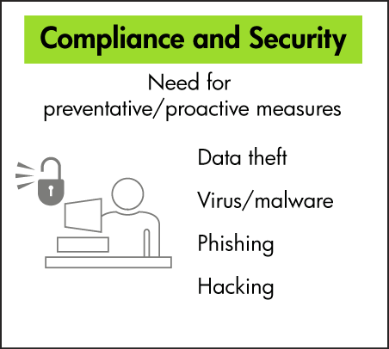
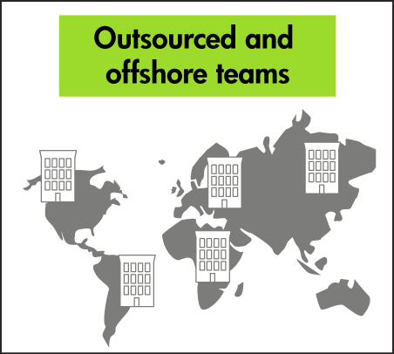
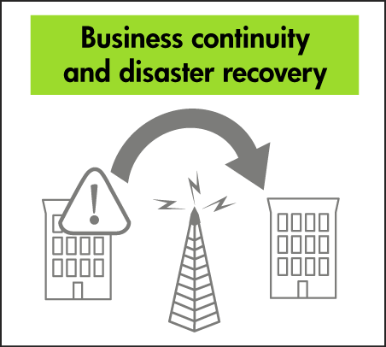
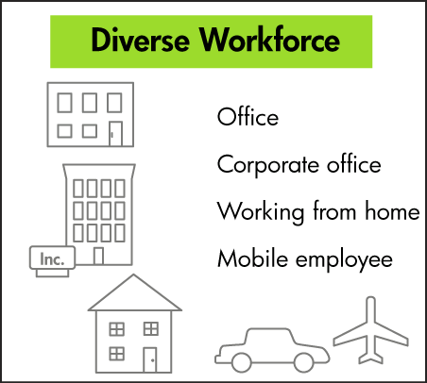
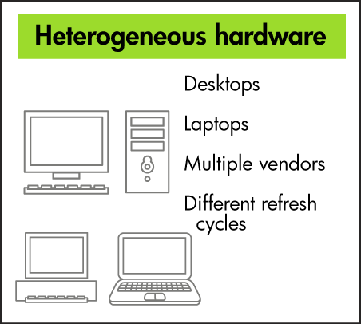
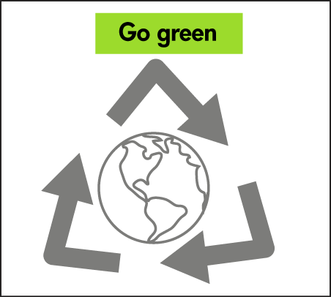
The changing desktop landscape

Slide 30
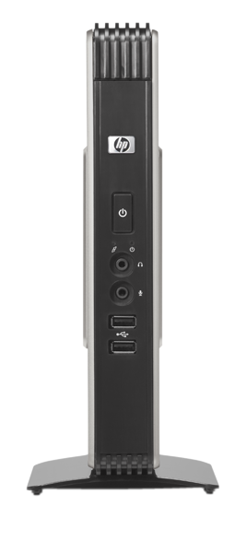
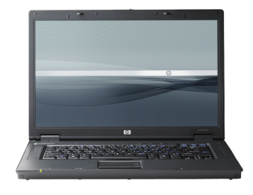
Client Virtualization Models
Server Hosted Apps
Server Hosted
Desktop
Dedicated Remote Desktop
Client
Client
Client
SBC, Terminal
Services
VDI
Blade PC/WS
Remotely access:
apps on server
shared desktop
dedicated desktop
Each compute model has its advantages and trade-offs
The needs of each user group, IT requirements, and existing infrastructure must be carefully considered
An optimal solution will likely involve a combination of models
Notes:
30

Slide 31
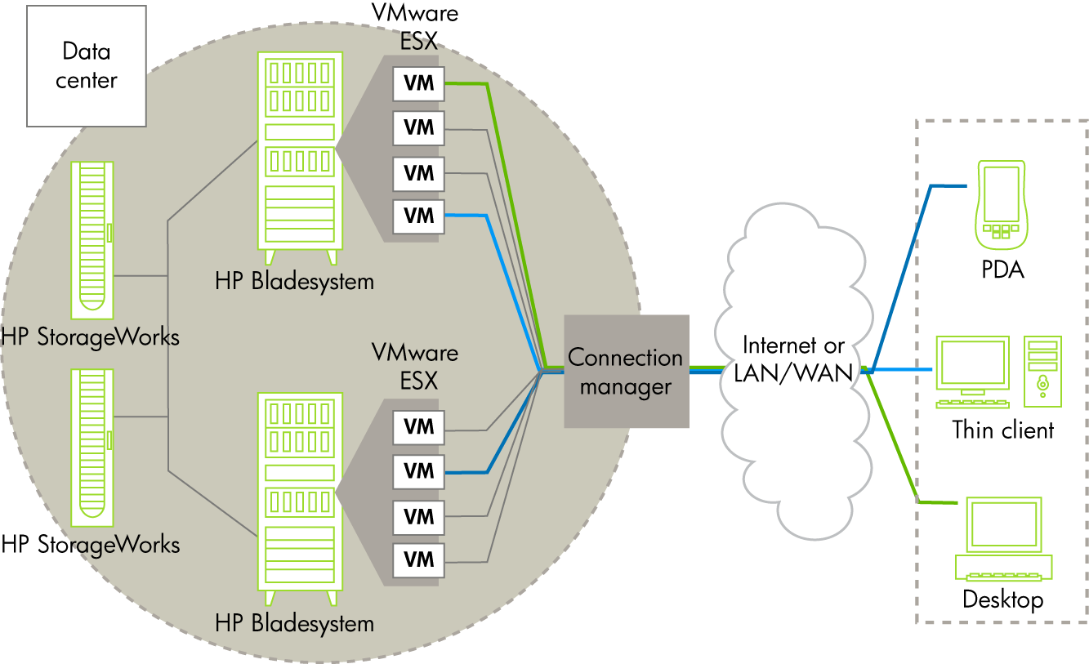
HP Virtual Desktop Infrastructure component overview

Slide 32
HP Thin Clients
Ideal Access Devices for VDI
1
Total Cost of Ownership*
80% less maintenance/year
25% capital cost savings
23% less to operate
25% productivity increase
Power consumption savings
20 watts versus 120 watts
Enhanced security
Easy
manageability
High
reliability
Environment-friendly
$
Lower overall costs
*Source: Zona Research, Intelliquest, META Group Study

Slide 33
Financial Opportunities
Notes:
Use this layout to divide sections within the presentation.

Slide 34
What is Possible / Practical?
Everything is possible
So let’s concentrate on what is practical
UNIX / Linux / Windows Servers
Readily adaptable to virtualization
Mature / scalable solutions from multiple vendors
80 – 90 % of your inventory is a realistic candidate
Storage
Drive to shared storage / goal of < 10% direct attached
Tiered shared storage model to keep costs manageable
Clients
Go for the low hanging fruit in the short term
40 – 50 % is a reasonable goal
Solutions are maturing & improving rapidly

Slide 35
How to Fund Virtualization
Don’t call it virtualization (nobody cares)
Focus on what it enables for IT user & budget $$ owners
  Faster deployments of new applications, upgrades, etc.
  Added (usable) capacity without added costs
  Reductions in space, power & physical plant infrastructure costs
IT as a utility
Everybody would like to be here
Virtualization (at all levels) is the KEY enabling technology
70% is a realistic 2 year goal – it will work
Status quo model is NOT financially sustainable

Slide 36
How to Fund Virtualization
When done right, it more than pays for itself
Remember CoDN – Cost of Doing Nothing (different)
When combined with a solid TCO study CoDN is the clincher
Think BIG
Small, incremental projects won’t pay off
Scope the project large enough to return sizeable savings to the IT budget

Slide 37
How to Fund Virtualization – HP Story
Category | Before | After
Data Centers | 87+ | 6 (3x2)
Applications | 8000+ | 2200 1600 final goal
Server configs | Uncountable | 9 (3x3) S M L UNIX Linux Windows
Server : Admin | ~ 20:1 | ~200 : 1
Return to the business (ROI) > 4:1 There is much more to tell – we’d welcome an invitation to review our transformation story with you

Slide 38
TCO Examples
Notes:
Use this layout to divide sections within the presentation.

Slide 39
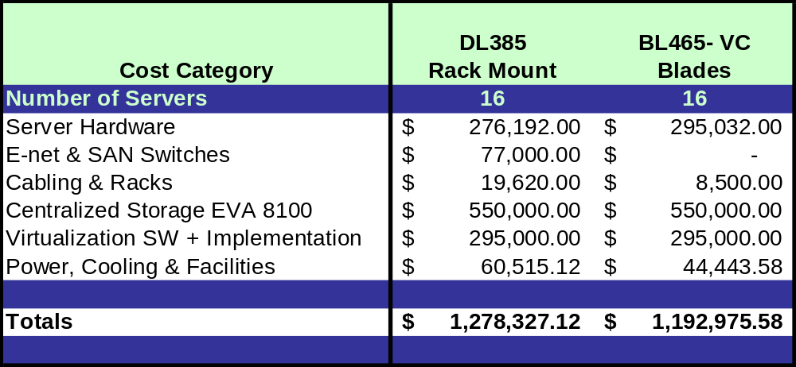
Optimizing Through Virtualization

Slide 40
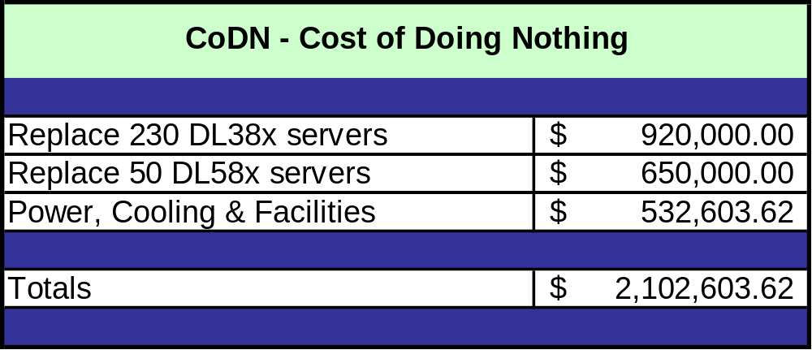
Optimizing Through Virtualization

Slide 41

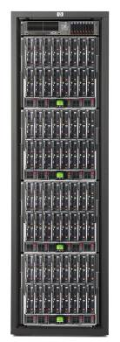
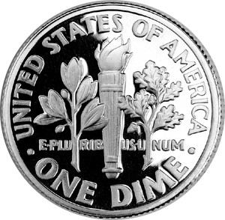
You can deploy THIS in your data center
Or, you can deploy THIS in 1/16th the space!
640 standard 1U
Rack mount servers
256 ft² floor space
290 Kilowatts
Hardware $9600K
Pwr/cool $1200K
3yr TCO $10800K
64 BladeSystem servers with 10 VM per host
16 ft² floor space
20 Kilowatts
Hardware $960K
VMware $480K
Pwr/cool $80K
3yr TCO $1520K
“Pair of dimes shift”

Slide 42
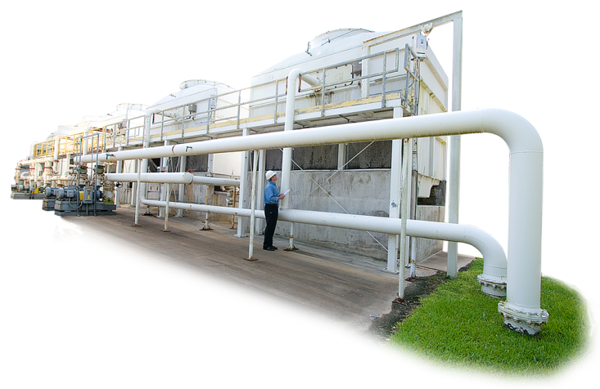

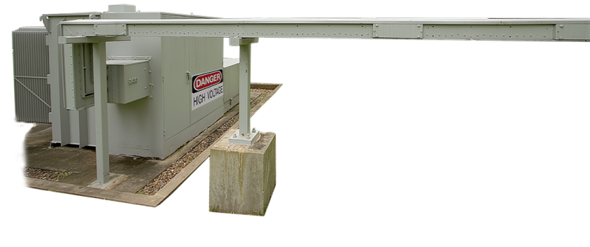
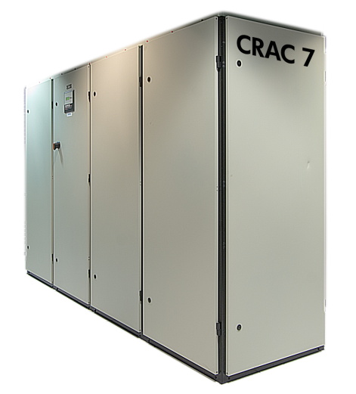
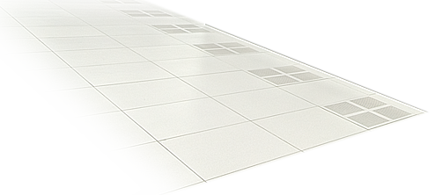
Squeezing cost out of the energy envelope
Optimizing from chip to chiller
10 mWh
Conversion
Powering IT
35 kWh
60 kWh
Cooling
IT
Dynamic Smart Cooling
& Services
Storage & Server Consolidation
3.3 mWh
Assuming a 60% savings consolidating servers, 45% savings consolidating storage and 45% remaining cooling savings from Thermal Zone Mapping & DSC together.

Slide 43
Current and Future Virtualization Trends
Management of virtualized environments will be the focus and a differentiator
Network Convergence allowing consolidation of interfaces (SAN, Network, FCoE, etc.)
Virtual Network Switching allowing multiple network switches to be managed as one
Storage Virtualization and thin provisioning will become mainstream
Movement toward a complete virtual infrastructure (virtual data center)
  Virtualization of all aspects of the data center hardware
  Software based intelligence to provision and manage virtual resources automatically
  Self maintaining, Self healing, Self governing data center
  Intelligent power management will be part the virtual data center

Slide 44
Questions?
Gene Mortensen
gene.mortensen@eds.com
Bob Erdelen
robert.erdelen@hp.com
EDS and the EDS logo are registered trademarks of Hewlett-Packard Development Company, LP. HP is an equal opportunity employer and values the diversity of its people. ©2008 Hewlett-Packard Development Company, LP.

