Slide 1
Consumer Technologies
And IT Standards
Presented by:
Isaac Gindi
Chief, Information Technology Division
Los Angeles County Public Works

Slide 2
These technologies have three things in common:
Personal Computer
Graphical User Interface
Mobile Phone
PDA
Wireless Networking
Flash Drive
Instant Messaging
Desktop Search
Smart Phone
They were first endorsed by consumers
They were resisted by IT professionals
They became enterprise solutions anyway

Slide 3


Why did IT resist those technologies?
The IT
Illusion:
Vision:
The IT Reality:
Security and reliability achieved by strict standards.
Security and stability through planning
and partnership.

Slide 4
Embracing Emerging Technologies through IT Partnership
Build Relationships
Lead the Curve
Involve Business in Governance
Expand your Resources
Using Standards and Guidelines
Never Say No
Notes:
This is our plan: We are going to touch on how to be proactive and “Lead the Curve” with emerging technologies

Slide 5

Build Relationships
Make a point to learn about your business units:
What do they do?
What obstacles do they face?
What processes take the most time?
What concerns keep them awake at night?
What do they need most?
What are they happiest with?
Notes:
This probably goes without saying. You need to know and understand your business units.
Obviously, you don’t need to know every detail about every job, but it’s important to work closely with the other managers to see what

Slide 6

Lead the Curve
Be Proactive:
Evaluate new technology
Identify potential issues
Set realistic expectations
Leverage the manufacturer
Find creative solutions
Remember, your business units can also help with testing and research.
Notes:
Increasingly, new technologies appear first in the consumer market, and our customers are becoming more sophisticated users of technology. They expect the technology they use at home to be available at work.

Slide 7
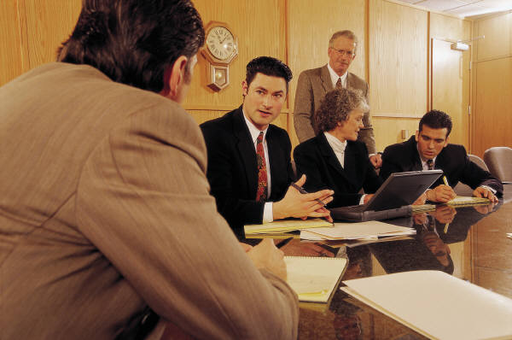
Involve Business in Governance
Advantages of a governance body
composed of business leaders
Create a forum for discussing policies and standards
Achieve consensus on major IT initiatives
Raise the level of awareness of IT issues

Slide 8


Expand Resources and Knowledge
There must be
a better way
to do this.
How to engage them:
Ask them to participate in standards or IT Governance committees
Get their business perspective on IT initiatives
Power Users
Notes:
Power users always know about and want the latest technology because they truly want to solve problems and increase productivity.
(CLICK)
We’ve had great success working with our power users in both IT governance committees and in setting standards. They work within the business units, so they have a detailed understanding of the needs of their units.

Slide 9


Expand Resources and Knowledge
The world would be a better place without …
How to engage them:
Focus on business solutions, not technologies
Listen to the fresh perspective
Offer alternatives
Non-conformists
Love technology, just usually not yours
Resists the status-quo
Wants to change your entire infrastructure
Notes:
The Advocate of Alternative Technology
Love technology, just usually not yours
Resists the status-quo
Wants to change your entire infrastructure

Slide 10


Expand Resources and Knowledge
I may not be on the I.T. payroll, but I love to use my skills.
How to engage them:
Educate them on development standards and best practices
Provide venues to discuss both their projects and yours
Encourage them to develop their IT skills and they might become your future stars!
Programmers in Business Units
Notes:
We have several names for programmers in business units including amateurs, hobbyists, or rogues.
Regardless, these people can actually make your life easier if you embrace them instead of trying to fight.
Bring them into the fold by providing them with insight into your best practices, preferred technologies, and the reasons for both. Give them an opportunity to do what they love without making them break rules. We have some great developers in my division that previously worked in this capacity.

Slide 11

Role of Standards
Avoid strict product standards wherever possible
Adopt data and interoperability standards
Invest time in creating standards of service for different customer groups
Determine the appropriate level of flexibility for certain groups
Notes:
Many organizations use standards to name the specific hardware and software products that the business units are allowed to buy and connect to the network.
Some products

Slide 12
Role of Guidelines
Use the 95% rule – Most people can use the same products (but not everyone)
Allow more flexibility
Open the discussion for support levels on unique equipment
Provide interoperability; enhance compatibility and security
Notes:
Many organizations use standards to name the specific hardware and software products that the business units are allowed to buy and connect to the network. Another method that allows for more flexibility

Slide 13

Never Say No
Sometimes it can be difficult to say yes:
Security risks
Stability risks
Support issues
Find a way to fill the needs of the customer without compromising your infrastructure.

Slide 14

Never Say No
Ways to present the qualified yes:
Explain your concerns
Discuss possible options
Agree on the level of support
Your relationship will help support discussion.

