Slide 1
Information Security Threats
A Brief History
Steven Richards
IBM

Slide 2


“The three golden rules to ensure computer security are:
do not own a computer; do not power it on; and do not use it.”

Slide 3
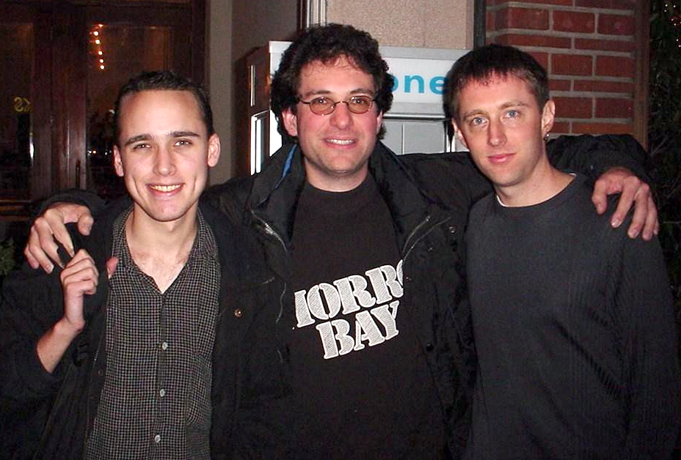

Slide 4
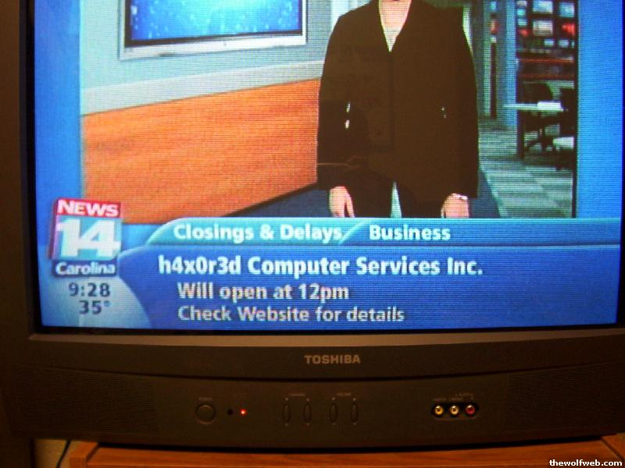
Hacker fun….

Slide 5

“What’s my computer saying to me?”

Slide 6
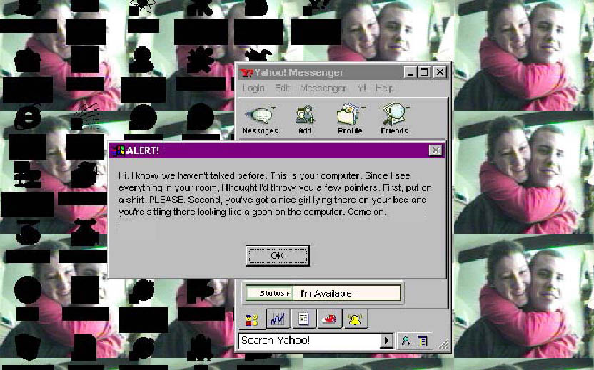
Here’s what he saw on his screen…

Slide 7




Notes:
Chen Ing-Hau, the author of the infamous CIH virus, has been detained by authorities in Taiwan.
The virus, which triggers on the anniversary of the Chernobyl nuclear disaster, caused over $250 million damage in South Korea alone last year, infecting a quarter of a million computers according to government reports.
David Smith - Wrote the Melissa virus
Joseph McElroy, 18, from Woodford Green in East London, showed signs of relief after Judge Andrew Goymer sentenced him to 200 hours community service for breaking into an unclassified network at Fermilab
Jeffrey Lee Parson wrote a variant of Blaster (script kiddie)

Slide 8


Shift from “Glory-Motivated-Vandals” to “Financially-Politically-Motivated-Cyber-Crime”
  They are more organized and collaborative
  They have a Roadmap
  They are playing Chess
The “Designer Worms” and “Designer Trojans”
  What are the implications when Patient ZERO *is* the only target?
  http://www.us-cert.gov/cas/techalerts/TA05-189A.html
The Bot-Networks (Worms → Bots)
  “Computational Currency”
  SPAM Relays
  Spyware/Adware subscriptions
  Distributed Denial of Service Attacks
  ID Harvesting

Slide 9





Notes:
==
Brian Salcedo – Hacked Lowes Home Improvement via wireless AP accessed from a car in their parking lot
Jeremy Jaynes (SPAM KING) of Raleigh, N.C., was convicted on three counts of using deceptive routing information in sending bulk commercial e-mail.
grossed more than $24 million in various e-mail scams.
In August 2004, a federal grand jury in Los Angeles indicted Saad "Jay" Echouafni, 37, the chief executive officer of Orbit Communication in Sudbury, Massachusetts--a competitor of Expert Satellite. The indictment alleges that Echouafni and a business partner hired a clutch of computer hackers to launch the DDoS attacks against Expert Satellite and other companies.
Andrew Schwarmkoff, 28, was arraigned in a Boston-area District Court on multiple counts of fraud, identity theft, larceny, and receiving stolen goods, the Boston Herald reported Wednesday. He used phishing attacks -- phony e-mails that demand recipients provide their credit card and bank account numbers or risk losing access to the cards or accounts -- to collect the confidential information.
When police arrested Schwarmkoff Friday, they reportedly found credit card scanning devices, over 100 identity cards with bogus information, $200,000 worth of stolen merchandise, and nearly $15,000 in cash.

Slide 10

©2005 Commonwealth Office of Technology 10

Slide 11

©2005 Commonwealth Office of Technology 11

Slide 12
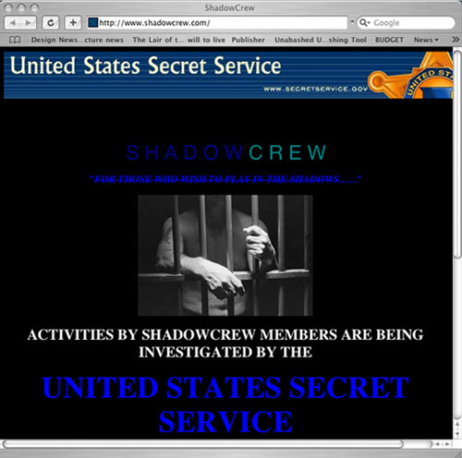
1.5M credit & bank cards
And ~$4M damages

Slide 13
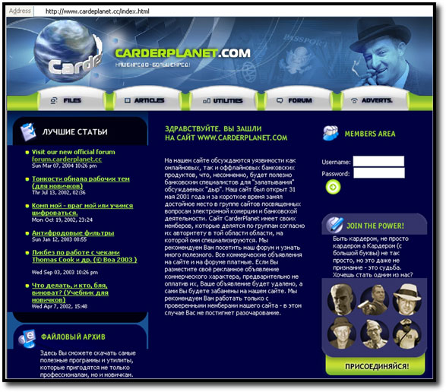
©2005 Commonwealth Office of Technology 13

Slide 14
“China has downloaded 10 to 20 terabytes of data from the NIPRNet (DOD’s Non-Classified IP Router Network),” said Maj. Gen. William Lord, director of information, services and integration in the Air Force’s Office of Warfighting Integration and Chief Information Officer, during the recent Air Force IT Conference in Montgomery, Ala.
“They’re looking for your identity so they can get into the network as you,” said Lord, adding that Chinese hackers had yet to penetrate DOD’s secret, classified network. “There is a nation-state threat by the Chinese.”
LT. COL. JOE RUFFINI, COUNTERTERRORISM EXPERT:
Yes, we did, Glenn. There have been several instances of computer disks recovered, the ones you`re talking about in Iraq, some Department of Education schools, emergency crisis management plans were found on the disk, school floor plans, school emergency response plans. But the point I`d like to make here is, you know, when we post this stuff on our Web sites, we can`t get surprised when our enemies download it.
©2005 Commonwealth Office of Technology 14

Slide 15
Best Practices are Still Best Practices
  Network
  Systems
  Applications
  Data
  Users
©2005 Commonwealth Office of Technology 15

Slide 16
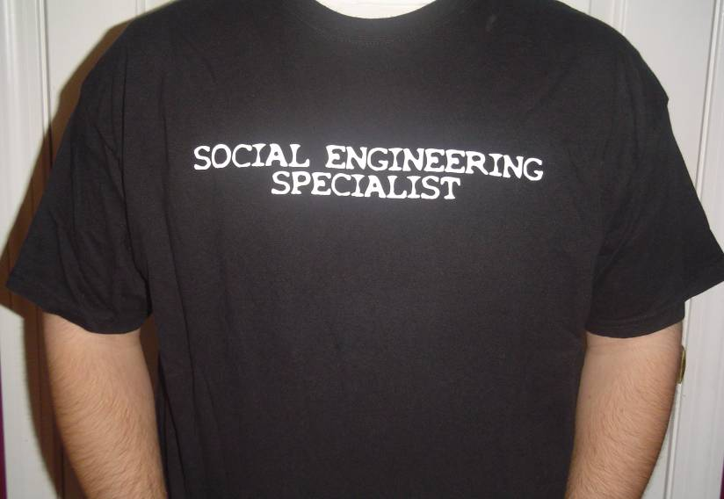
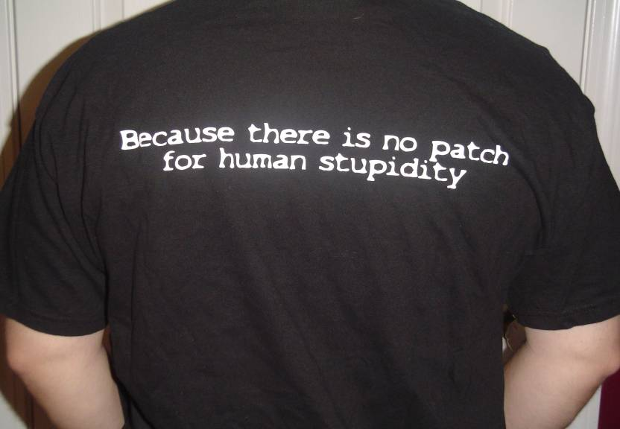
©2005 Commonwealth Office of Technology 16

Slide 17
Charles King
Blue Coat Systems
Securing the Web Gateway

Slide 18



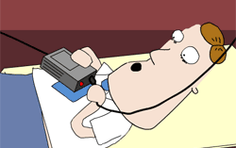

Secure Web Gateway 1.0
URL Filtering database w/daily updates
  Objectionable & Unproductive Content
  Employee monitoring placed demands on Auth options
Limited Web Anti-Virus deployments
  Performance/Scale Issues
  Lack of Web Threats vs Expense
Emerging IM & P2P controls
  Evaluation interest, very little adoption
Bandwidth Management
  Younger employee downloads (music, video, etc.)
Productivity was the
main issue to solve

Slide 19






An Enterprise Without Boundaries
Outsourced
Web Apps
Managed
Datacenter
Branch Office
Branch Office
Users are Everywhere
Applications are Everywhere
Performance is Poor
Security is Poor
LOB App
File Servers
Branch Office
Intranet
E-Mail

Slide 20





Internet Economic Drivers
Legal Economy
  Online Ads, Online Ads, Online Ads
    Driven by Search Engines & Collaborative Content
  Information Access, 24/7, Anywhere
    Performance is expected, latency means “closed”
Illegal Economy
  Identities are the new currency
    Personal, CRM/HR databases, Laptops
  Malware infrastructure
    Segmented functions (detect, develop, rent, execute)
    Goal to be undetected/invisible
Notes:
Interestingly enough, ads drive the online economy making FaceBook almost the same valuation as Ford, while the underground has developed its own economy using identity as the new currency. A key point is that these are both economies with segmented functions, scale, productivity, profits and risk. Proof that the illegal economy has developed are the signs of segmentation. Some players only research vulnerabilities, others develop toolkits for the newly found vulnerabilities, some rent botnets, while the true criminal executes the various parts to collect identity information to auction if off or commit financial fraud. Unlike years past with Melissa and I LOVE YOU viruses that were fast, destructive and very visible, the new underground economy seeks no attention and likes to be undetected and invisible.

Slide 21





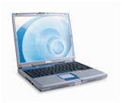
Then IT Gets Worse – Web 2.0
Web 2.0 makes the web an application platform with collaborative two-way content and mash-ups
  Architecture of participation and remixable data sources
New Services & Shapes
  SaaS, Social Computing, Collective Intelligence
Applications/Techniques
  Blogs, Wikis, Podcasts, RIAs, RSS, Tagging, Widgets
New Technologies
  AJAX, Flash/Flex, XML, XAML, OpenAPIs, Plugins
Today’s Toys, Tomorrow’s Tools…
  YouTube for training, Wikis for collective intelligence
  Provides strong ROI for companies
Notes:
As Web 2.0 continues to develop, the IT situation gets worse. Web applications become collaborative with two-way content creating an architecture of participation and remixable data sources. Software as a Service (SaaS) and collective intelligence such as Wikis continue to evolve. Underneath these new services and applications are new technologies such as Asynchronous JavaScript with XML, mark-up languages, and plug-ins. Web pages rated for content in the past, are now a mix of various widgets from multiple sources and authors.
Like most new technologies they are adopted for social reasons and then become useful as tools providing leverage to the business world.
> WORMS, ACTIVE EXPLOITS, VULNERABILITIES & PATCHES --ActiveX Control
> Flaws Affect MySpace and Facebook Users (January 31, 2008)
> Vulnerabilities in two ActiveX controls that Facebook and MySpace
> members use to upload images to their pages could be exploited to
> crash Internet Explorer (IE) and possibly allow remote code execution,
> which could in turn allow attackers to take control of the machine on
> which IE runs or steal data. The ActiveX controls in question are
> based on a commercial control known as Image Uploader.
>
http://www.computerworld.com/action/article.do?command=viewArticleBasic&arti
cleId=9060483&source=rss_topic17

Slide 22






Attack Vector Shift
Attacks shift to HTTP/SSL over SMTP
  83% of SPAM contains a URL
  Injected html/iframes in popular websites (malframes)
    70% of web-based infections in legitimate websites
    Undetected by firewalls, static URL filtering, reputation scores and AV scanning for known threats/signatures
    Fast-flux services constantly change DNS records every few minutes, or 1000s of sub-domains hide the real site making hostIDs useless to mitigate threats
Follow the herd, leads to “browse-by” infections
  Olympics, Sporting Events, Elections, Major News
May’07 Google Report
Notes:
Along with a shift in attack types, we also have a monumental shift in the transmission vector…from email (or SMTP) to the web (HTTP & SSL) for the first time since the Internet boomed. SMTP has always been the multiplier of viruses, hoaxes and threats due to mail lists, the store and forward design of mail servers, etc. However now the game has changed making the real-time protocols of the web the primary threat vector. Per the May 2007 Google report on malicious code and malware, they found 83% of SPAM contains a URL and that 70% of web based infections of malware come from a legitimate website. Hence the term “browse-by” installation as just visiting the site enables script codes to operate and install a malware program on a users system.
These browse-by installs go undetected by firewalls, static URL filtering and reputation ratings as popular sites are utilized, and common AV signatures do not provide a zero-hour protection layer. Attackers also mask their source with fast-flux DNS changes and 1000s of sub-domains making hostID ratings useless. In summary, following the herd for popular events, sports, news, etc. on the Internet leads to infection…by design of course…an open door always gets the latest threats.

Slide 23



Web 2.0 – Security Perspective
Pervasive Accessibility
  Blends work & social environments
Open Environment
  Everyone can publish/contribute
Rich Experience
  Complex activities behind interface
Web 2.0 Creates:
  More avenues for data leakage
  More surface areas for attacks
  Greater transparency for attackers
  Complicated trust scenarios
  Erosion of traditional boundaries
Traditional security
castle walls erode
Notes:
From a security perspective, Web 2.0 opens up another frontier for security solutions and technologies to evolve. Web 2.0 is an open environment blending social and work environments, providing a rich experience with complex activities behind the user’s interface. More avenues open up for data leakage, more surface area for new attacks, greater transparency for attackers, and new trust scenarios that all add up to the erosion of traditional security boundaries. A scan everything approach with a perspective that you are only as good as your last transaction develops.

Slide 24

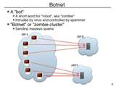
Your Web 2.0 Security Profile
Exposure Points
Public website:
  Host for injection pointer (MMC) to a malware server
  Malware payload server
  Mask for phishing attacks
Private network:
  Botnet infection for outbound attacks (SPAM, DoS, etc.)
  Source of identity information (CRM, HR, Credit Cards, etc.)
  Exposed to other networks (partners, services)
Remote clients:
  Web access via networks you do not control
  Undefended except for laptop security tools (AV, PFW)
  Laptops often stolen for identity lists (consultants, auditors, etc.)
  Rarely limit web content access (URL filtering)
Notes:
Looking at your exposure points from a Web 2.0 security profile, you have three key areas of concern. Your public website and brand reputation can be leveraged in phishing attacks, or just your web server resources to host pointers to malware download sources, or to function as a download server for malware. Your private network and computers can host botnets, or provide a foothold towards collecting valuable identity information, or as a network connection to other networks. Third is the often out of sight remote laptop that can host a malware program from exposure to web content with no filtering, or participating on a network you do not control. Also, laptops are now increasingly stolen for identity information data stores.

Slide 25
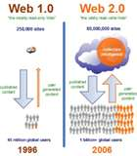


Your Web 2.0 Business Profile
Application Agility:
  Leverage SaaS to outsource services/applications
    Sales Mgmt, Travel, Benefits
  Leverage web-based applications across WAN
    ERP, SCM, HR, Payroll, Expenses
Increase Collaboration and Productivity:
  Provide collaborative knowledge tools to employees and business partners
  Online eLearning with voice, video & streaming media
  Provide LAN-like office experience “everywhere”
Manage Risk:
  Web security controls need to remove threats and latency at all locations (Data Center, Branch Office, Remote User)
  Slow Security = No Security
Notes:
Switching to your Web 2.0 Business profile highlights expectations new technologies can provide. The key is to support the increase in application agility, increases in collaboration and productivity, while managing risk, which translates into removing threats and latency. In the world of business, slow equals closed and in the security domain, slow security is no security as business process owners will turn off security features that inhibit these gains.

Slide 26

New Role for URL Filtering
Malware source blocking
  Collect 24/7 high volume user requests into threat labs
    Web 2.0 technologies block web spiders that crawl web for content
    User driven methodology replaces web crawlers
  Simulate desktop to unwrap attacks (honey clients)
    Custom encryption wrappers cloak attacks past gateways
  Multi-threat engine analysis & deep content inspection
    New proactive detection techniques (genes, skeletons)
  Human rater review to avoid over blocking & false positives
    Attack pointers in popular websites do not need blocking
    Block malware sources, not the widespread deployed pointers
  Immediate update to URL database
Real-time rating service to reduce “unrated” sites
  Common policy to allow unrated sites, reduces help desk calls
  Translation sites, Image Searches, Cached Content, etc.

Slide 27





Threat Detection Role Changes
IF malware is not blocked by URL categorization AND download payload has custom encryption
  THEN desktop threat prevention engine provides defense
  ELSE (no custom crypto wrapper) then SWG threat prevention engine provides first defense, then desktop second defense
User authenticated web content (MySpace, Facebook) and P2P downloads (encrypted)
  Desktop threat prevention engine provides defense
Proactive detection techniques (genes, skeletons) take lead over signature databases
  Q1’08 shows large increase in threat variants (10X – KL/RSA)
WW Security Software market is $7.4B for 2007 (Gartner)
  54.3% is AV vendors, resulting in ~$4B funding for anti-malware solutions

Slide 28

SPAM Reputation Ratings
email/SPAM
Malware Hosts
Web
Malware Hosts
Blue Coat
Websense
IronPort/Cisco
Secure Computing
Proofpoint
Most SPAM includes a URL today leading to malware source download sites (Valentine’s Day, April Fool’s Day – STORM)
Reputation ratings on malware hosts quickly eliminates SPAM at email gateways, attackers respond with fast-flux DNS profiles
  Email/SPAM host databases started in 2003/2004 era
Web-based attacks leverage pointers in popular websites to malware sources, surge in 2H2007 due to success rate
  April’08/iFrame - USA Today, Target, Wal-Mart (SANS)
  HTTP/S is now top threat vector over SMTP
BIG QUESTION – What is the overlap between email SPAM and Web malware hosts?

Slide 29
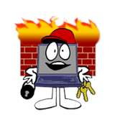
Web Application Firewalls
Emerging niche to manage 100s of web applications
  Update dynamic port stateful inspection firewalls as HTTP/S are dominant services/ports for web traffic
NIDS architecture with web application signatures at Layer-4 for performance, inspects HTTP/S traffic
Selected instances marketing as seen with P2P, IM and other emerging web technologies
QUESTION – Do you want to manage a policy for 100s of web application controls?
  Most customers dug into P2P and IM with interest, then backed away with simple web gateway policies in the end
  Gateway (& desktop) URL filtering with threat detection engines block a high percentage of web threats
  Web 2.0 fear vs enablement for productivity gains
Likely to become a new feature in web gateways going forward if revenues are minimal
  Repeat of IM & P2P gateway solutions?

Slide 30
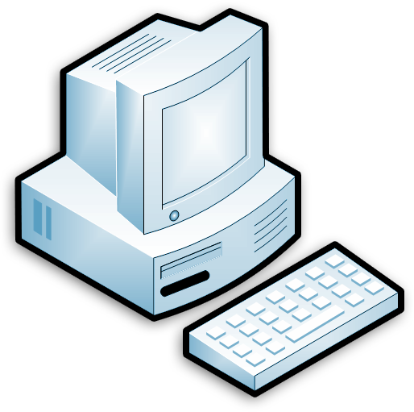
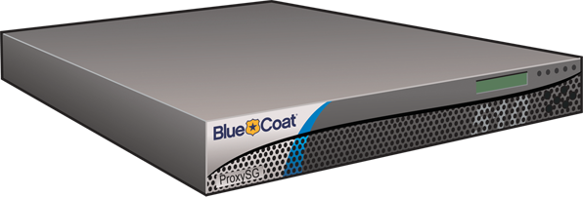
SWG Request Controls - Outbound
Outbound Requests:
  URL filtering + real-time rating service
    Plus IWF, custom lists, allow/deny lists, etc.
  Data Loss Prevention (DLP) integration via ICAP
    Vontu, VeriCept, Reconnex, Port Authority, etc.
  User & Group Authentication & Authorization policies
  Policy controls by user, location, service, destination, time, content
  Method level controls per protocol (ex. restrict outbound files)
  Certificate validation checks (e.g. SSL)
Internet
URL
Filtering
DLP
Checks
AAA
Policy
Method Controls
Cert. Validation
SWG
Notes:
ProxySG provides a wealth of control options on outbound requests even before they reach a destination web server. URL filtering can determine if the requested content should be allowed or not based on categorization ratings, reputation ratings, and real-time ratings of newly requested content. Specific allow and deny lists can be created to always allow or deny specific requests, perhaps related to a user or group of users. Data Loss Prevention integration allows any outbound content to pass verification for distribution, while ProxySG authentication realm support and authorization policies control users, content and services. Policies can be based on users & groups, location, service types, destination, time of day or the content itself as a few examples. Method level controls per protocol provide the ability to restrict outbound files in HTTP, FTP or IM as a simple example. For SSL, certificate validation checks occur at the beginning of SSL sessions and during to continuously validate the session.

Slide 31
SWG Request Controls - Inbound
Inbound Requests:
  Threat analysis (MMC & Malware), proactive & signature checks
    Kaspersky and Sophos are showing leading test results
  Protocol Compliance (buffer overflows, e.g. Quicktime - iTunes)
  Content Filters (attachments, executables, file types, etc.)
  Apparent data typing & container mismatch detection
  Active content validation checks
Malware
Detection
Protocol
Compliance
Content
Filters
Data
Types
Active
Content
Internet
URL
Filtering
DLP
Checks
AAA
Policy
Method Controls
Cert. Validation
SWG
Notes:
Once a request is approved by ProxySG and sent a web server, the returning inbound reply can be analyzed several ways. Proactive threat detection engines can analyze all inbound web objects (and optionally outbound as well) for malware, spyware and mobile malicious code. Protocol compliance checks prevent buffer overflow attacks as recently seen several times with the QuickTime vulnerability for iTunes users. Content filters look at file types, leveraging apparent data typing and container mismatch detection to remove any suspicious attachments or file types. Plus active content validation checks verify the origin and provider of active content to users. These are some of the most popular request controls for outbound and inbound traffic with ProxySG.

Slide 32
SWG Request Controls - All
All Requests:
  Default & Custom Logging & Reporting
  Object Caching upwards of 50% (optional for SSL)
    Object Pipelining & Adaptive Refresh technologies
  Bandwidth Management (e.g. Streaming media)
  Protocol Optimization
Object
Cache
Bandwidth
Management
Protocol
Optimization
Log Files
Reporter
Malware
Detection
Protocol
Compliance
Content
Filters
Data
Types
Active
Content
Internet
URL
Filtering
DLP
Checks
AAA
Policy
Method Controls
Cert. Validation
SWG
Notes:
For all requests, default and custom logging is provided for rich reporting details on user activities in all protocols, bandwidth usage, plus security, network and user specific reports, over 150 combined. Object caching provided upwards of 50% caching benefit to improve web request performance. By default no SSL traffic is cached, however it can optionally be activated based on policy controls. Object pipelining requests all web objects at once, greatly improving upon the default of four web object requests from client browsers, plus adaptive refresh algorithms keep cache content fresh and ready to serve users. Increasingly more sporting events and reality events can be viewed over the web with streaming media, bandwidth management provides the ability to set limits on how much of your network resources can be utilized, and for what users and groups, time of day, and service type. Rather than blocking and frustrating users, the game or event is on, however with proper limits. Finally, protocol optimization removes the LAN-like chattiness to create more efficient protocol usage for long distance requests over the web.

Slide 33
Web Applications
A Change in the Times
Kristen Sullivan

Slide 34
System/Data Vulnerabilities
Web applications are the #1 focus of hackers:
  75% of attacks at Application layer (Gartner)
  XSS and SQL Injection are #1 and #2 reported vulnerabilities (Mitre)
Most sites are vulnerable:
  90% of sites are vulnerable to application attacks (Watchfire)
  78% percent of easily exploitable vulnerabilities affected Web applications (Symantec)
  80% of organizations will experience an application security incident by 2010 (Gartner)

Slide 35
System/Data Vulnerabilities
Common myths and false senses of security:
  "We have a firewall"
  "We use Network vulnerability Scanners"
The Reality: Security and Spending are Unbalanced (according to Watchfire and Gartner)
  75% of attacks are to the application, but only 10% of money allocated for security goes to protecting applications
  25% of attacks are to the network
  90% of the money allocated for security goes to protection of the network

Slide 36
SQL Injection
SQL Injection is a method of attacking a system to gain access or control over the database layer of an application. It is also categorized as the ability of user to influence SQL statements.

Slide 37
Other Examples of Injection
Javascript Injection
LDAP Injection
HTML Injection
PHP Injection
Email Injection

Slide 38
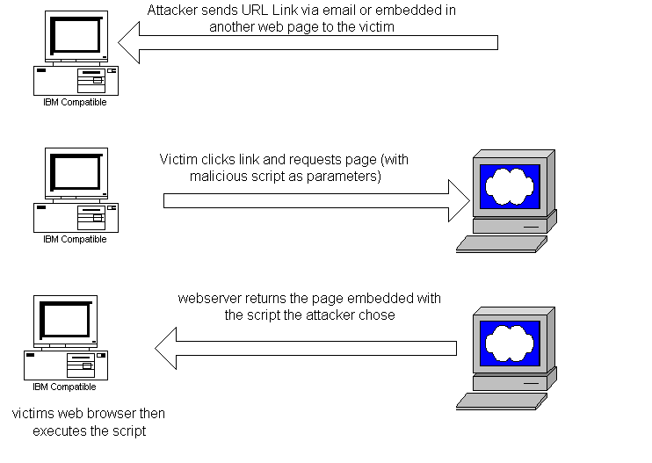
Cross-Site Scripting
The User is the Victim

Slide 39

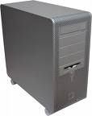

Cross-Site Request Forgery (CSRF)
Using the User as an Accomplice

Slide 40

Feel like this now?
Feeling Like This Now???

Slide 41
Finding a Balance
It’s obviously unrealistic to assume that every vulnerability can be fixed.

Slide 42
Some Solutions

Slide 43
INPUT VALIDATION
Input Validation is the validation or sanitization of input data to ensure that it is safe and is not malicious.
If an unexpected input occurs, abort!
Input Validation is IMPERATIVE!
Validate all data received from the user’s browser
  Hidden form fields, check boxes, select boxes all require validation! Just because the user cannot edit the values doesn’t mean they can’t be changed.

Slide 44
Whitelisting vs. Blacklisting
What is a Blacklist?
What is a Whitelist?
Which is better and why?
If you are a non –believer, see http://ha.ckers.org/xss.html
Notes:
Whitelisting should be used first
Blacklisting can be used as an extra preventative following the whitelisting.
For example, the whitelist could only allow alphanumeric characters while the blacklist disallows the words SELECT, DROP or UPDATE
Searching for valid data easier than invalid data
Attackers represent data in many different manners
Unlike blacklisting, it’s a preventative for unknown future vulnerabilities.
Think of the example of HTML tags

Slide 45
Train, Train, Train
SSL Certificates and Man-In-The-Middle attacks
Surfing the web can be dangerous

Slide 46
HIPPA, IRS 1075, etc.
Compliance is not just in the business rules
Vulnerabilities within applications can cause an agency to fall out of compliance

Slide 47
Assess Regularly and Often
“Instead of brushing security on, we have to bake it in.”
Notes:
In house AND COT solutions

Slide 48
Resources
www.gartner.com
www.mitre.org
www.watchfire.com
www.symantec.com
www.fbi.gov
www.f-secure.com
www.nctimes.com
www.theage.com.au
www.wired.com

